Slide 1

LARC
Where are we now?
Where are we going next?
LARC Learning Session #2
Rainbow Towers
29 January 2020
LARC
Barbara Chase McKinney, MD, MPH
LARC Global Health Consultant
@BCMcKinneyMD

Slide 2

WHY
Notes:
Why does quality matter?

Slide 3
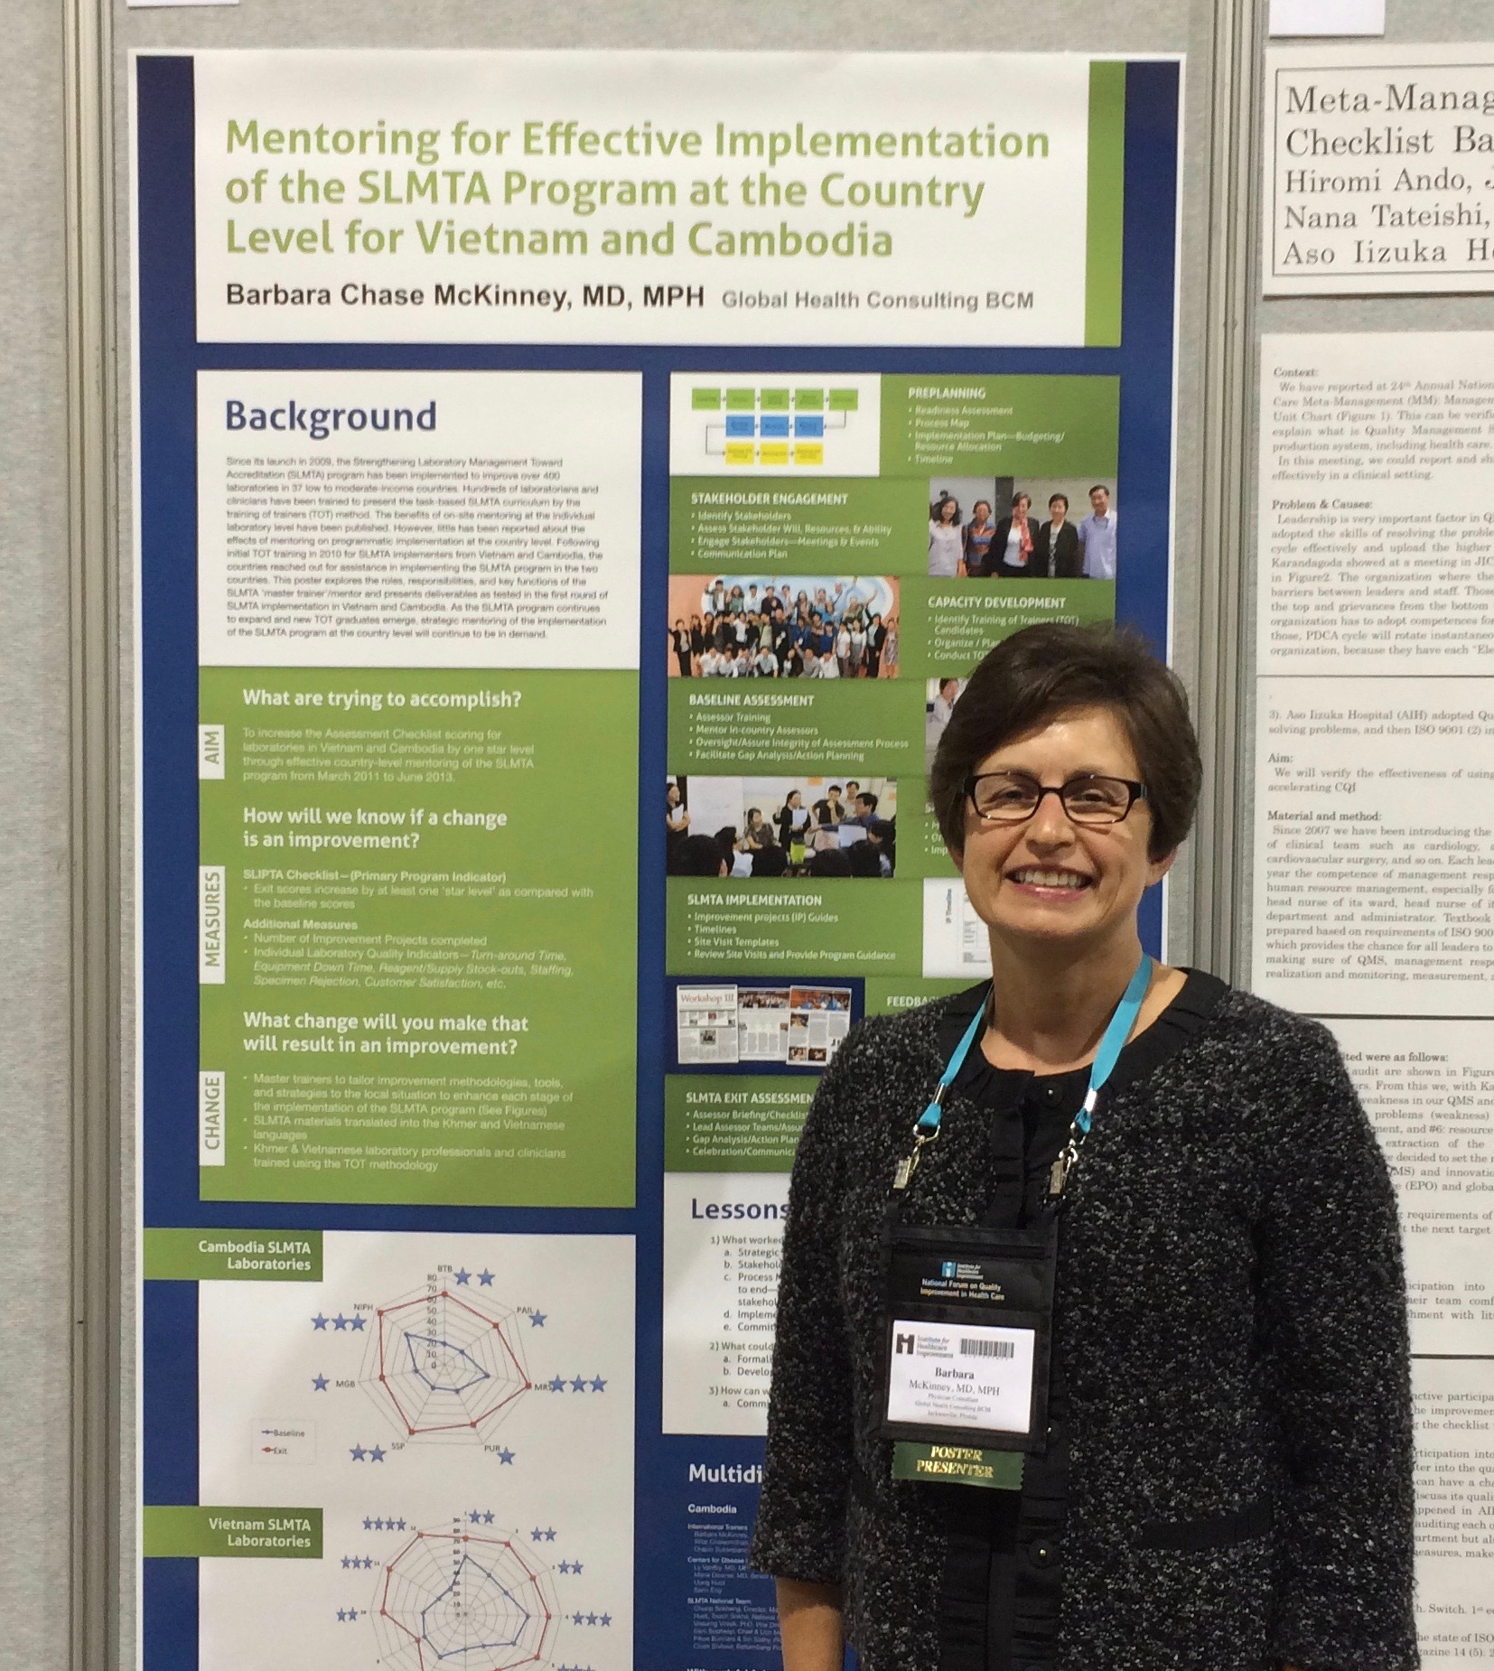
Quality Improvement Introduction:
Johns Hopkins & Institute for Healthcare Improvement (IHI)

Slide 4
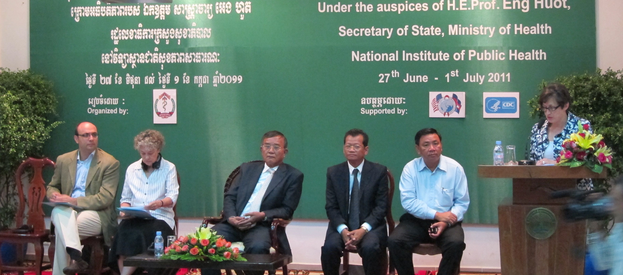
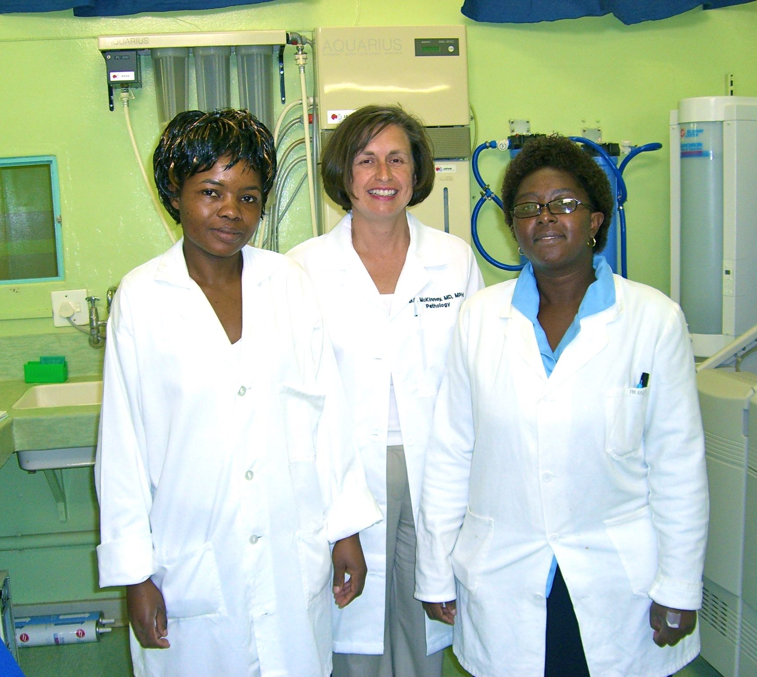
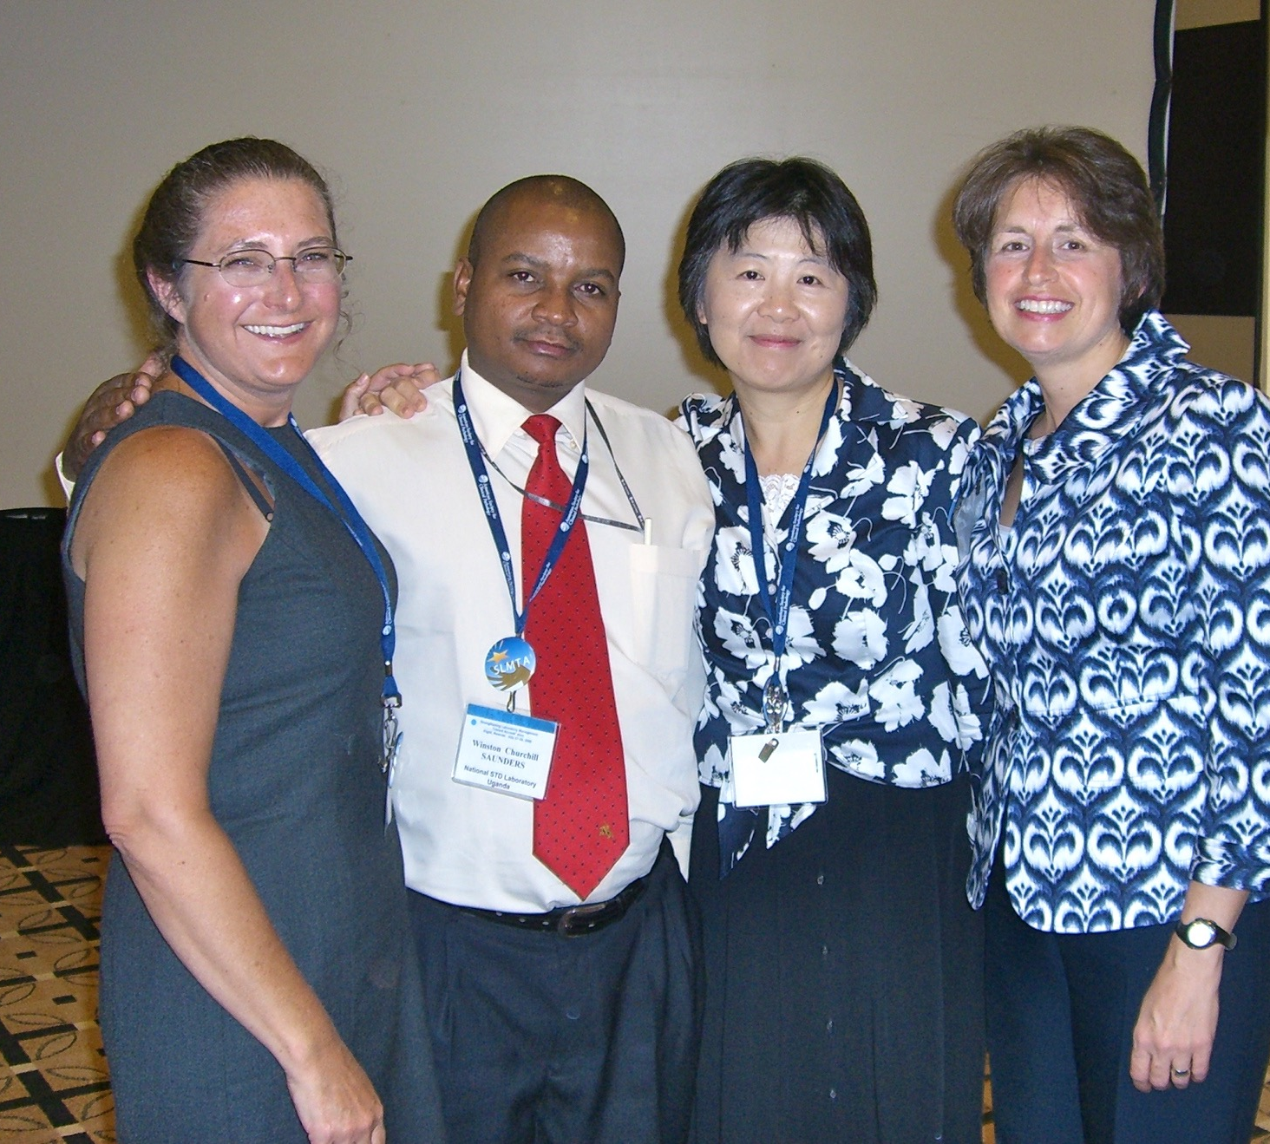


SLMTA
SLMTA was launched in 2009, and as of May 2018, has been implemented in 1100+ laboratories in 52 countries in Africa, Asia, Latin America, the Caribbean, and even Micronesia in the Pacific.

Slide 5
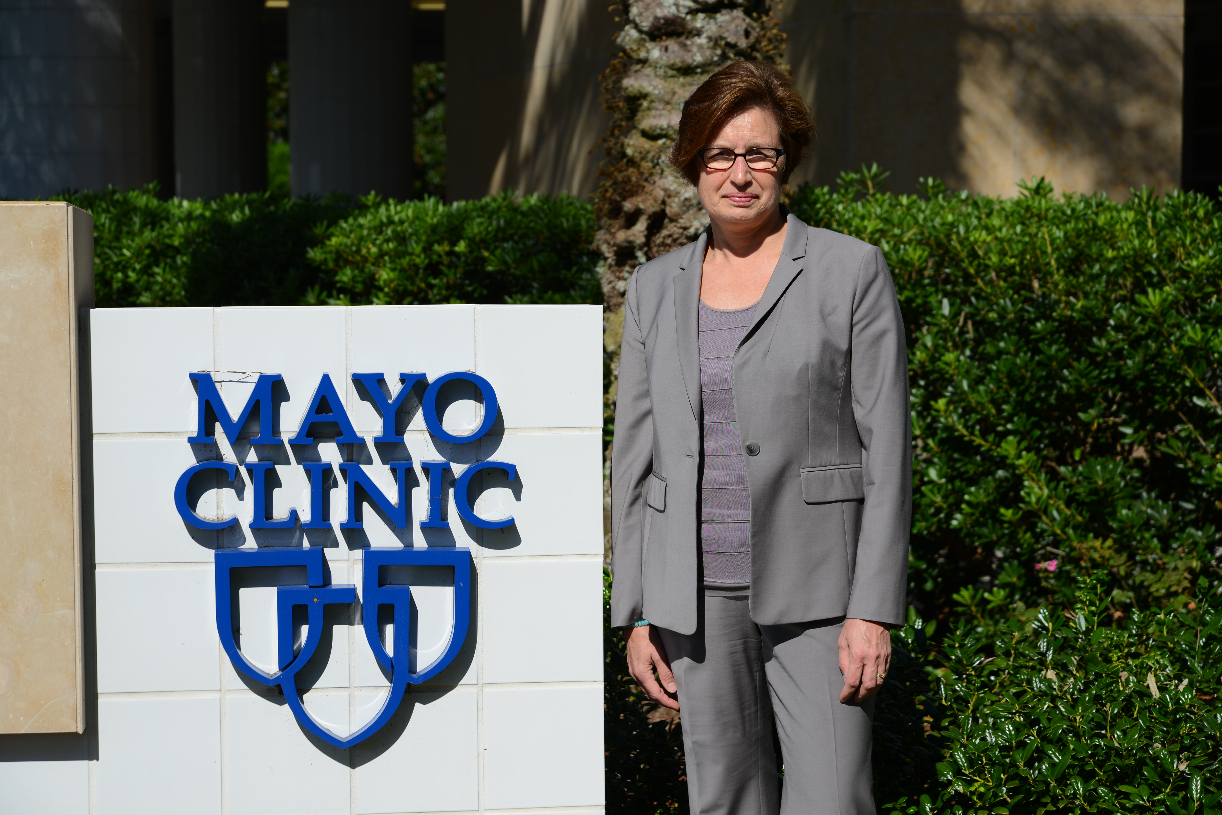

US Healthcare System
Mayo Clinic
The Joint Commission

Slide 6

WHY?
Quality Improvement has the power to Transform Healthcare

Slide 7
WHO
Notes:
Why does quality matter?

Slide 8

Do you have what it takes to be a quality ninja?
Wear the Glasses
  See Opportunities for Improvement (OFI)
Passion for Improvement
Ability to Engage Others
See the Big Picture
  Yet also give Attention to Detail
Learn & Use Quality Improvement (QI) Tools skillfully
Outcome driven
Grit (Perseverance)
QUALITY

Slide 9
Quality Improvement
“The combined and unceasing efforts of everyone—healthcare professionals, patients and their families, researchers, payers, planners and educators—to make the changes that will lead to better patient outcomes (health), better system performance (care) and better professional development.”
                Paul B. Batalden and Frank Davidoff
Qual Saf Health Care. 2007 Feb; 16(1): 2–3.

Slide 10
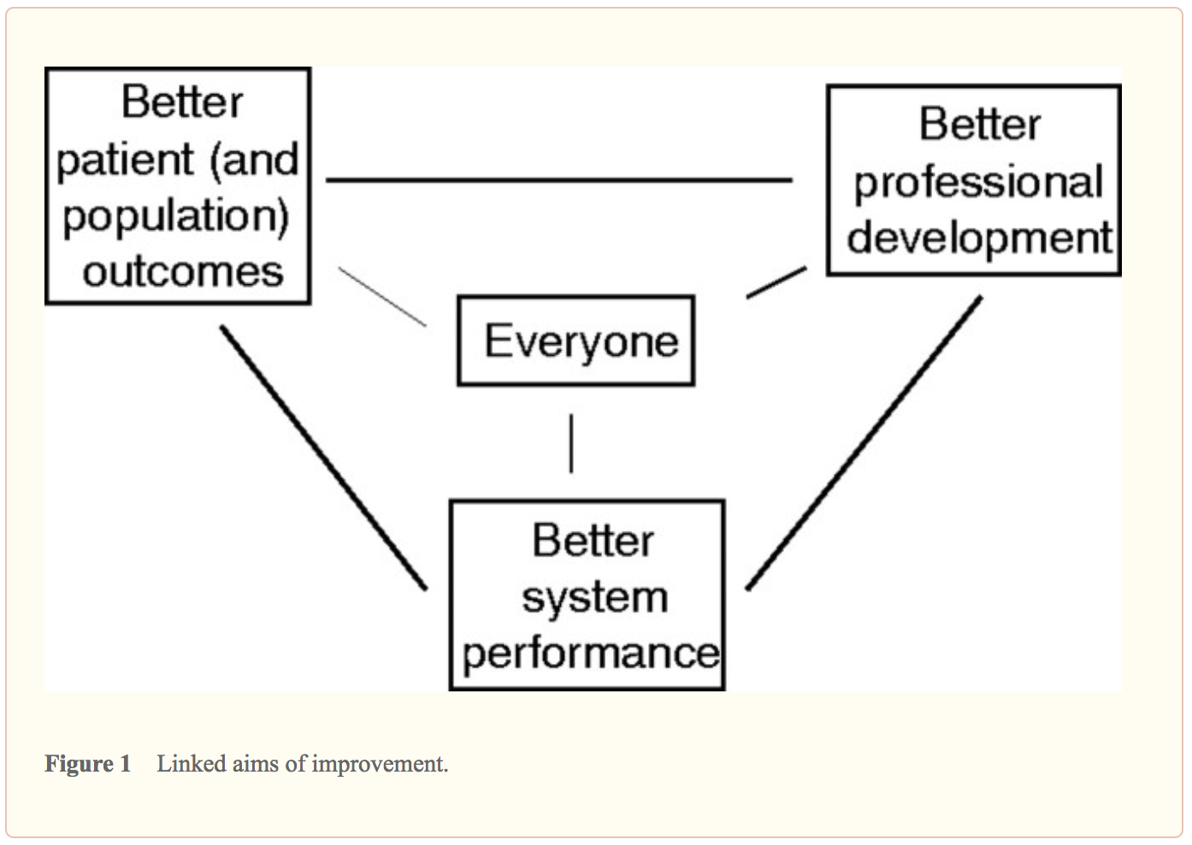
What is “quality improvement” and how can it transform healthcare?
Qual Saf Health Care.
2007 Feb; 16(1): 2–3.
Notes:
Focus on these three components - Moving to How QI achieved…focus on these three components to share some examples of

Slide 11
It is all about CHANGE!
Old Process
Tests of CHANGE
Multiple PDSAs
Implement the New CHANGE
Sustain the New CHANGE

Slide 12
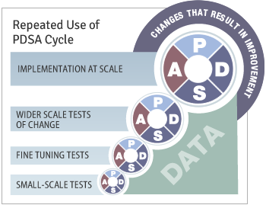
Quality Improvement
Overview
Old Process
Tests of CHANGE
Multiple PDSAs
Implement the New CHANGE
Sustain the New CHANGE
Define
Measure
Analyze
Improve
Control

Slide 13
WHY
LARC
Notes:
Why does quality matter?

Slide 14
The great aim of education is not knowledge, but action!
Herbert Spencer

Slide 15
LARC = ACTION
Introduction: Webinar
Session I: Define Measure Analyze
Session II: Simulation Improve
Smart Start: On-Site Session
Session III: Control Share/Report
Final Report
Total
= 6-9
Months
2 Months
1 Week
2-3 months
2-3 months
1 Month
Preparation
Project Outline
Action Period
Action Period
Report Completion
Notes:
Key elements of a learning collaborative
Focused on one opportunity
Expertise
Learn from each other

Slide 16
Purpose/Expectations:
To create an improvement culture where team members understand and utilize practical QI tools:
to successfully complete a QI project
and
to make continuous process improvement the way you work for the future!

Slide 17

Embed Improvement in your DNA

Slide 18






To increase the percentage of viral load samples collected from eligible patients from 45% (Jul 2016) to 80% by Aug 2017
To increase the percentage of viral load tests ordered for eligible patients from 0% (July 2016) to 80% by June 2017 in CPN, CCR, and ARV clinics
To increase the percentage of patients with viral load results placed in their files from 4% (October 2016) to 80% by June 2017
Mozambique
Malawi
Kenya
LARC Project
spread to
all Clinic
Clinician Education
All Clinic
Clinic Director Follow-up
Clinician Education began
Nationwide HCW strike
To increase the percentage of high viral load patients with documented timely follow-up from 12% (average from Dec’15 to June ‘16) to 80% by June 2017
To increase the percentage of high VL patients with a documented return visit from 35% (Oct 2016) to 100% by June 2017
To increase the percentage of high VL patients 1) contacted ≤ 1 week after results receipt from 27% to 90%, and 2) initiated with IAC ≤ 1 month from 6% to 90% between June 2016 and June 2017
Swaziland
Tanzania
Uganda
Baseline
HVL register implemented
IAC forms implemented
HVL stickers on patient files

Slide 19
LARC Overview

Slide 20


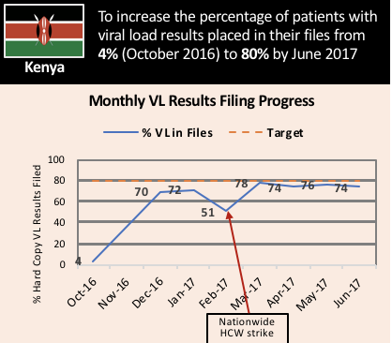
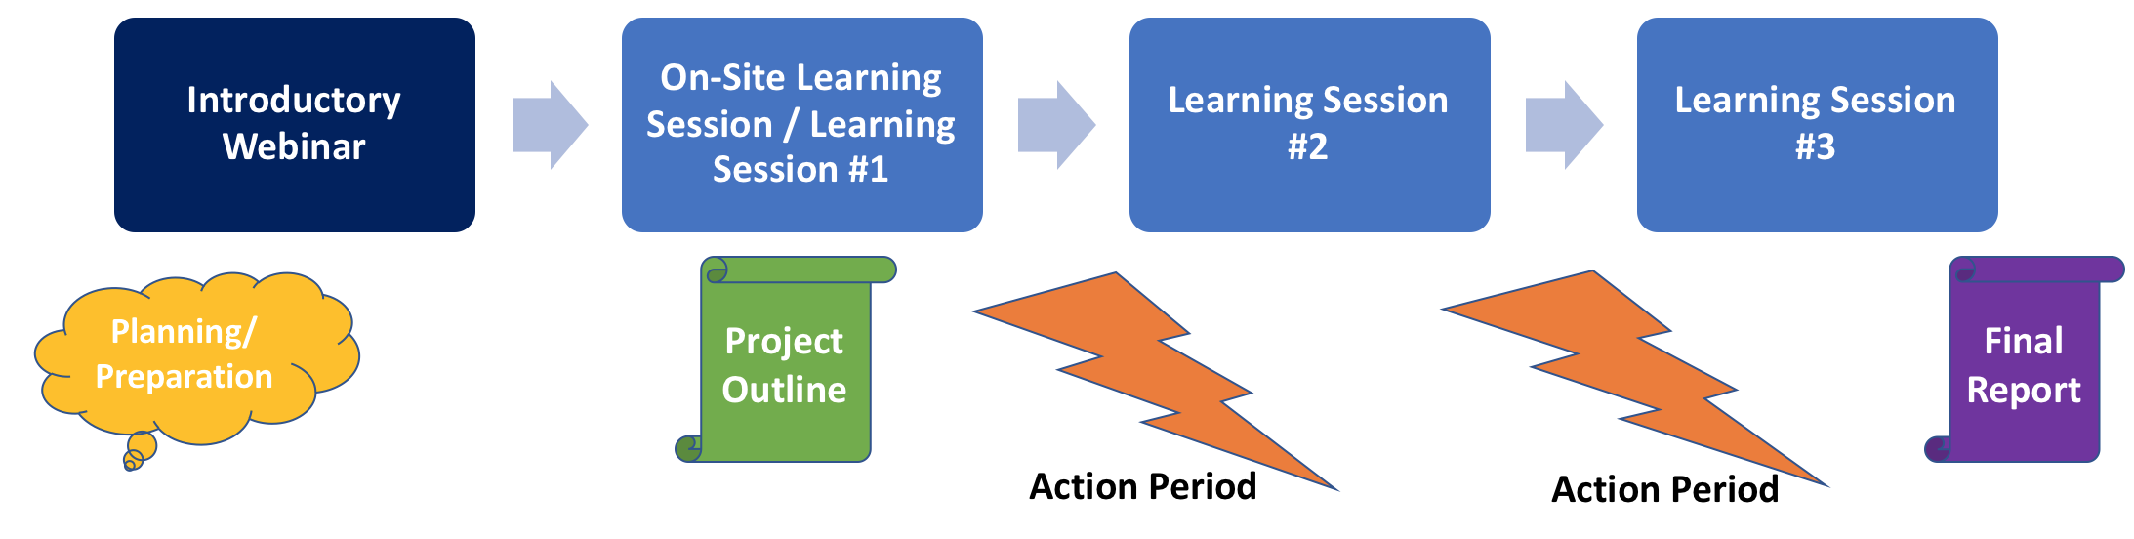
What is LARC?
Laboratory African Regional Improvement Collaborative
Bringing together multidisciplinary clinical teams to improve any process or system
CURRICULUM: Quality Improvement (QI) Methodologies |  | DELIVERY MODEL: Learning Collaborative |  | OUTCOME
Focused on QI concepts, skills, tools & implementation 30+ QI Tools with Templates Coordinated step-by-step guidance through project Just-in-time training to produce QI project deliverables (PPT Modules) |  | Introductory Webinar Smart Start + Learning Sessions Delivered over 6-9 months Action Periods Interspersed for Project Implementation Mentoring & Coaching Site Visits Learning shared among collaborative members |  | Improved Healthcare Delivery – Safer, higher-quality, client-centered Successfully Completed Project/s - Result-driven Embedded QI Concepts & Skills → Culture of Improvement

Slide 21
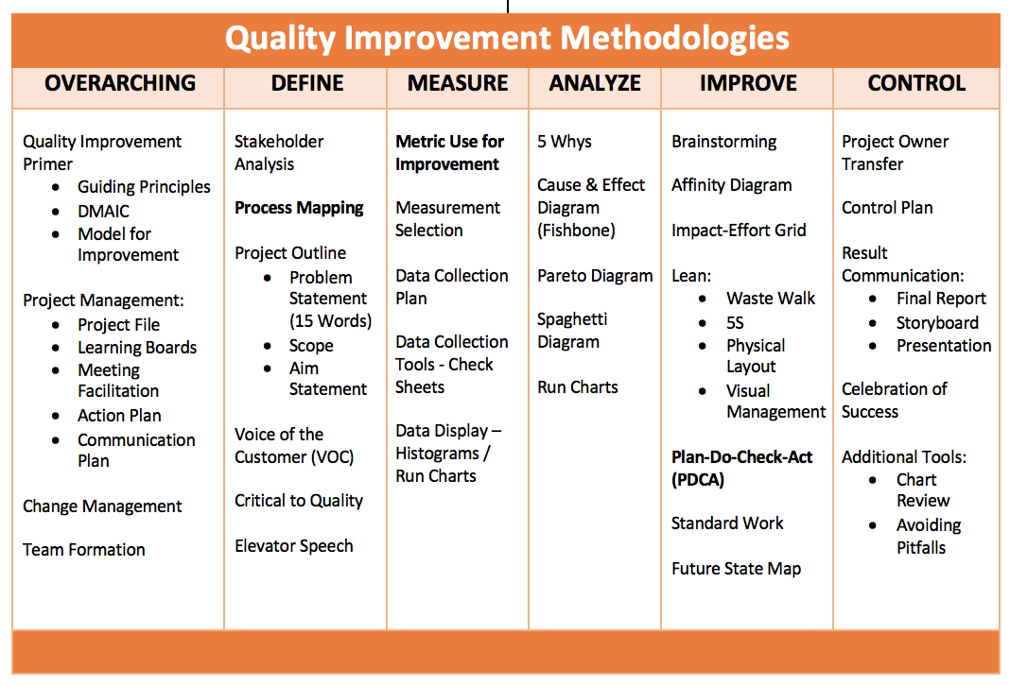

Slide 22
Tool Review

Slide 24
Items for Review
Project Management
  Learning Board
  Meeting Facilitation
Team Formation
Data Collection
Stakeholder Analysis
VOC
Pareto Chart
Fishbone

Slide 25
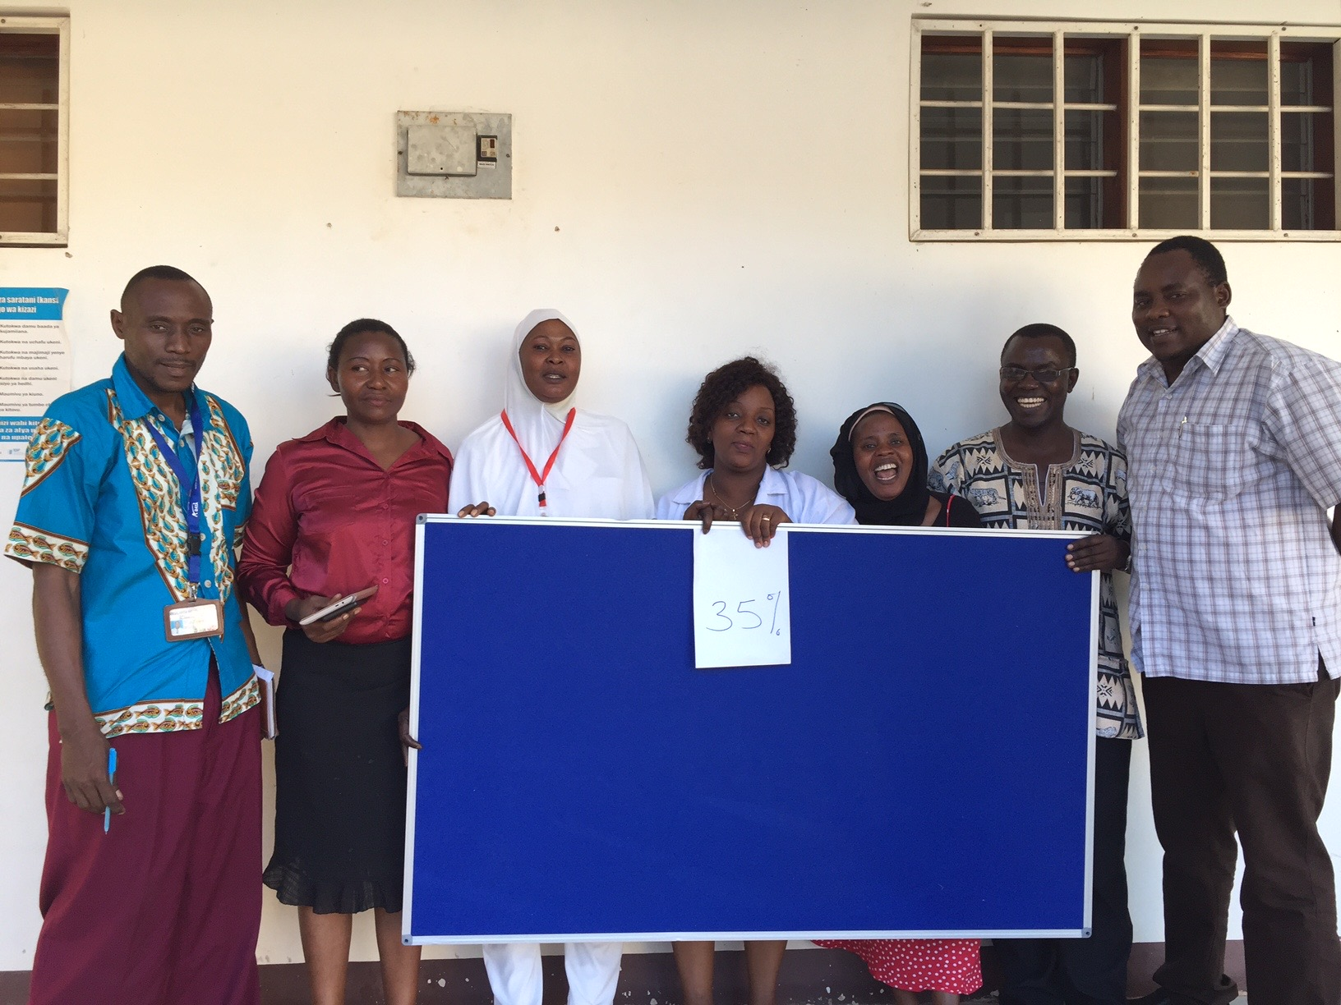
Learning Board
Workbook, p. 16-17

Slide 26
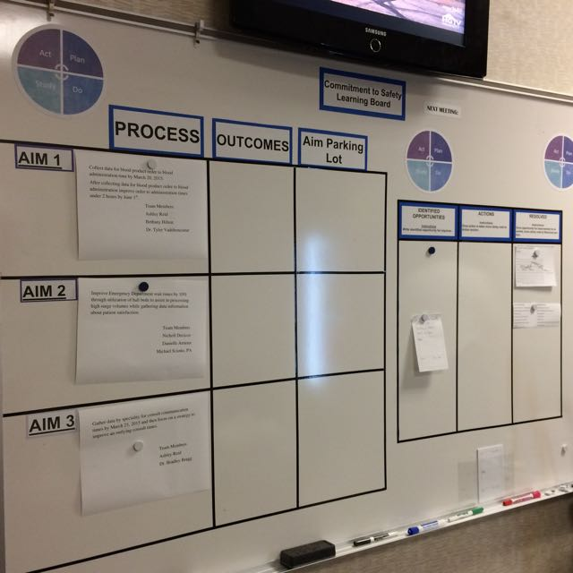
Two sides of the
Learning Board:
Project
ID Opportunities /Just Do It
Project
ID Opportunities
Just Do It

Slide 27
LEARNING BOARD
PROJECT |  |  | ID Opportunities / JUST DO IT
Aim / Metric | Changes |  | Identified Opportunities | Actions | Resolved

Slide 28
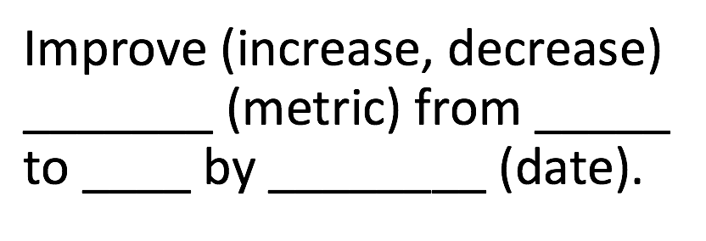
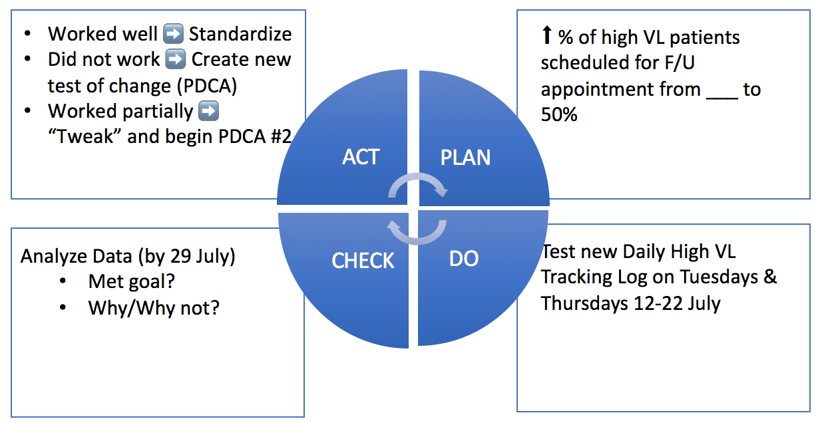
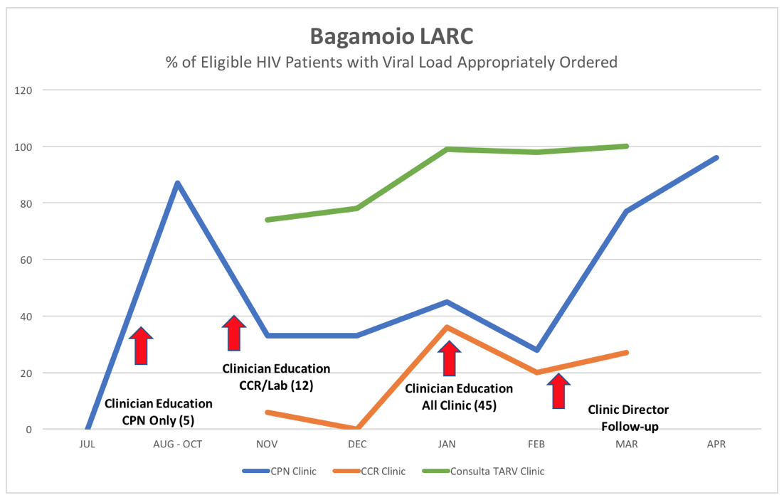
LEARNING BOARD
PROJECT |  |  | ID Opportunities / JUST DO IT
Aim / Metric | Changes |  | Identified Opportunities | Actions | Resolved

Slide 29
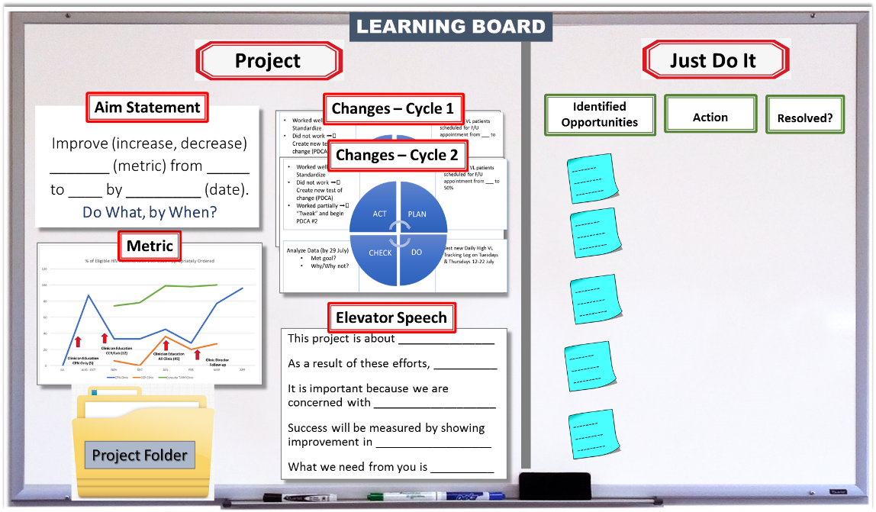

Slide 30
What is a Just Do It versus a Project?
Just Do It
Project
Simple
Involves 1 or 2 persons
Localized
Implemented in short time frame (typically less than 1 week)
Complex
Involves many people
Cuts across cadres or locations
Implemented in longer time frame (1 or more months)

Slide 31
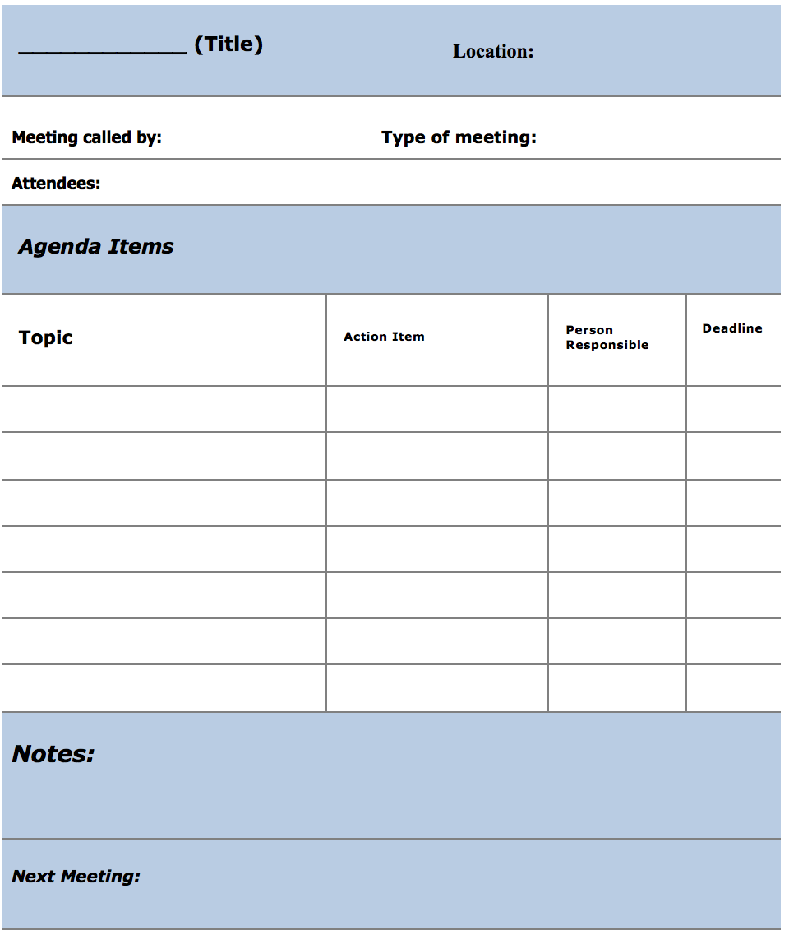
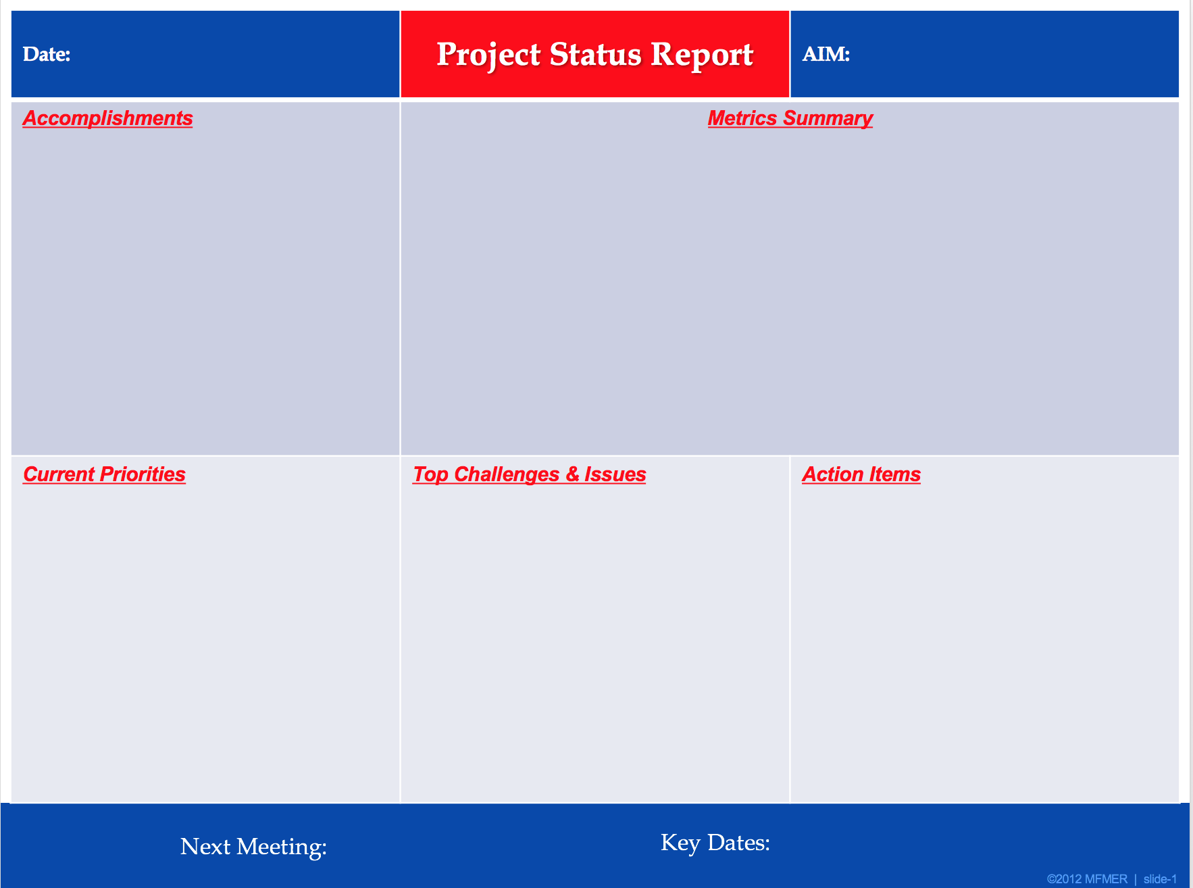
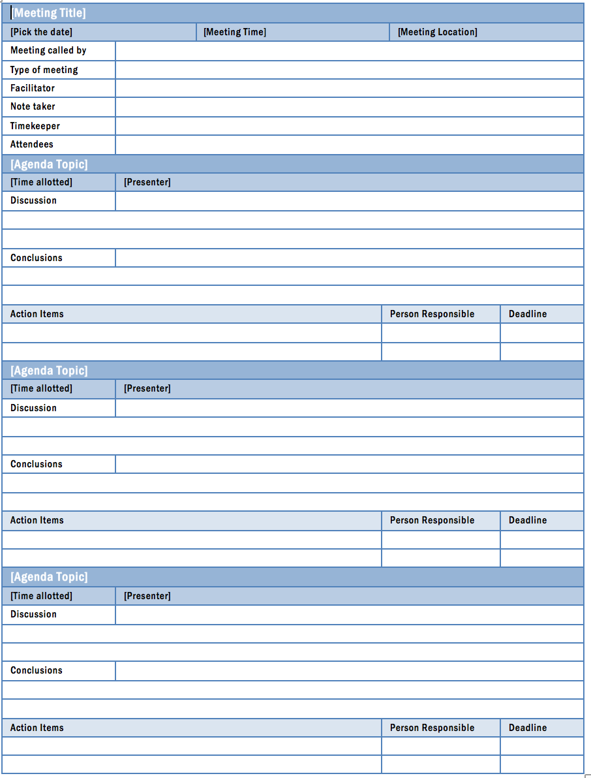
Meeting Facilitation
Workbook, p. 19-24

Slide 32
What needs to be covered during team meetings?
Focus on Aim - What are you really trying to accomplish?
Current team highlights or concerns
Current PDSA
  STUDY
    How was it implemented?
    Data Review – Improvement?
    Reflection
    Do you want to adopt, adapt, or abandon
Next PDSA
Additional Expertise or Collaboration Needed
Upcoming events

Slide 33
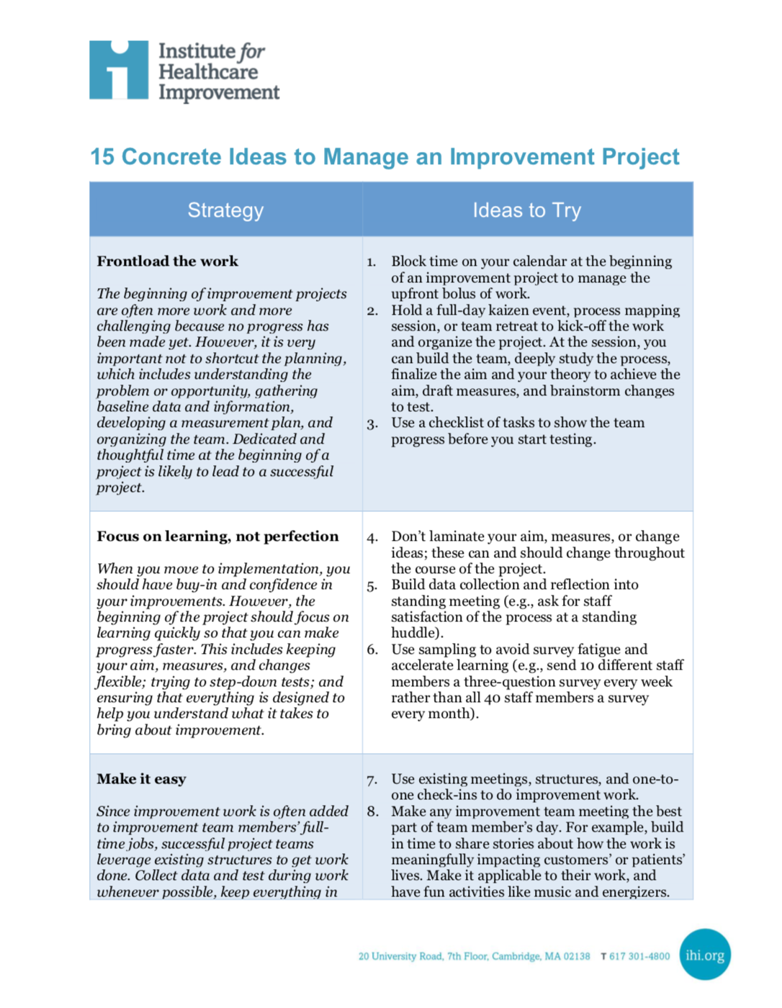
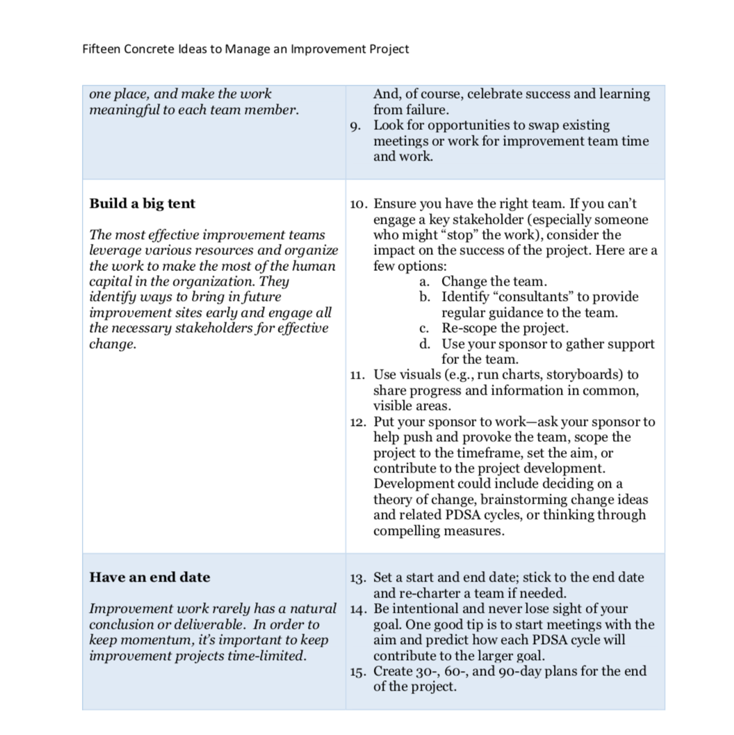

Slide 34
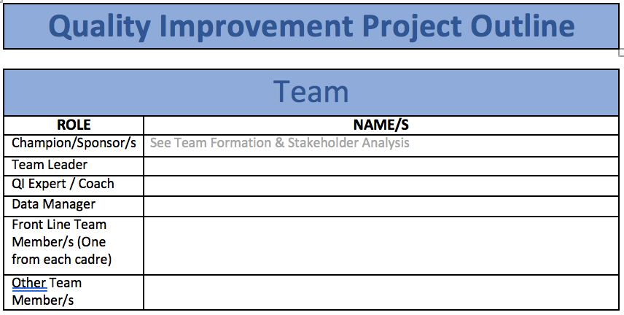
Team Formation
Workbook, p. 30-32

Slide 35
Team Functional Assessment
IHI QI 201: Planning for Spread
Novice Team
Meets weekly; manager and director are engaged and present
Has begun small tests of change with PDSA documentation
Working on building a team and seeing failure in a positive light
Strong Team
Has implemented more than three successful initiatives in the unit
Is submitting measures
Advanced Team
Has met or exceeded project performance targets
Mentors other teams

Slide 36
Data Collection –
Coaches @ Site Visits: Assure clarity & authenticity of Data Collection - See Raw Data, Source of Data, Data Collection Tool
Numerator = # of VL Test Results Entered into Green Book
Denominator = Total Test Results Returned to Clinic
Cohort # | OI / ART # | Test Returned to Clinic - Yes | VL Test Result Recorded in Green Book – Yes
TOTALS |  | # of Tests Returned to Clinic | # of Results in Green Book

Slide 37

Don’t miss the forest for the trees

Slide 38
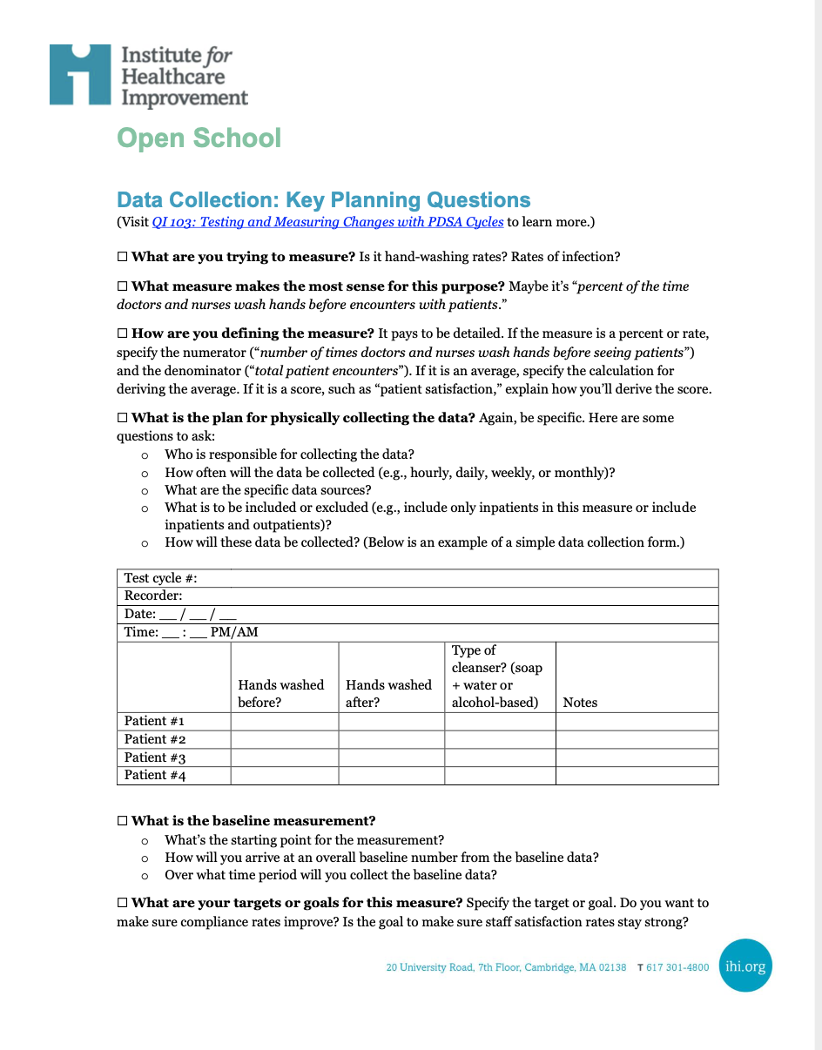
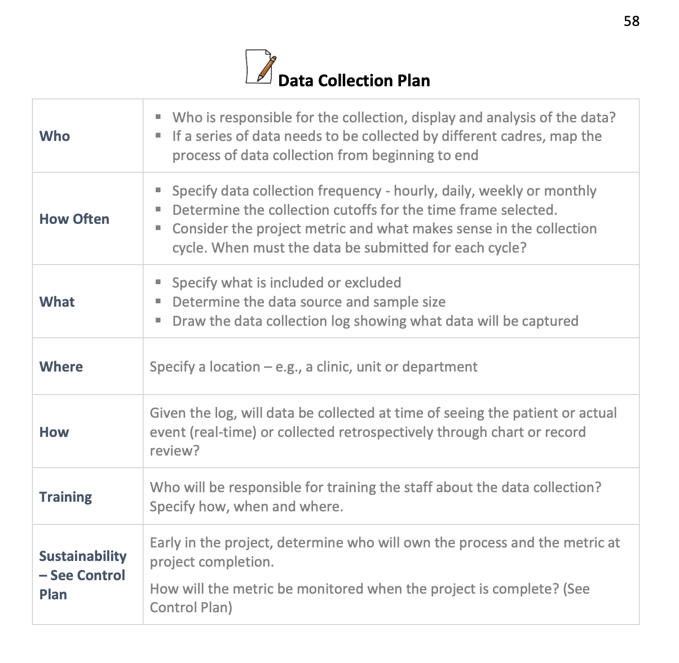
Resources
IHI Open School
Workbook
Visit QI 103: Testing and Measuring
Changes with PDSA Cycles to learn more.
Workbook, p. 53-59

Slide 39
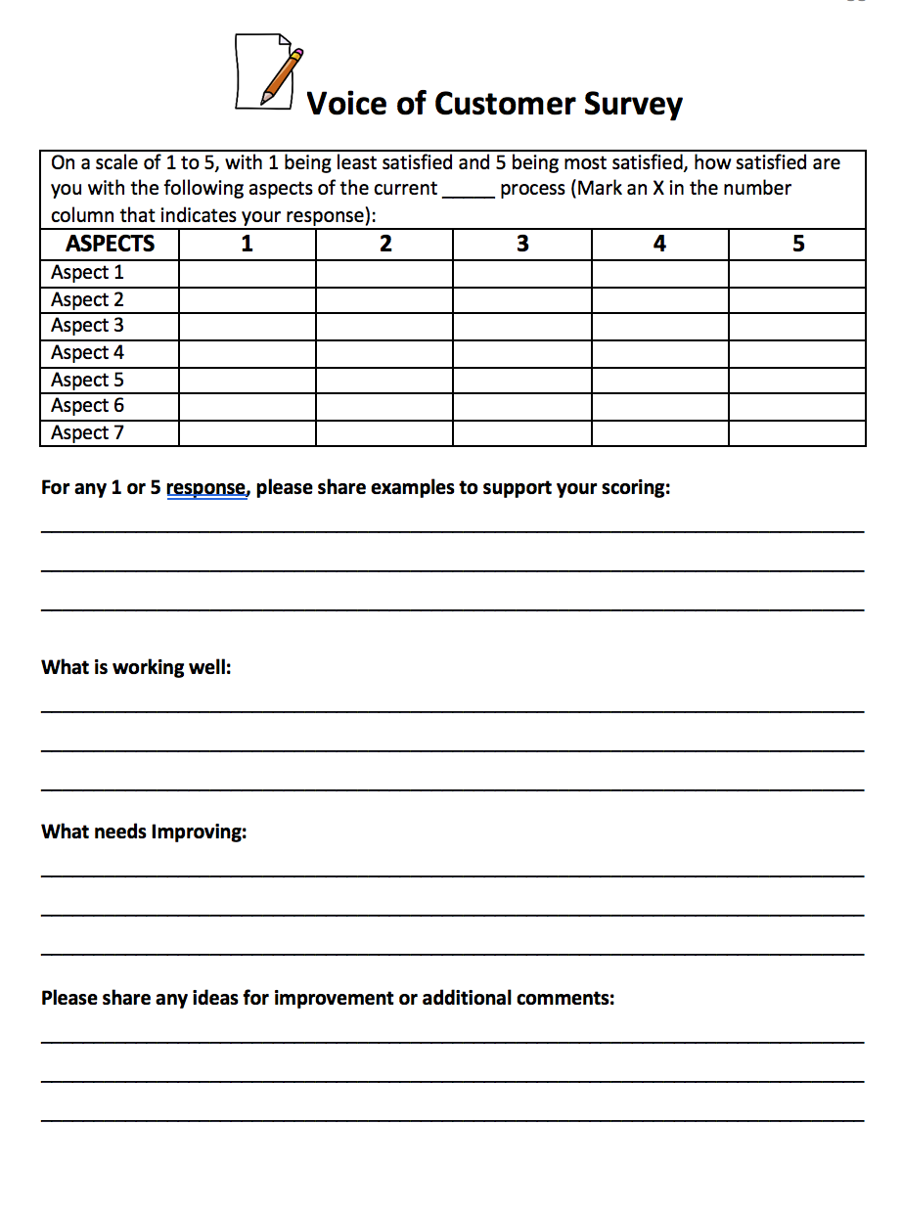
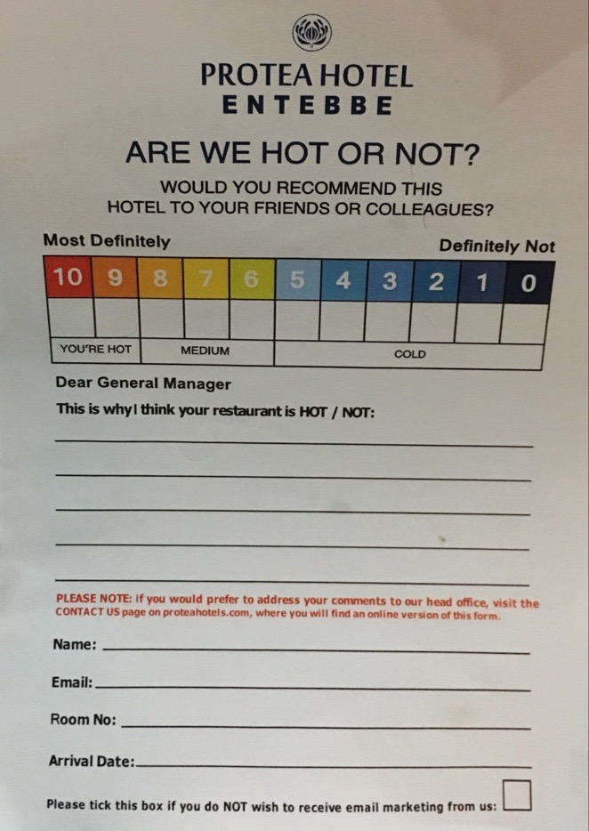
Voice of the Customer
Workbook, p. 43-45

Slide 40
VOC
Relate VOC to Project
Show improvement when repeat

Slide 41
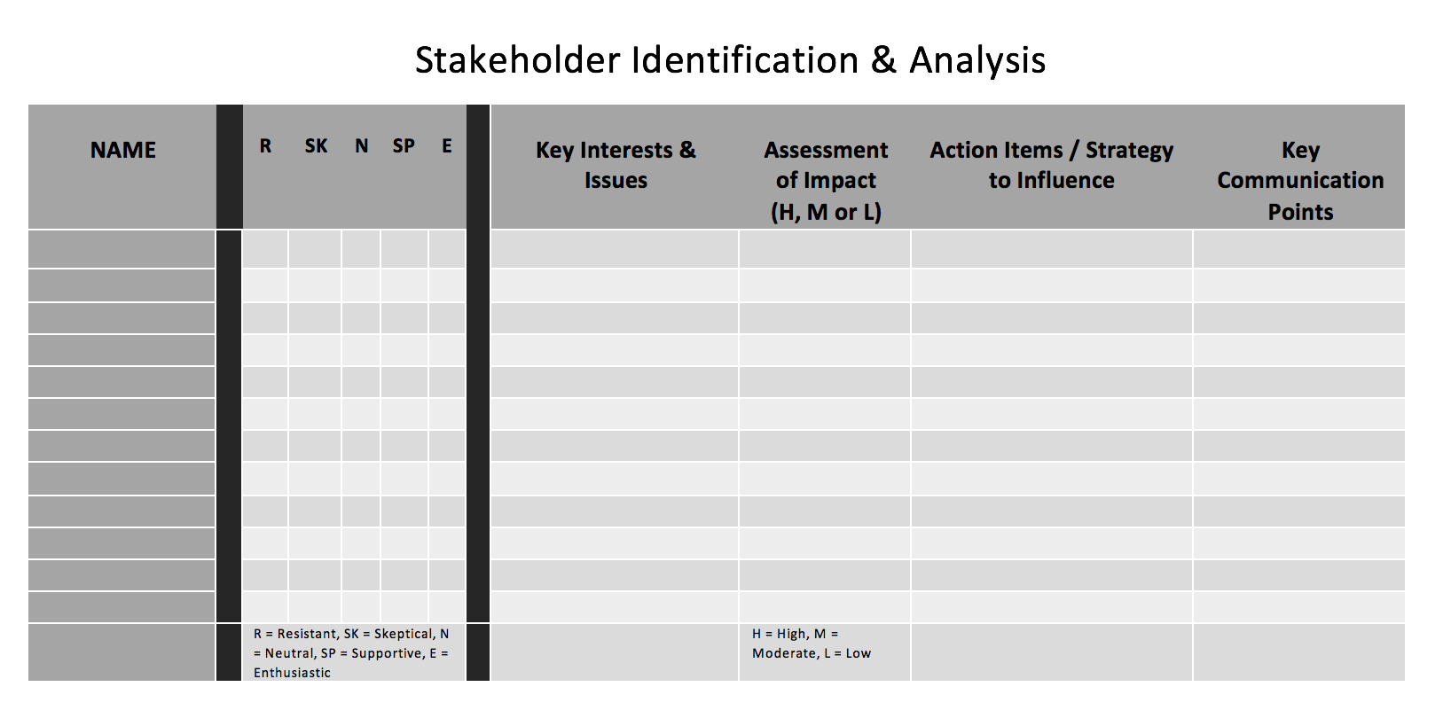
Stakeholder Analysis
Workbook, p. 34-37

Slide 42
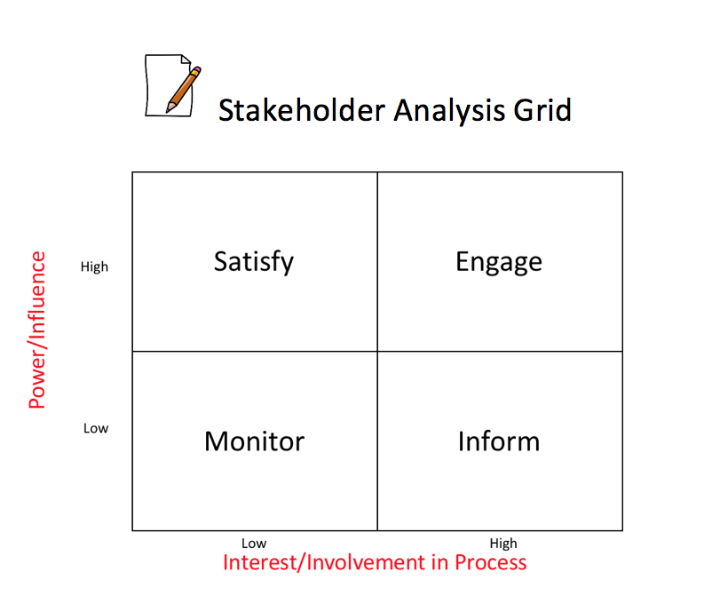
Stakeholder Analysis Grid
Workbook, p. 34-37

Slide 43
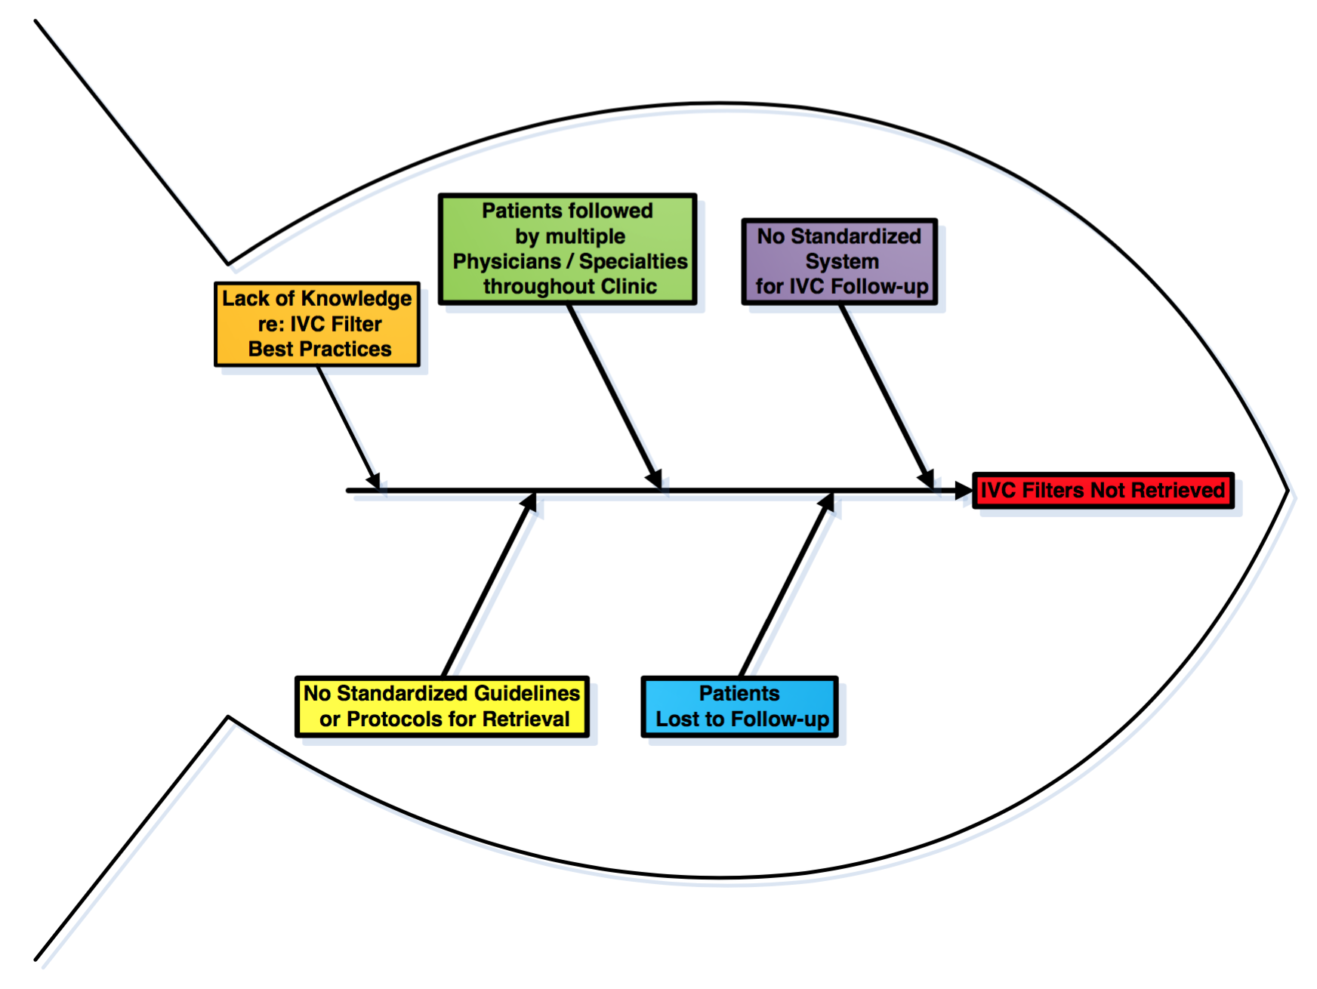
Fishbone
Diagram

Slide 44
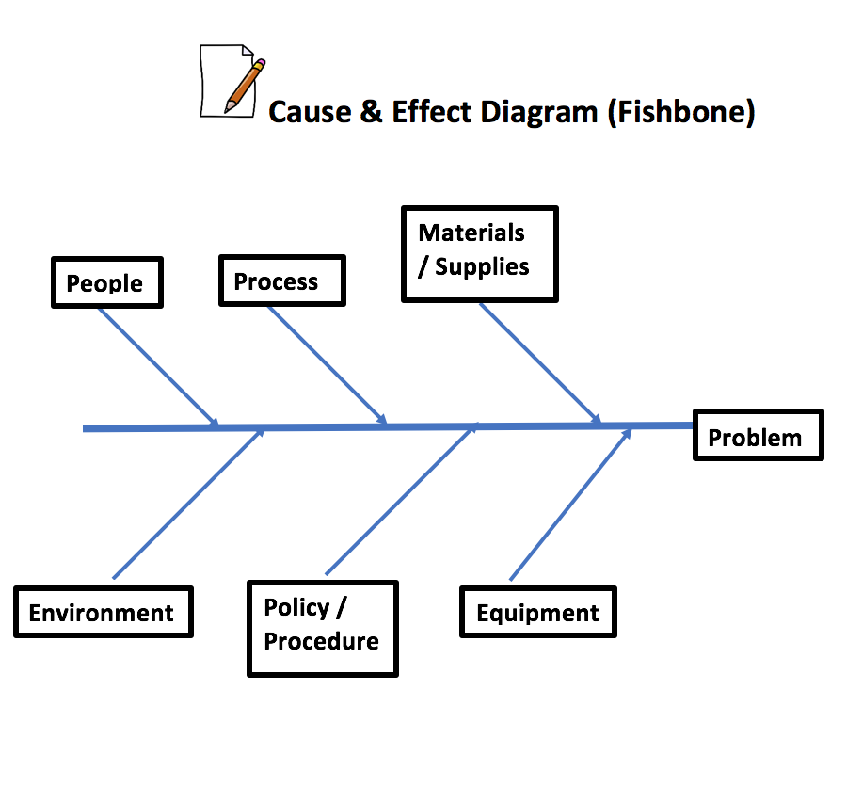
Categories to Review for Potential Causes
6 Ms
Man (People)
Methods (Policy/Procedure)
Materials (Supplies)
Mother Nature (Environment)
Measurement (Process)
Machine (Equipment)
Workbook, p. 64

Slide 45



Shape the Path: Tweak the Environment
Notes:
Introduce the concept - Change must be made as easy as possible. Share the story of the Staples ”Easy” button and Amazon “1-Click” – marketing master pieces that make buying easy, eliminating extra steps.

Slide 46
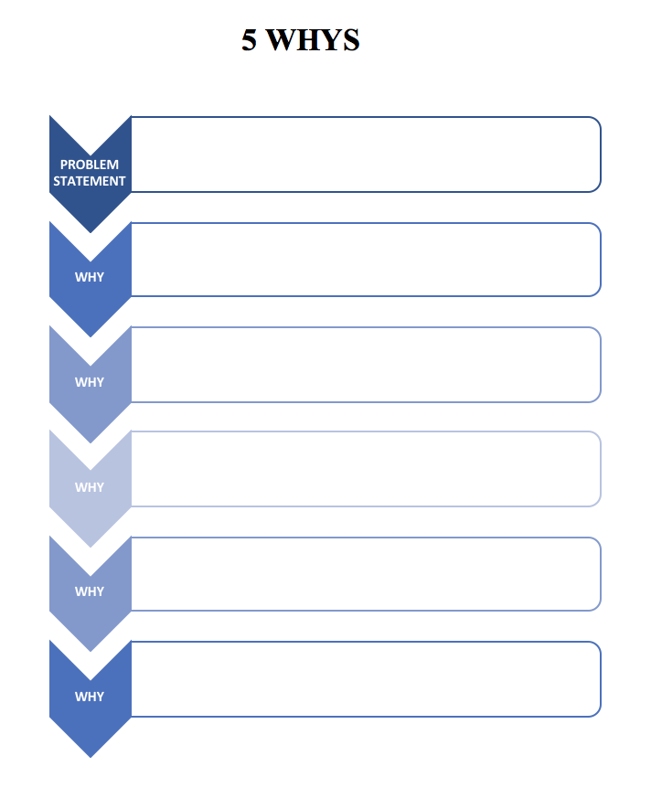
5 Whys

Slide 47
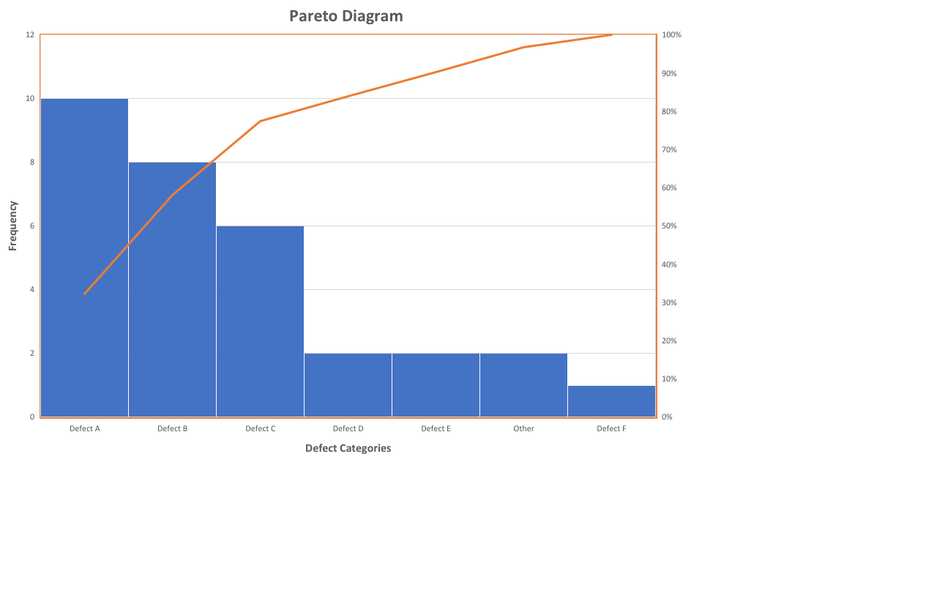
Pareto
Diagram

Slide 48
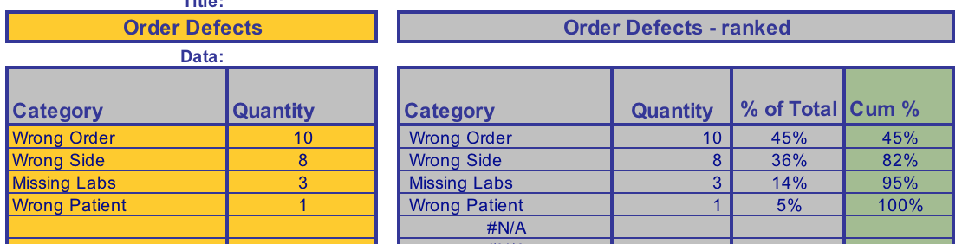
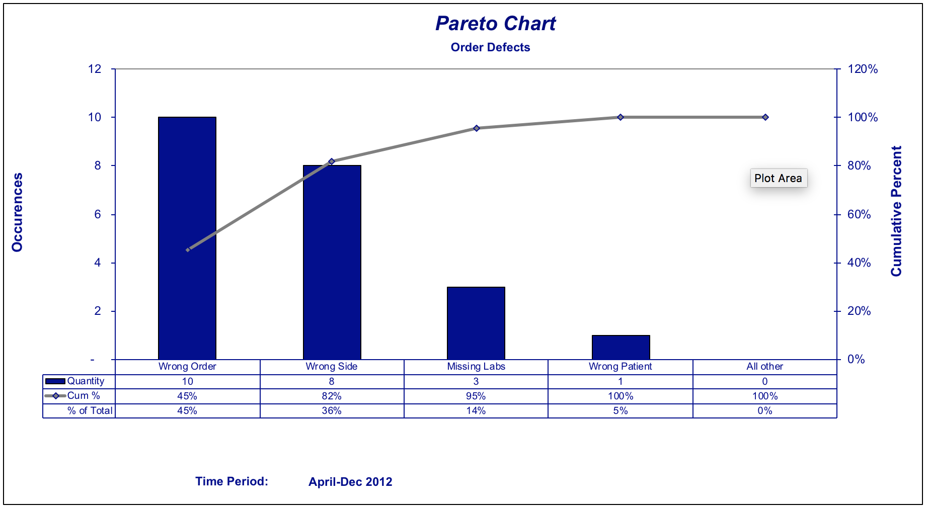
Pareto Table/
Diagram

Slide 49
Quality Improvement Primer
Guiding Principles
DMAIC
Model for Improvement

Slide 50
Guiding Principles for Quality Improvement
Focus on the needs of the USERS
Focus on PROCESSES to increase the productivity of work
Use DATA to improve services
Use TEAMS to improve quality
Improve COMMUNICATION
Workbook, p. 6

Slide 51
The LARC Quality Improvement Collaborative:
LEARNING SESSION II
How to be a Quality Ninja
IMPROVE
LARC

Slide 52
Learning Session #2 Overview

Slide 53
LARC = Quality Improvement Collaborative
Introduction: Webinar
Session I: Define Measure Analyze
Session II: Simulation Improve
Smart Start: On-Site Session
Session III: Control Share/Report
Final Report
Total
= 6-9
Months
2 Months
1 Week
2-3 months
2-3 months
1 Month
Preparation
Project Outline
Action Period
Action Period
Report Completion
Notes:
Key elements of a learning collaborative
Focused on one opportunity
Expertise
Learn from each other

Slide 54
Quality Improvement Collaborative Overview: Program Delivery
Introduction Webinar
Launch
Session I
Session II
Session III
Final Report
Smart Start
(on site)
Total Implementation Period = 6 Months
2 Months
2 months
2 months
1 Month
Project Outline
Action Period
Action Period
Action Period
Report
Completion
Preparation
Notes:
Still the collaborative model – learning sessions and action periods, but Shortened

Slide 56
Building Toward IMPROVE
DEFINE
Problem Statement
MEASURE
Magnitude of problem
ANALYZE
The root cause of the problem
Process step affected
What your customer thinks
Aim Statement
IMPROVE
???
PHASE
Outputs → Inputs

Slide 58
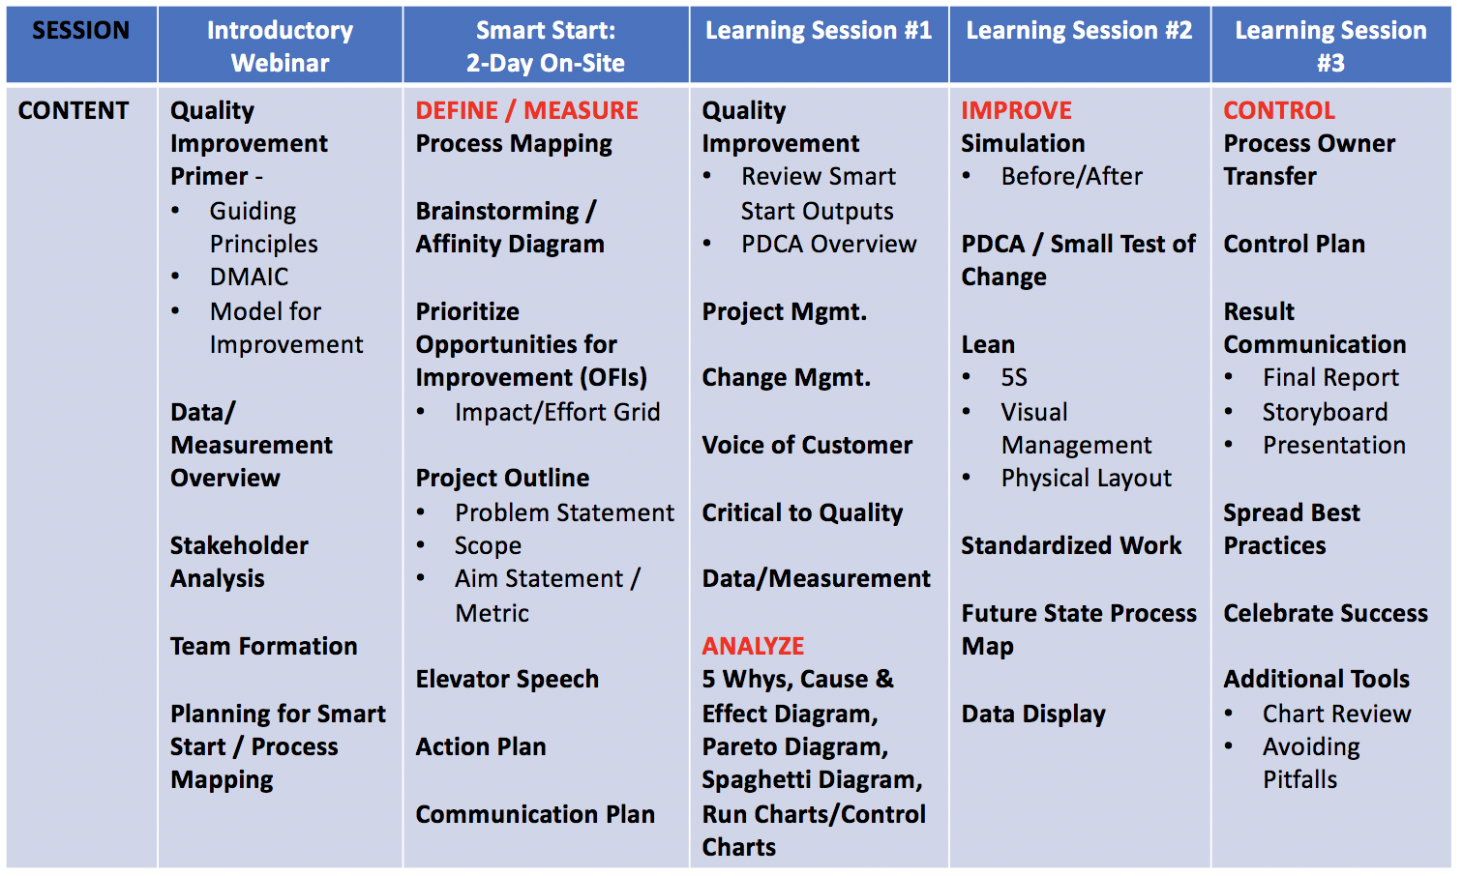
Learning Session #2 Overview

Slide 59
Project Deliverables
On-Site / Session 1
DEFINE / MEASURE / ANALYZE
Session 2
IMPROVE
Session 3
CONTROL
Identify Stakeholders
Team Formation
Map the Process (Current)
ID / Prioritize Opportunities
  Project Outline
Baseline Metrics - Data Collection Tool/Plan
Action Plan
Elevator Speech
VOC Information
Root Cause Analysis
1 Rapid/Small Test of Change (PDSA)
Presentation
  Update Project Outline, if necessary
1 5S Exercise
1 Visual Management Application
2 or more Tests of Change (PDSA)
Select and Implement Change
Modify Solution(s) where necessary by additional Test of Change (PDSA)
Create Future State Map
Create Standard Work
Presentation
Update Project Outline, if necessary
Validate Solution(s) / Interventions
Create Control Plan
Transfer to Operational Owner
Share/Spread Intervention, if applicable
Final Presentation
Project Champion
Notes:
Just in Time training to accomplish deliverables

Slide 60
Session 2 Deliverables
Improve
  Update Project Outline, if necessary
1 5S Exercise
1 Visual Management Application
2 or more Tests of Change (PDSA)
Select and Implement Change
Modify Solution(s) where necessary by additional Test of Change (PDSA)
Data Display
Create Future State Map
Create Standard Work
Presentation

