Slide 1
Zimbabwe Viral Load Clinic: Laboratory Interface Learning Session 1
28- 30 October 2019
Holiday Inn, Harare

Slide 2
Outline
Epidemiology of HIV in Zimbabwe
Evolution of ART Provision in Zimbabwe(2004- 2019)
Viral load background in Zimbabwe
Progress Made and Challenges in viral Load Services
Link with VL CLI
Objectives and Outputs of Meeting

Slide 3
Objectives of Learning Session
Sensitize participants on the VL CLI
To introduce the LARC team
Prime participants on the QI principles
Identify current gaps in management of clients on ART with high VL
Develop plans for the first Action Period

Slide 4
Expected Outputs
Engaged stakeholders with QI capacity
Facility plans for Action Period 1 of the VL CLI

Slide 5
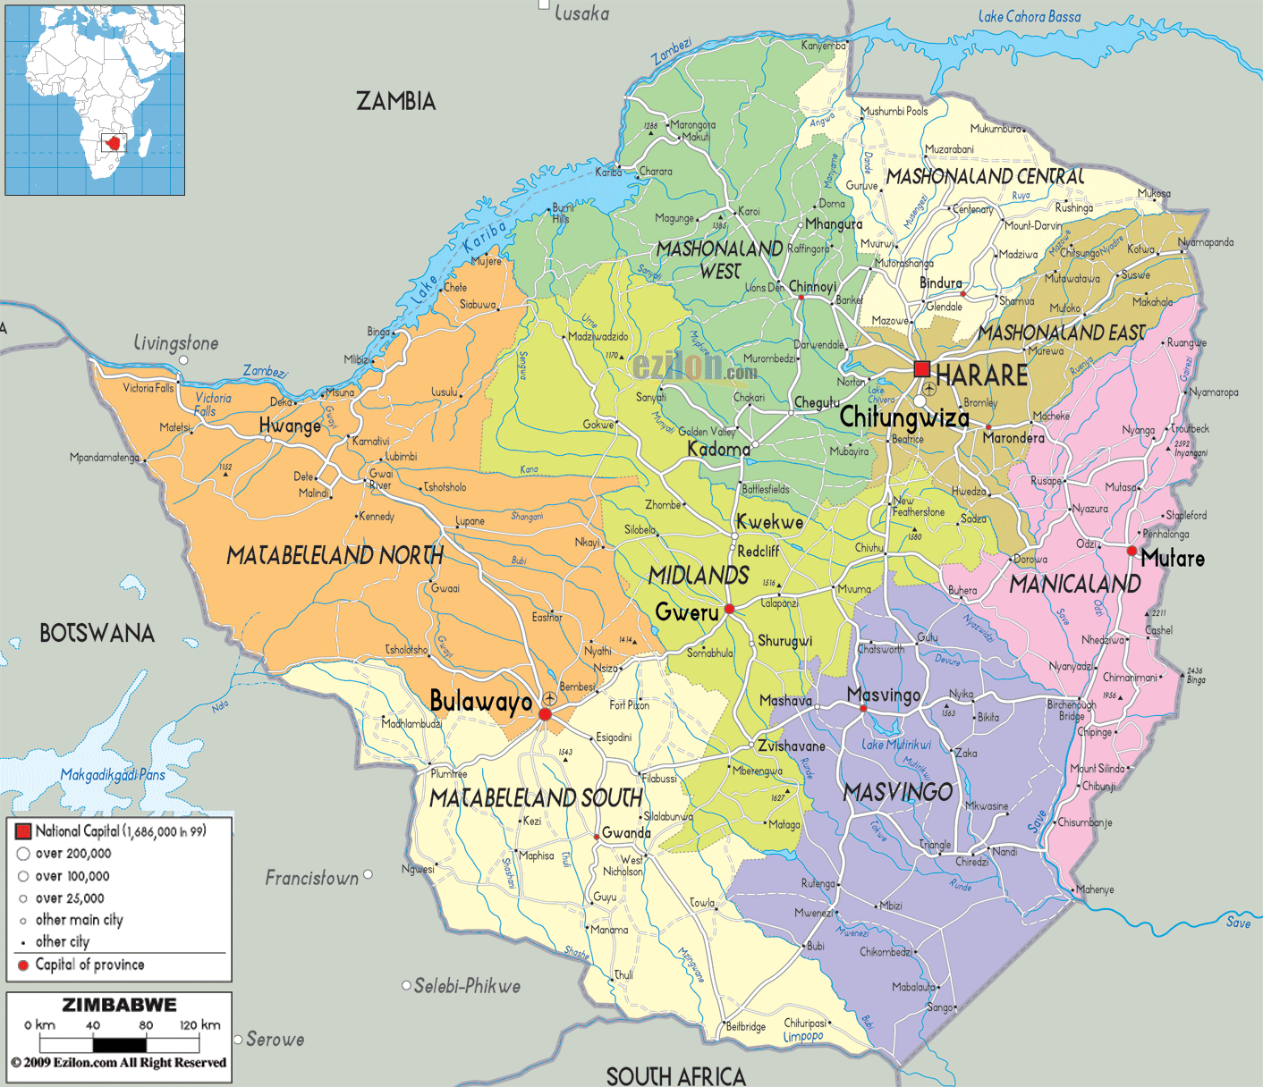
Country Context:
Zimbabwe remain one of the countries in the world heavily burdened by HIV/AIDS & TB
1.3m PLHIV
1,25m adults
76,592 children
(2017 HIV estimates)
HIV Prevalence: 13.7% among 15-49 yr age group
Female 16.7%
Male 10.5%
HIV Incidence: 0.48% in 2016 (down from 1.42% in 2011, 0.98% in 2013)
(ZIMPHIA, 2016)
MTCT rate 6.7%
(2017 HIV estimates)
TB/HIV co-infectivity rate of 63% [Global TB Report, 2018]
Total Popn ~ 13 million (2012 Census)
Notes:
Zimbabwe has a projected population of 13m people and is among the countries in Sub-Saharan
Africa worst affected by the HIV

Slide 6
HIV services have significantly been decentralised since program inception which has brought services closer to those who need them….
Health facilities offering HIV Services as @ June 2019
Major Partnerships: NAC, PEPFAR( USAID, CDC), GF, DFID, JSI , WHO, UNICEF, UNAIDS, MSF, CHAI
Source-DHIS2
Notes:
This graph shows health facilities offering HIV services in Zimbabwe as at June 2018. 85% (n=1588) of these sites offer both adult and paediatric ART. While we note with some concern that uptake of IPT is low, IPT coverage is relatively fair, standing at 73% in Zimbabwe. There is therefore potential to improve IPT coverage
Out of 1588 sites, 39% (n=624), have ePMS installed in them.
While we note that these sites are high volume sites, we may need as a program to be proactive in looking for opportunities to scale up ePMS coverage to approximately 3/5 of the facilities where ePMS is not installed. In the medium term we may need to operationalise roving DECs concept to capture all HIV data particularly in sites with low coverage of HIV ePMS

Slide 7
Evolution of the OI/ART Programme, 2004 - 2018
Addendum to the 2016 National ART Guidelines
2016 National ART Guidelines
2013 National ART Guidelines
2010 National ART Guidelines
Country introduced OI/ART programme in April 2004 guided by
Nationwide Scale-up of ART plans covering periods 2005-2007; 2008 – 2012 & 2013 – 2017,
Prior to 2016 Guidelines, targeted VL testing for suspected treatment failure, and then routine VL for all clients on ART since 2016

Slide 8
Viral Load Testing Coverage, 2015 - 2018

Slide 9
Despite routine VL having been scaled up significantly since 2016, VL testing coverage remains low …
From Jan-Jun 2019, a total of 143,040 (31% of the target) VL tests were done and VL suppression was 87%
Country has adequate VL testing platforms deployed country wide [both conventional (22) & POC (100)] however, with limited capacity utilization
Challenges relating to VL testing include:
Sample transportation system
Extended total Turnaround Time
Low viral load capacity utilization….
Source: 2017 ART End Term Programme Review
Notes:
The capacity is sufficient and the figure is based on 8 hour shifts however some labs are working 16 or 24 hour shifts .
Procuring more high throughput platforms will not solve the TAT issues however the sample and reporting systems needs to be strengthened . In addition, the country should consider replacing old platforms (2 BM platforms) that have been giving operational issues

Slide 10
Adults Estimated 90-90-90 Estimated Progress
Progress towards targets
Children Estimated 90-90-90 Estimated Progress
Source: Draft Shiny 90, 2018 HIV Estimates

Slide 11
Proportion of active patients enrolled in ART from 2013-2017 with suppressed VL from the first VL test stratified by age at health facilities with ePMS and in ART care for at least 12 months from ART initiation (N=114,857)
Adolescents aged 10-19 years had the least proportion of active patients that were suppressed (58%) compared to all the other age groups.
Older age groups tended to have higher proportions of active patients on ART that were virally suppressed
Source: ePMS 2018

Slide 12
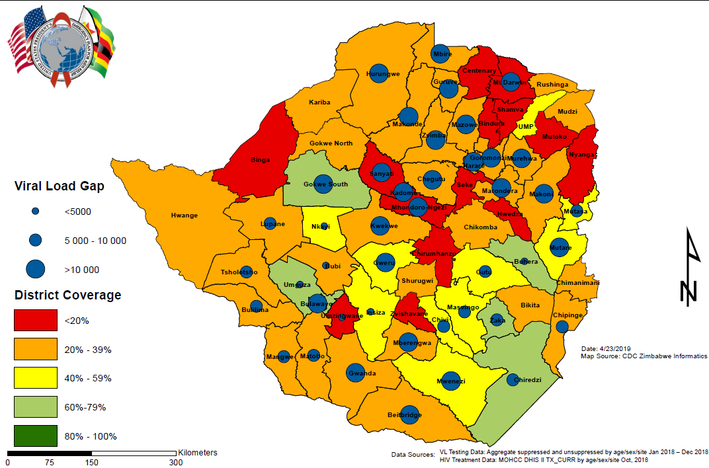
What does our gap to VL coverage look like?
Coverage Vs Testing Gap
All-Age, Sex
Notes:
To select high gap districts for lab clinic interphase strengthening activities so that resources are directed to areas of greatest need and lowest coverage as a subset of total patients on art. Optimized integrated sample transport system in high gap (>10,000) to improve access, coverage and quality of care

Slide 13
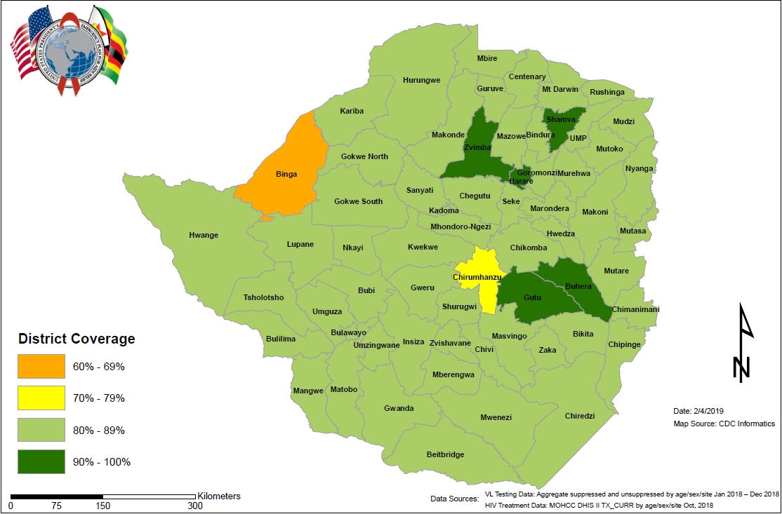
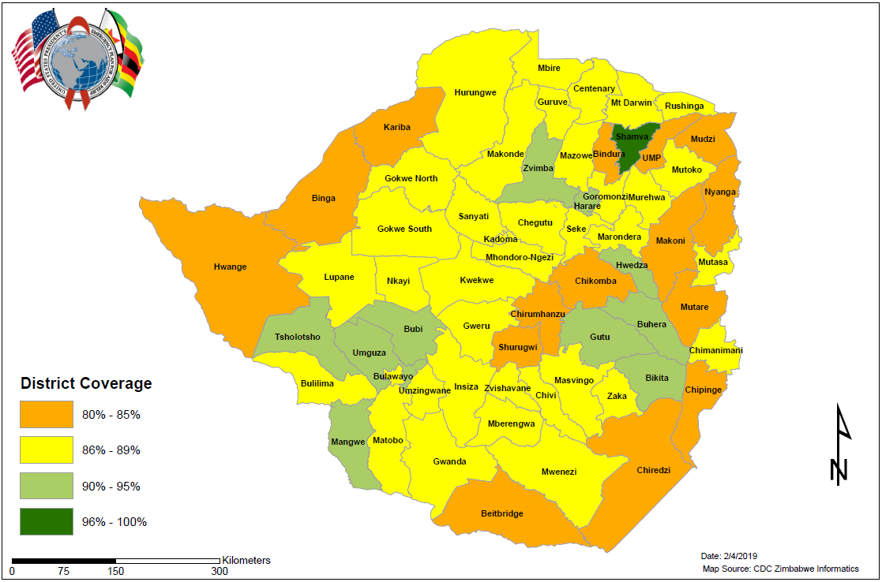
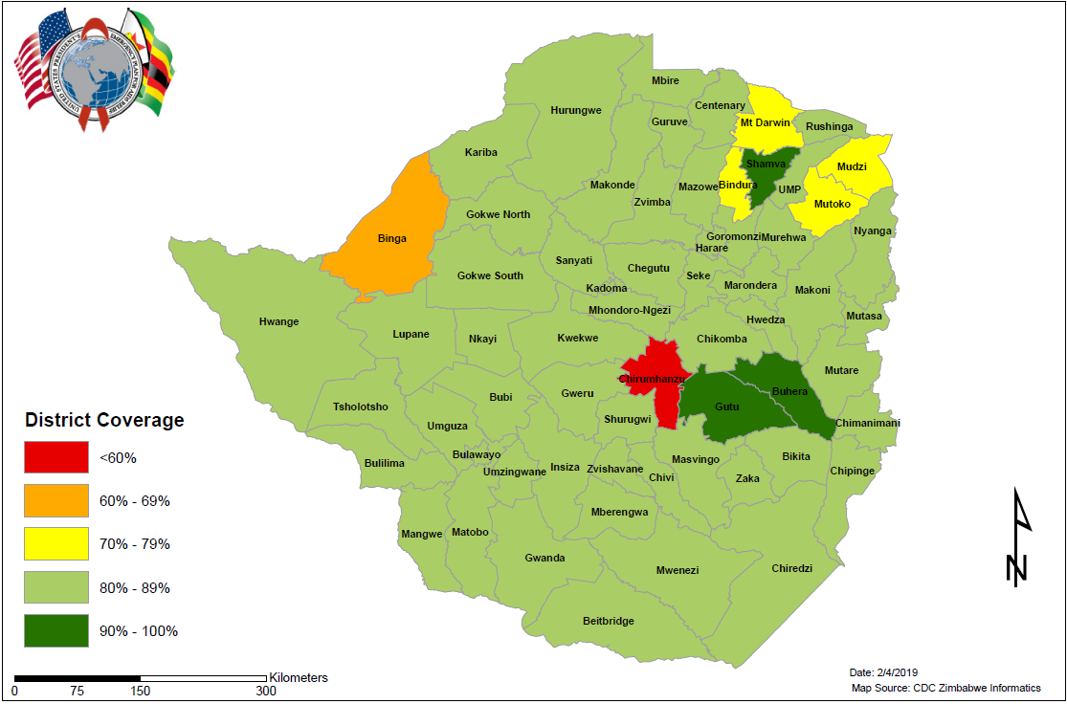
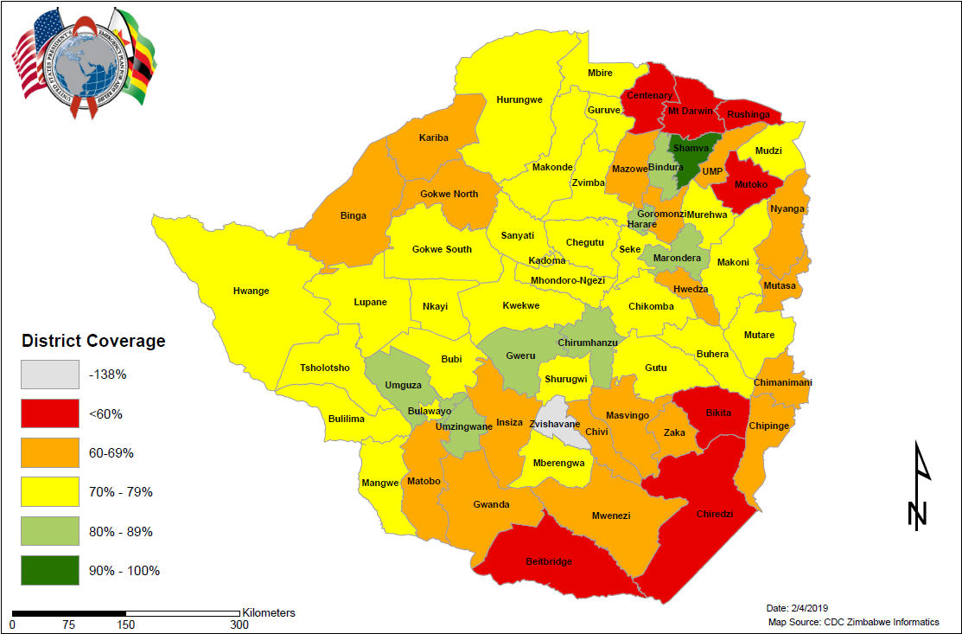
Suppression
Suppression
All-Age, Sex
Adult Male
Suppression
Suppression
Adult Female
Pediatrics
Notes:
District Suppression Maps

Slide 14
2018 Viral Suppression by Province

Slide 15
Management of PLHIV enrolled in ART care with High Viral Load in the Zimbabwe ART Program, 2004-2017
Leakages along the VL care cascade
840,971 patients entered in the ePMS
721,514 (85.8%) never had a VL done
119,457 (14.2%) ever had a VL done
96,754 (81%) have VL<1,000
22,703 (19%) have VL ≥1,000
7,764 (34.2%) had a follow-up VL done
3,076 (39.6%) had 2nd VL<1,000
4,688 (60.4%) had 2nd VL ≥1,000
1,991 (42.5%) switched to 2nd-line ART
85.8%
65.8%
57.5%
Source: ePMS Report, 2018
Missed opportunities in actioning on unsuppressed VL result reaching the 3rd 90
Unavailability of resistance testing with most clients accessing service from private sector (US$200 – US$700/test
Limited 3rd line options due to unavailability of single formulations of NRTIs

Slide 16
Viral Load scale up in Zimbabwe: Clinical challenges
Weak Sample transportation
Long TAT and inadequate systems to track TAT
No system for facilities to track coverage of routine VL monitoring of client cohorts
Shortages of critical M&E tools for VL monitoring of VL for clients, leading to a improvisation
For facilities with tools, inadequate documentation of VL sample collection and results leading to data quality issues.
For clients with high VL load- inadequate documentation of EAC sessions, repeat VL, recording of repeat VL Result, and whether clients re-suppressed or switched to second line

Slide 17
Link with VL CLI
With the current challenges, MOHCC will be implementing a VL CLI over the following phases to address them,
Phase 1: Increase VL results recorded in green booklets from baseline to 95% by November 2020
Phase 2: Increase proportion of clients with a high initial VL managed according to guidelines from baseline to 90% by November 2020
Phase 3: Increasing 12month VL coverage in participating facilities from baseline to 90% by November 2020

Slide 18
Mbare Polyclinic
Kuwadzana Polyclinic
Parirenyatwa Central Hospital
Zengeza Polyclinic
Seke North Clinic
Hatcliffe Polyclinic
Beatrice Road Infectious Disease Hospital Laboratory
National Microbiology Reference Laboratory
St Marys Clinic
Chitungwiza Central Hospital
Hopely Clinic
Overspill Clinic
Epworth Polyclinic
Budiriro Polyclinic
PSI Laboratory- Chitungwiza

