Slide 1
Data Collection Plan
Ministry of Health and Child Care: AIDS & TB Unit
Japhet Mabuku
Data Quality Officer
Holiday Inn, Harare
Date: 28 October 2019

Slide 2
Outline
Why Measure
Collaborative Aim and Data Collection
CLI Collaborative Data Collection and Reporting tools
Data Flow
CLI QI Collaborative Data reporting requirements
CQI Baseline Data Collection & next steps

Slide 3
Why Measure?
It’s very simple:
“You can’t improve what you can’t measure!”
Using Measure to Support Improvement
Notes:
“You can’t improve what you can’t measure.” Measurement gives us power. And, it enables us to see if we are improving.

Slide 4
Why Measure?
Separates what you think is happening from what is really happening
Establishes a baseline: It’s ok to start out with low scores!
Helps to avoid putting ineffective solutions in place
To monitor improvements and prevent slippage
Indicate whether changes lead to improvements
Standardized measures allow for comparing performance across sites

Slide 5
Model for Improvement
What can you measure and observe to know the new change is improving the problem / helping reach the goal?
What are we trying to
Performance Measurement
accomplish?
How will we know that a
change is an improvement?
What change can we make that
will result in improvement?
Act
Plan
Study
Do
The Model for Improvement was developed by Associates in Process Improvement.
Notes:
5
5
The MFI in detail - Review briefly the entire model for Improvement (MFI). You can use a quick personal example like weight loss to highlight
What are we trying to accomplish? This question is asking ‘what is our goal’? Lose weight
How will I know a change is an improvement? This question is asking about the measurement. We will know because we measure. I have a Scale – I’m going to measure / weigh myself
What change can we make that will result in improvement? This question is asking about specific changes or interventions to impact losing weight. We do the PDSA cycle to make sure the intervention chosen actually works and to accelerate improvement efforts by building off of good changes one at a time.
e.g. interventions might include running 5 miles a day. I plan it, I do it (run), I study the results – how do I feel? Scale – any loss? Etc. These are meant to be quick changes. You can use other sources of data in the study phase like ‘loose clothes or I can run farther or faster etc’ since the big measure of losing weight on the scale may not have shown up yet. And then I build on that…I’m going to eat only potatoes. I plan it (buy potatoes and pick the day), I do it, I study / measure the results (I got sick and gained a pound) and I act on it. This intervention DID not work – I am not going to implement it broadly. Keep going….
Explanation: The Model for Improvement is a simple yet powerful tool for accelerating improvement. The model is not meant to replace change models that organizations may already be using, but rather to accelerate improvement. This model has been used very successfully by hundreds of health care organizations in many countries to improve many different health care processes and outcomes. The model has two parts: a) three fundamental questions, which can be addressed in any order and b) the Plan-Do-Study-Act (PDSA) cycle.
The three questions are fundamental to developing the Aim of the improvement initiative. The PDSA cycle guides the tests of a change to see if the change is an improvement.

Slide 6
Clinical → Phased Approach:
Phase 1. Improve Documentation of Viral Load Test Results
Phase 2. Improve Patient Care According to Guidelines
Phase 3. Improve Viral Load Coverage
Laboratory
Improve turnaround time (TAT), time from sample collection to time results reach clinic
Improve Specimen Rejection Rates
Overarching Goals: “Make Every Test (Viral Load) Count”

Slide 7
Overarching Goal Phase 1: Improve Utilization of Viral Load Test Results
Aim #1 – Increase proportion of Viral Load Test Results recorded in patient record (Green Book) from _________ to 95% by 22 January 2020.
Aim #1 – Increase proportion of Viral Load Test Results recorded in patient record (Green Book) from _________ to 95% by 22 January 2020.
Overarching Goal Phase 1: Improve Documentation of Viral Load Test Results

Slide 8
Aim #1 Increase proportion of Viral Load Test Results recorded in patient record (Green Book) from _________ to 95% by 22 January 2020.
Numerator = # of VL Test Results Entered into Green Book
Denominator = Total Test Results Received By The Facility
Cohort # | OI / ART # | Test Returned to Clinic - Yes | VL Test Result Recorded in Green Book – Yes
TOTALS |  | # of Tests Returned to Clinic | # of Results in Green Book

Slide 9
Data Collection for Aim #1
Baseline Data
Chooses 6 cohorts – October 2018 to March 2019
Select 25 red & green tagged charts randomly from each cohort
Determine if the VL Test results were recorded in Green Book
Complete Data Collection Record
Prospective Data
At the end of each Clinic day, pull a sample of charts that have been seen in clinic on that day
Review the first 5 charts that have a viral load test result available
Determine if the VL Test results were recorded in Green Book
Complete Data Collection Record

Slide 10
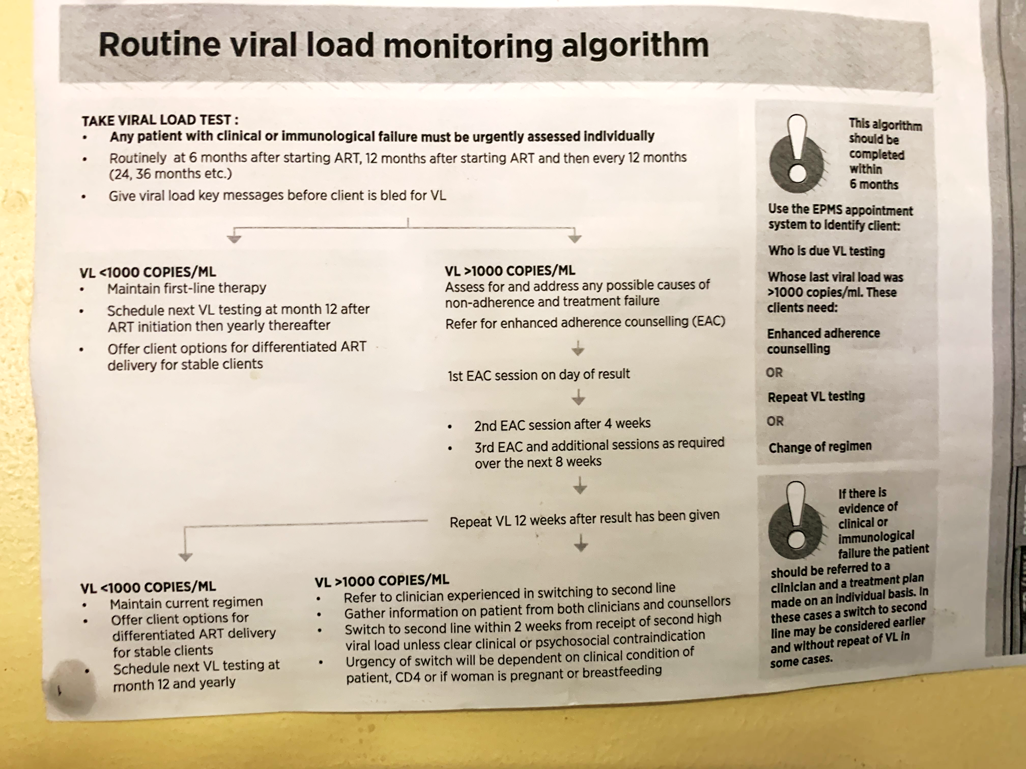
Overarching Goal Phase 2: Improve Patient Care According to Guidelines
Aim #2 – Increase proportion of High Viral Load Patients cared for according to guidelines from _________ to __________ by 15 November 2020.
Aim #2 – Increase proportion of High Viral Load Patients cared for according to guidelines from _________ to __________ by 15 November 2020.
Overarching Goal Phase 2: Improve Patient Care According to Guidelines

Slide 11
Aim #2 Increase proportion of High Viral Load (HVL) Patients cared for according to guidelines from _________ to __________ by 15 November 2020.
Numerator = # of HVL Patients Cared for According to Guidelines*
Denominator = # Patients with High Viral Load
Cohort # | OI/ART # | HVL Result (Date) | EAC #1 (Date) | EAC #2 | EAC #3 | EACs Yes/No | Repeat VL Due Date – 4 mo. from HVL Date | VL Repeat (Date) | Repeat VL – Yes/No | 3 EACs & Repeat VL* – Yes/No
TOTALS |  | (Tally # for) # of Patients with HVL |  |  |  |  |  |  |  | # of Patients Cared for According to Guidelines*
* Guidelines = 3 EACs & repeat Viral Load within 4 months

Slide 12
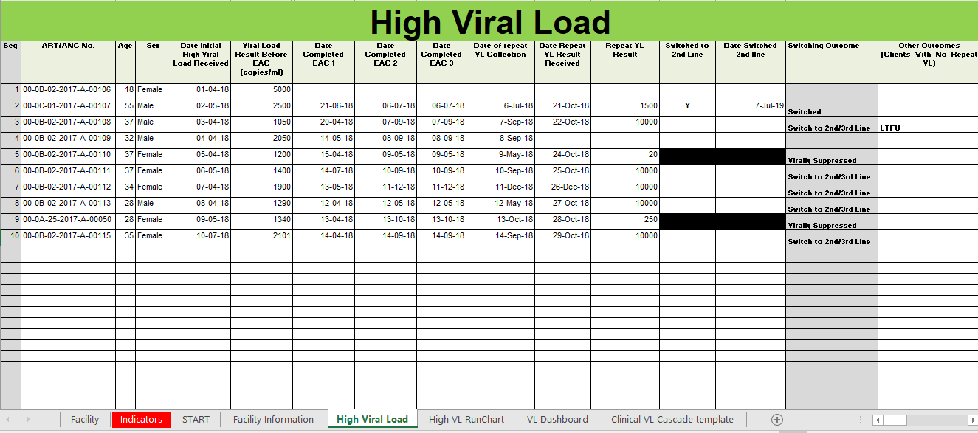
Baseline Data Collection - Facility
No Repeat VL
The system can be used to monitor High Viral Load Clients

Slide 13
Data Collection for Aim #2
Baseline Data
Select all high viral load (HVL) Patients from the year of 2018
Select 25 randomly or all charts, depending on the number
Determine if 3 EAC’s and repeat viral load were performed within four months of date of identification of high viral load
Complete Data Collection Log
Prospective Data
At the end of each day, review any HVL charts that have been seen in clinic on that day
Track any care provided for the specific patient
Complete Data Collection Record as care is provided
Consider creating several short term aims in order to reach this long-term aim, e.g., patient called with high viral load results, patient return for first EAC, etc.

Slide 14
Overarching Goal Phase 3: Improve Viral Load Coverage
Viral Load Test Result
Aim #3 – Increase proportion of Eligible Patients with a Viral Load Test completed* in the past 12 months from _________ to __________ by 15 November 2020.
* - Test Result Recorded
Aim #3 – Increase proportion of Eligible Patients with a Viral Load Test completed* in the past 12 months from _________ to __________ by 15 November 2020.
* - Test Result Recorded
Overarching Goal Phase 3: Improve Viral Load Coverage

Slide 15
Aim #3 Increase proportion of Eligible Patients with a Viral Load Test completed* in the past 12 months from _________ to __________ by 15 November 2020.
Numerator = # of Viral Load Results recorded in Patient Record
Denominator = # of Patients Eligible for a Viral Load Test
* - Test Result Recorded

Slide 16
Overarching Goal - Laboratory: Improve Turnaround Time
Aim #4
Increase proportion of viral load samples that reach targeted* turnaround times (time from sample collection to time results reach clinic) from _________ to __________ by 15 November 2020.
* - Nationally determined targets

Slide 17
Overarching Goal - Laboratory: Improve Specimen Rejection Rates
Aim #5
Reduce the proportion of VL sample rejection rates from _________ to __________ by 15 November 2020.
* - Nationally determined targets

Slide 18
CLI QI Collaborative Indicator Guide - Facility
Indicator | Numerator | Denominator | Data Source (Numerator) | Data Source (Denominator)
Proportion of Viral Load results recorded in OI ART patient care booklet | # of Viral Load Test results recorded into OI ART patient care booklet | # of Total Viral Load results received by the facility | OI ART patient care booklet | OI ART patient care booklet Viral Load register (Improvised)
Proportion of High Viral Load clients cared for according to ART | # of PLHIV and on ART who had a high viral load who received a repeat VL after completing three (3) EAC sessions within 4 months | # of PLHIV and on ART who had a high viral load result issued four (4) months back | High Viral Load Request Form Viral Load register (Improvised) | Viral Load Request form
Proportion of ART with VL test done within the past 12 months | # of PLHIV and on ART at the facility who had a VL test done in the past 12 months | `# of PLHIV and on ART for more than 6 months at the facility during the month under review | OI ART patient care booklet | OI ART patient care booklet

Slide 19
CLI QI Collaborative Indicator Guide - Laboratory
Indicator | Numerator | Denominator | Data Source (Numerator) | Data Source (Denominator)
Proportion of VL samples collected at facility and results received at the facility with 30 days | # of VL samples collected at facility and results received at the facility with 30 days during the period under review | # of VL samples collected at facility during the period under review. | LIMS Lab Register | LIMS Lab Register
Proportion of VL tests rejected by each lab | # of VL tests rejected by each lab during the period under review | # number of VL samples received during the period under review | LIMS Lab Register | LIMS Lab Register

Slide 20
Data Reporting

Slide 21
Baseline Data Reporting tool (HVL)
System generated

Slide 22
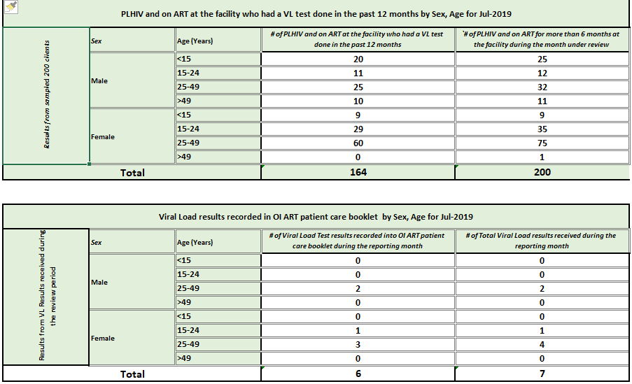
Baseline Data Collection & Reporting

Slide 23
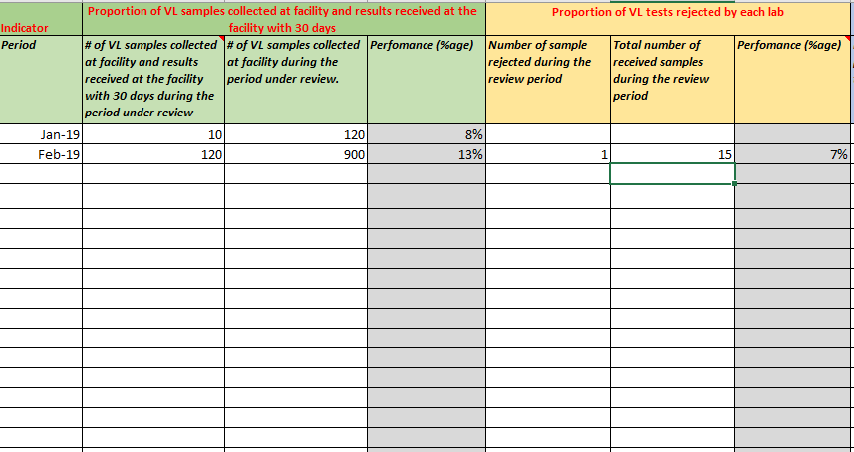
Baseline Data Collection - Laboratory

Slide 24
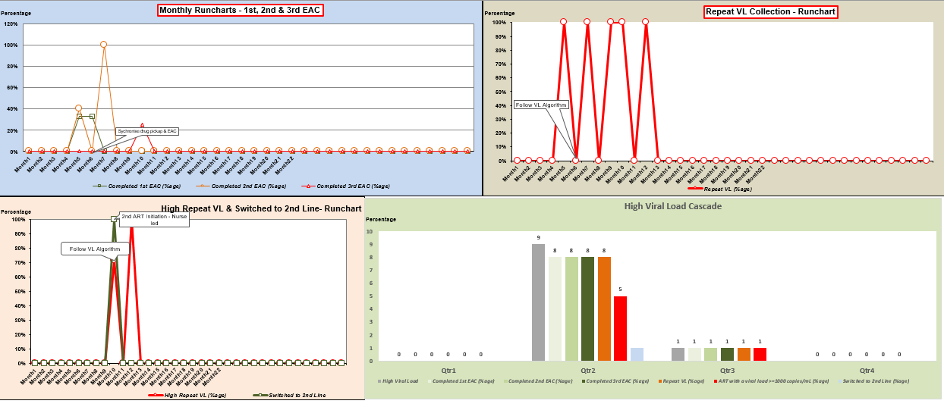
Facility Runchats and Cascade

Slide 25
Data Flow

Slide 26
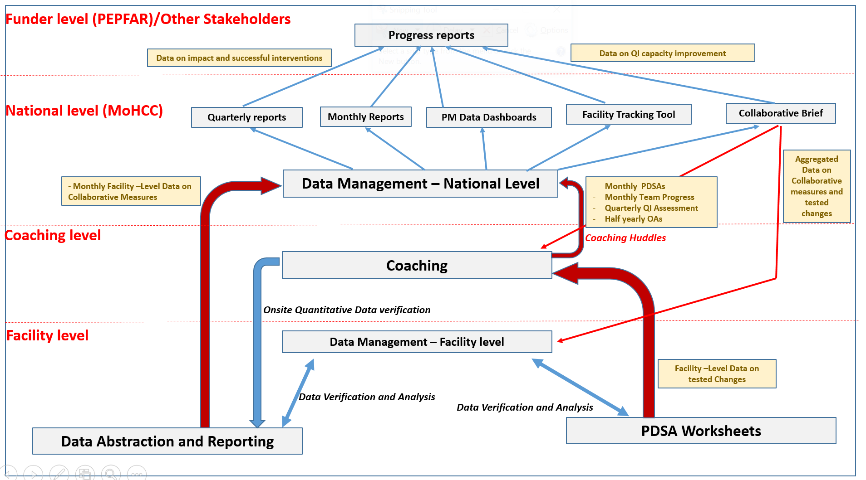

Slide 27
Data Collection and Reporting Requirements
Collaborative data collection – Sites are responsible for collection of their own data. Coaches and Data Manager will provide technical support to sites during data abstraction process.
DECs will be trained on the abstraction process and the CLI QI collaborative measures/indicators. SOPs will be shared which can be used as reference material by DECs.
Sites should conduct monthly data analysis to discuss Data .
Monthly aggregated data is sent to the national office (MoHCC) via email or through the coaches

Slide 28
CQI Baseline Data Collection next steps
All facilities to collect baseline data for all the 3 Indicators by Dec 2019
All Labs to collect baseline data for the 2 indicators by Dec 2019

Slide 29
Implementation of Improvement Work is vital for success!
“You can’t fatten a cow by just weighing it!”
(Palestinian Proverb)

Slide 30
Ke a Leboga
Thank you
Ndatenda
Ngiyabonga

