Slide 1
The LARC Quality Improvement Collaborative: Smart Start 2-Day On-Site Session
Process Mapping & Beyond

Slide 2
2 Days

Slide 3
WHY
Start with Why

Slide 4
LARC Reviews
“LARC takes us to the site for solutions, not sitting centrally and saying, this will work, it must work…”
Geoff Akuzike Chipungu MBBS
CDC Laboratory Advisor, Malawi

Slide 5
What is this project about?
“Viral load suppression for patients”
Mapopa Kenneth Kapira, HDA

Slide 6
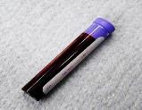
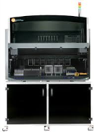
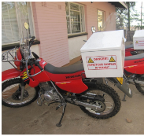
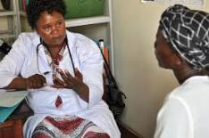
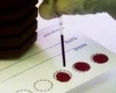
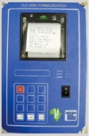
The Viral Load Cascade
Demand Creation for Testing
Specimen Collection & Processing
Sample Transport
Laboratory Testing
Result Reporting & Interpretation by Clinician
Patient Management

Slide 7
2 Days
To set your project up for SUCCESS
Session Outcomes:
An understanding of your current state via process mapping
A complete project outline – with aims and measures – to provide clear direction for the project!

Slide 8
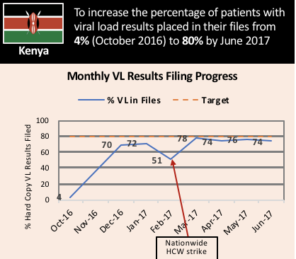
What is LARC? Laboratory African Regional Improvement Collaborative
Bringing together multidisciplinary clinical teams to improve any process or system
CURRICULUM: Quality Improvement (QI) Methodologies |  | DELIVERY MODEL: Learning Collaborative |  | OUTCOME
Focused on QI concepts, skills, tools & implementation 30+ QI Tools with Templates Coordinated step-by-step guidance through project Just-in-time training to produce QI project deliverables |  | Introductory Webinar 4 Learning Sessions – 1 On-Site Delivered over 6-9 months Action Periods Interspersed for Project Implementation Mentoring & Coaching Site Visits Learning shared among collaborative members |  | Improved Healthcare Delivery – Safer, higher-quality, client-centered Successfully Completed Project/s - Result-driven Embedded QI Concepts & Skills → Culture of Improvement

Slide 9
Quality Improvement Collaborative Overview: Program Delivery
Introduction Webinar
Launch
Session I
Session II
Session III
Final Report
Smart Start
(on site)
Total Implementation Period = 6 Months
2 Months
2 months
2 months
1 Month
Project Outline
Action Period
Action Period
Action Period
Report
Completion
Preparation
Notes:
Still the collaborative model – learning sessions and action periods, but Shortened

Slide 10
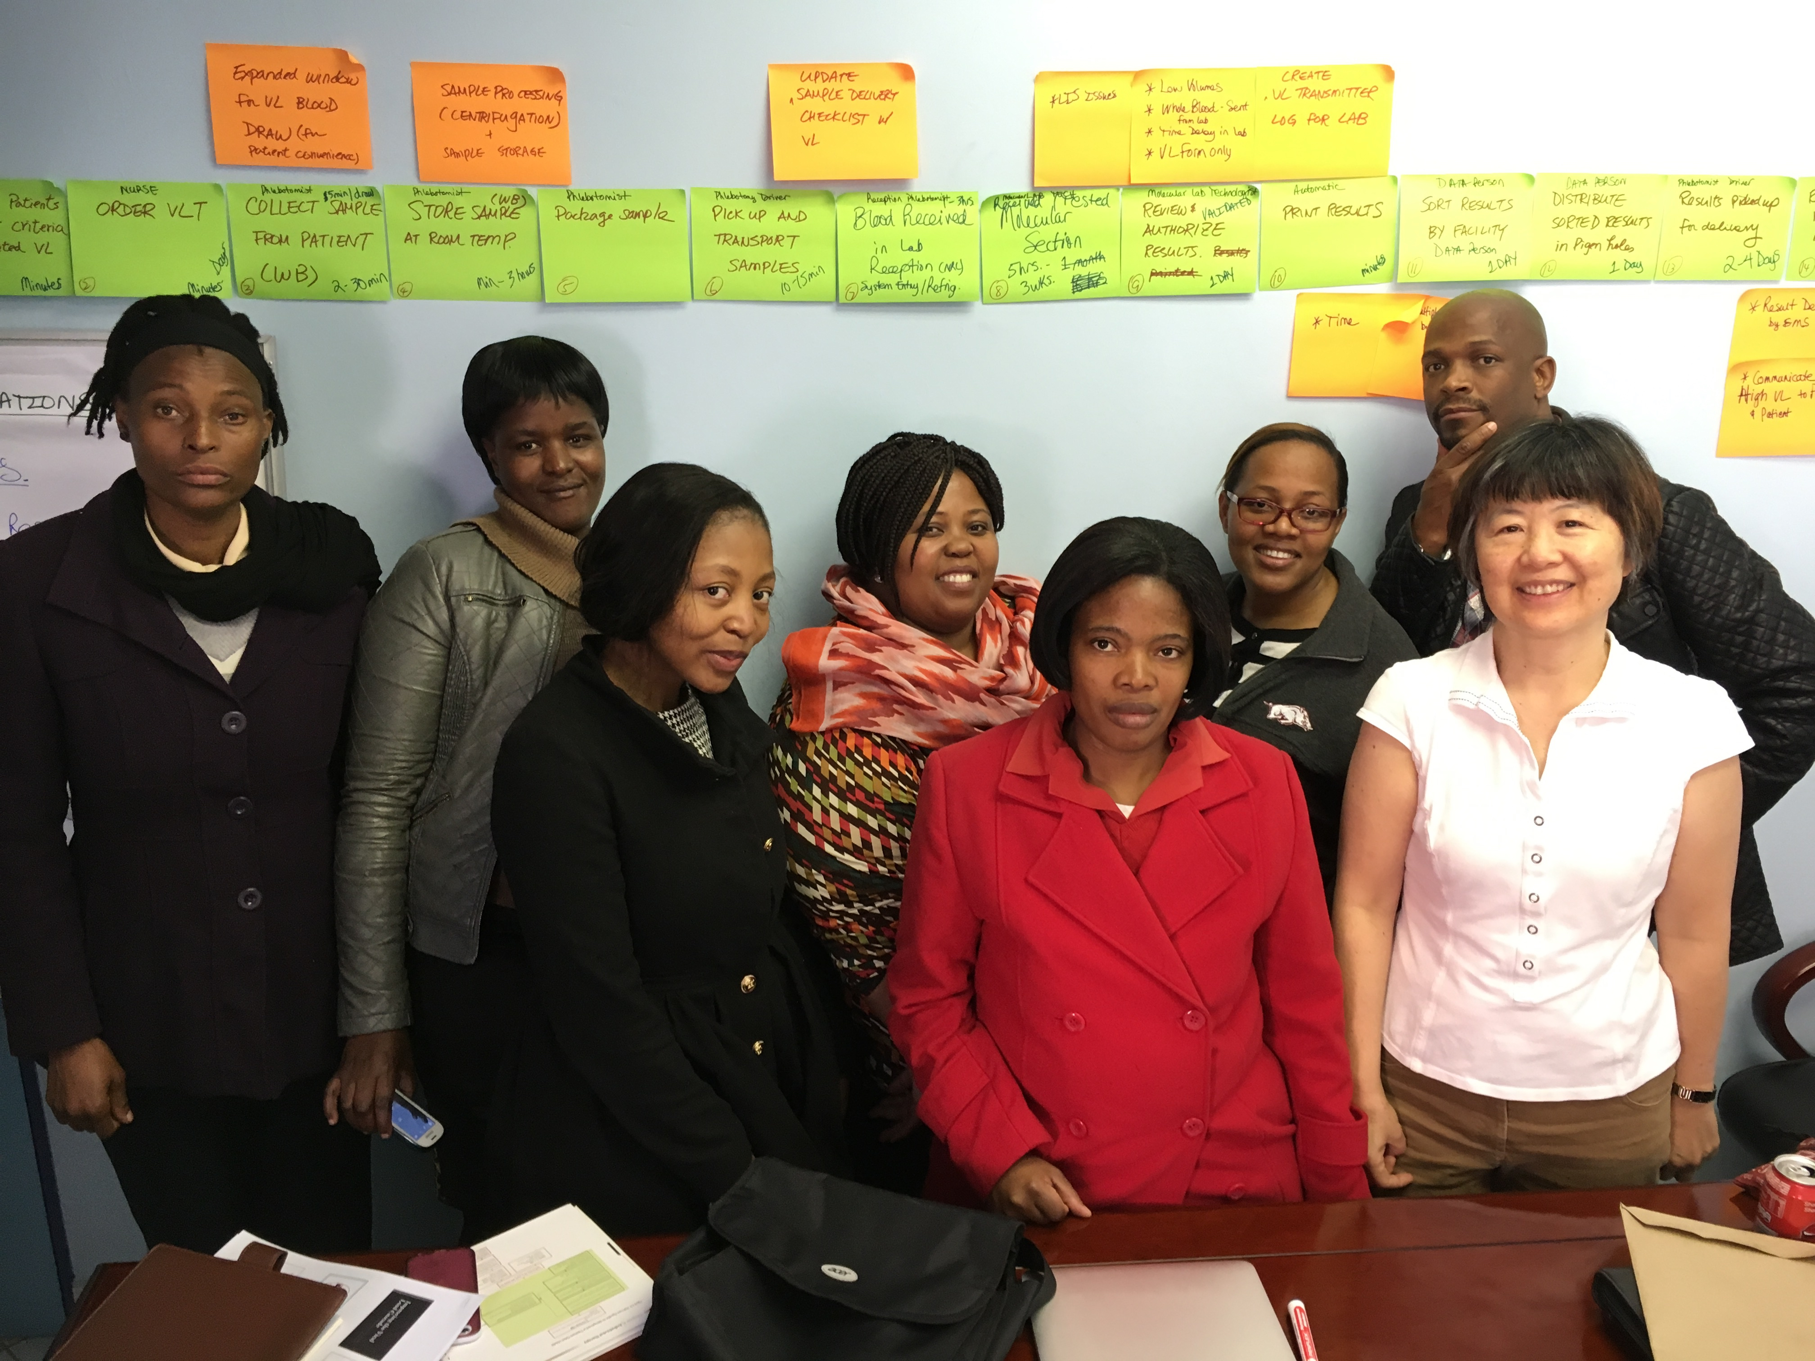
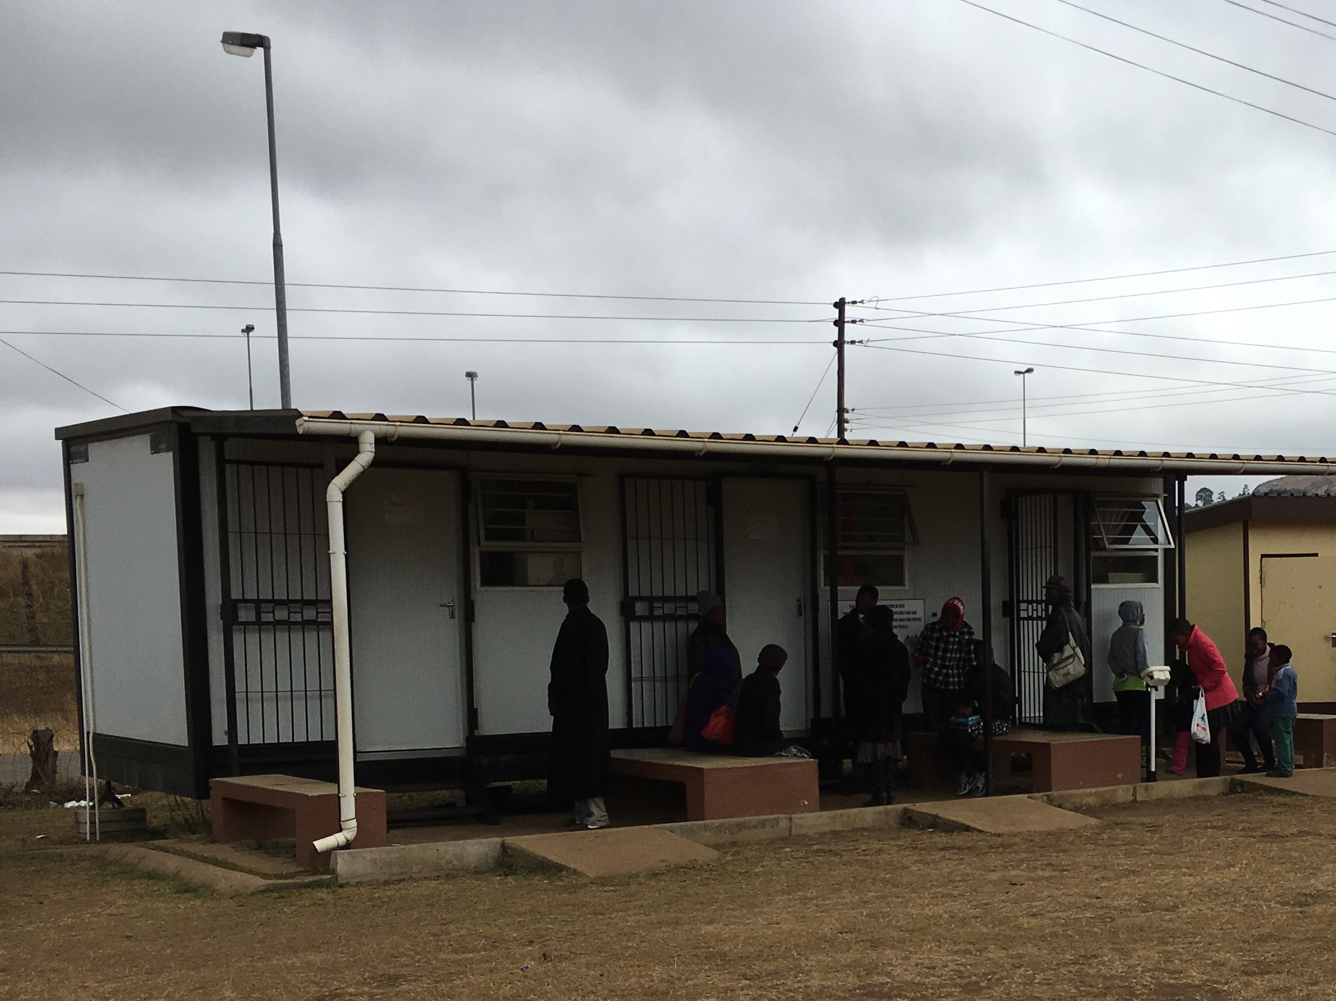
Project Kickoff – Two Day Overview
Day #1 | Day #2
Orientation Process Mapping Current State | Identify / Prioritize Opportunities For Improvement (OFI) Problem Statement
Process Mapping @ Site - Go and See | Project Implementation – Outline & Action Plan Project Communication

Slide 11
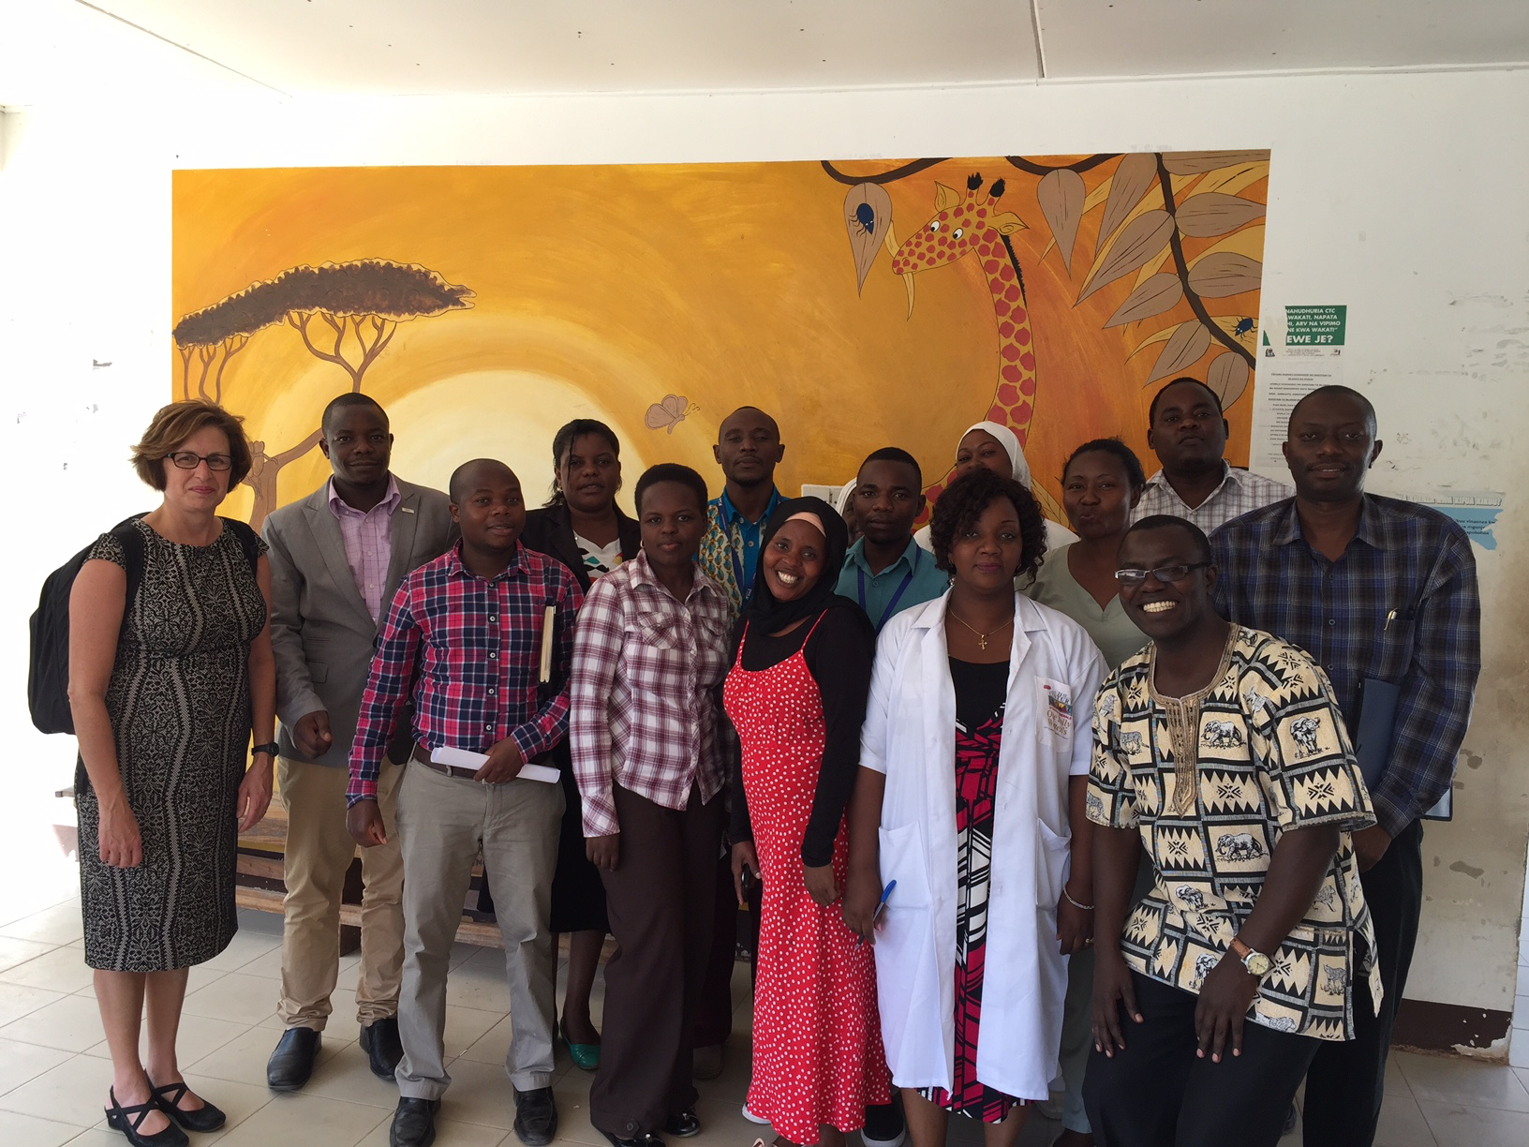
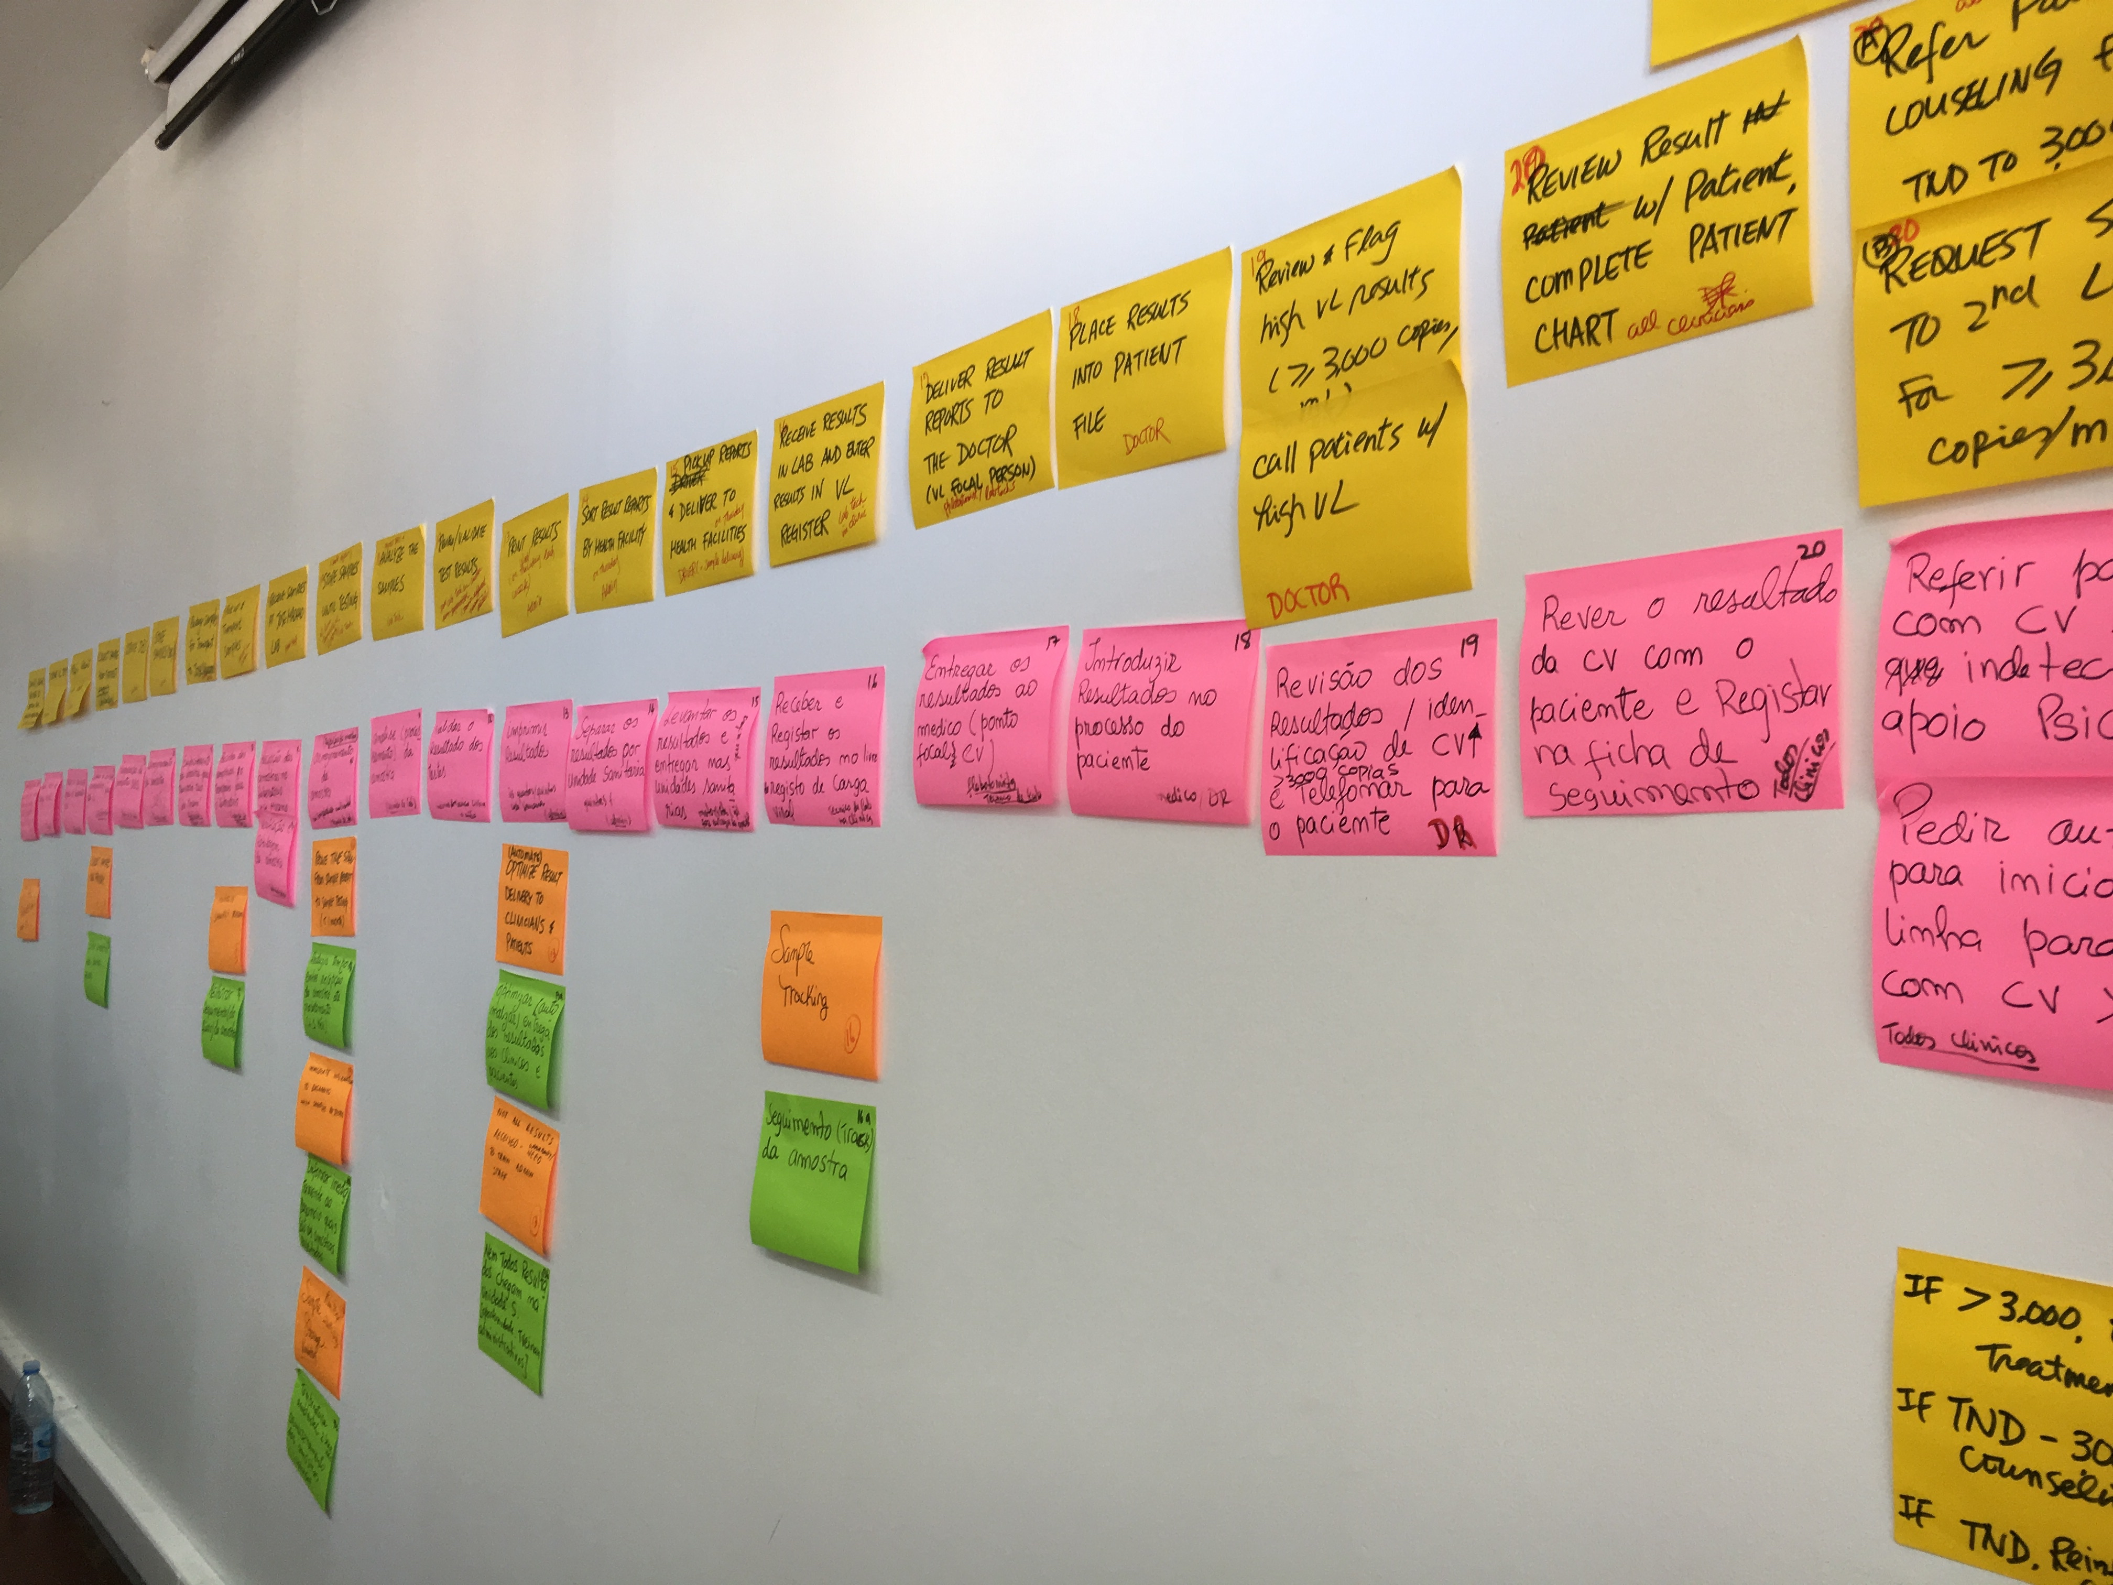
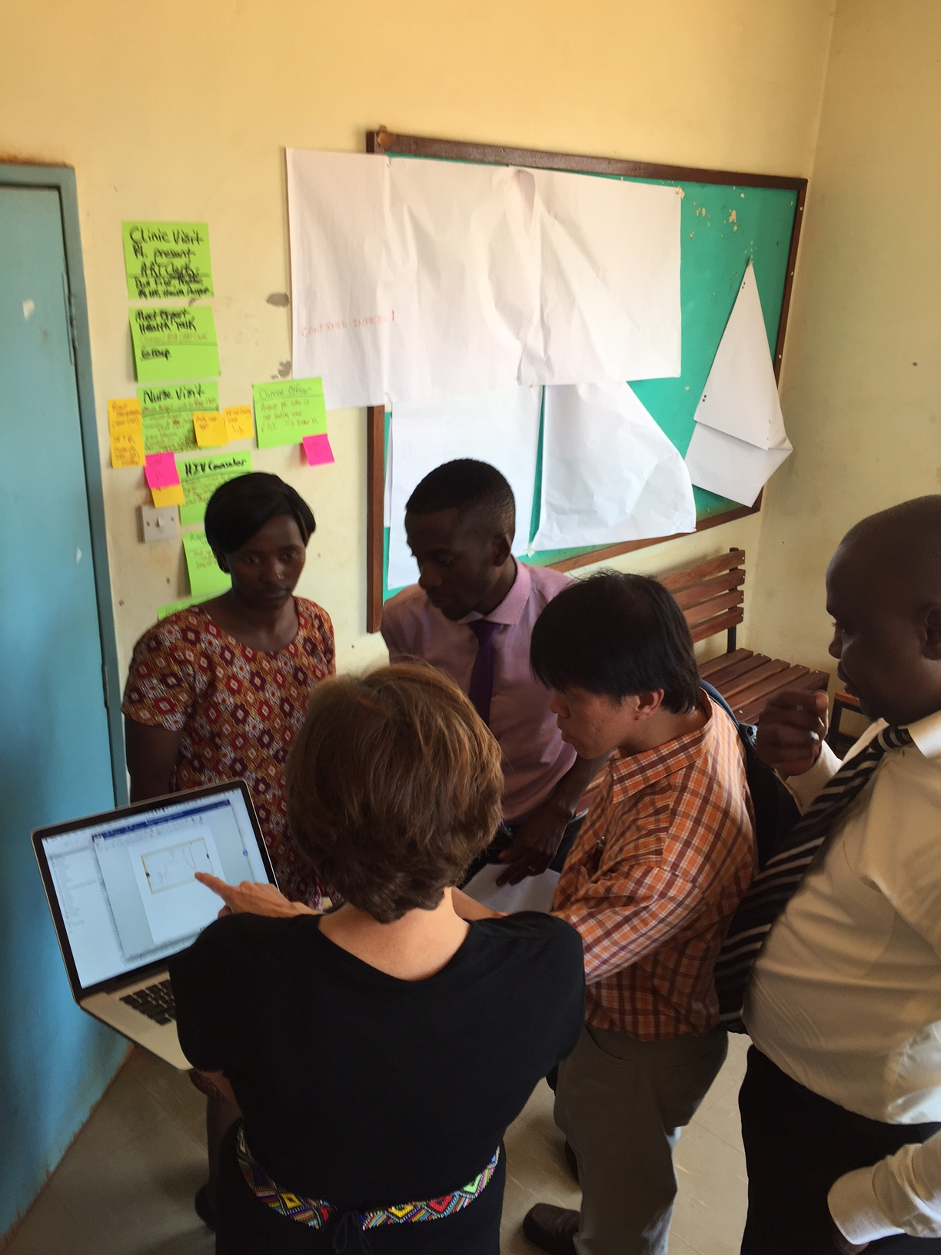
Project Kickoff – Day #1
Day #1
Overview “Start with Why” Review Viral Load Cascade Review Process Mapping
Process Mapping Current State
Process Mapping @ Site - Go and See Chart Review

Slide 12
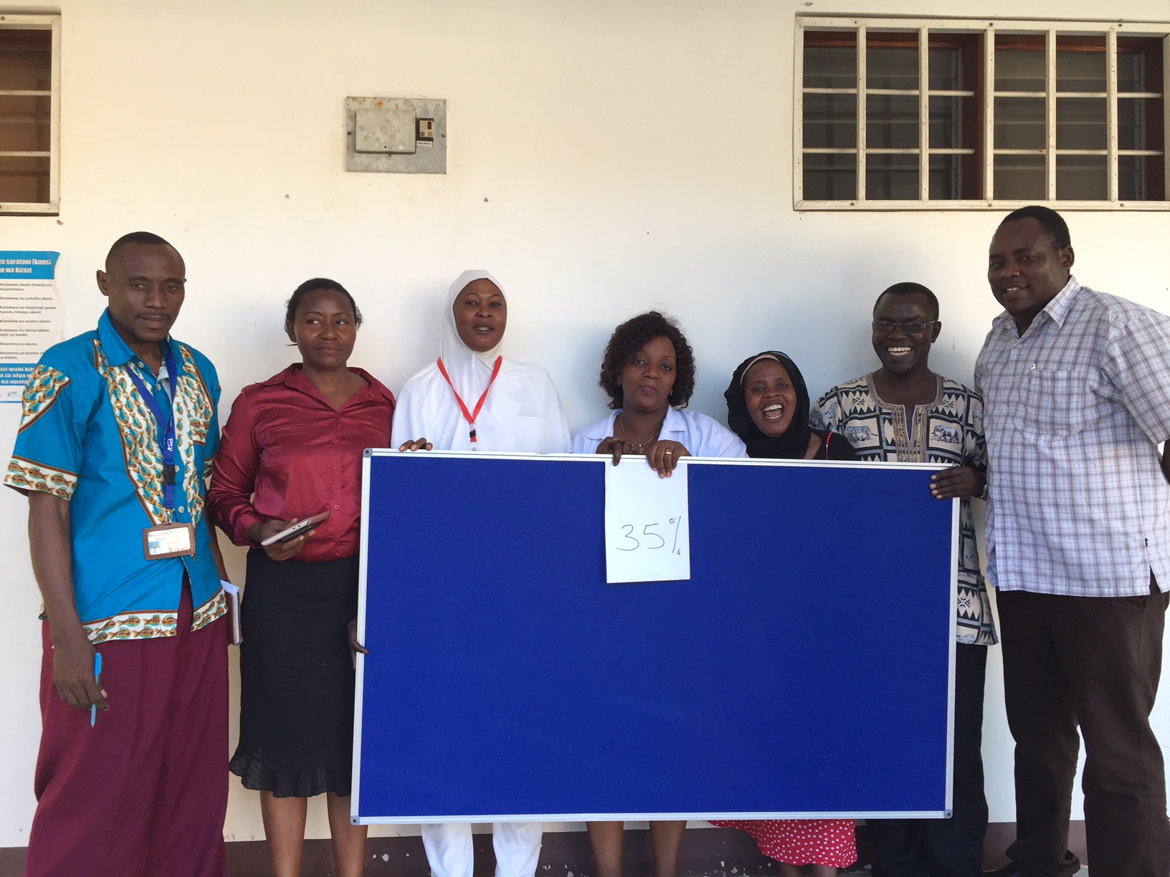
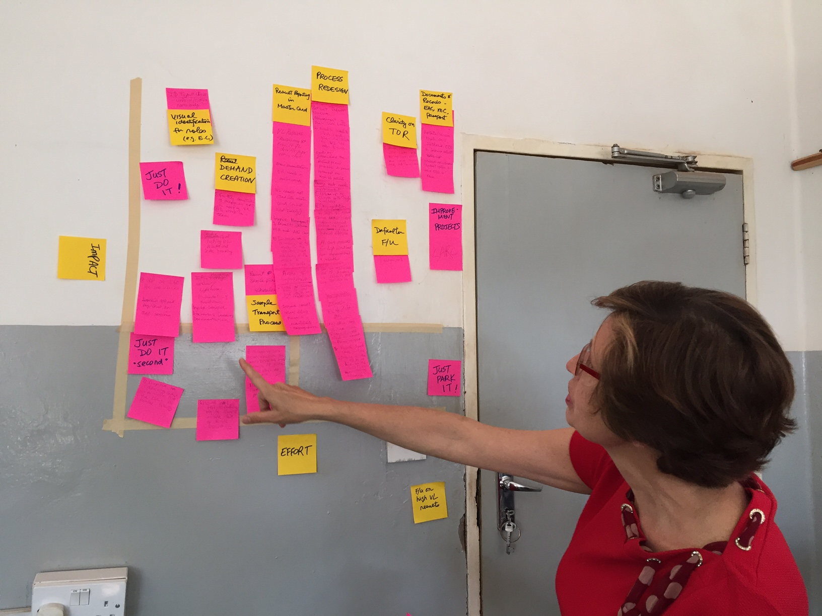
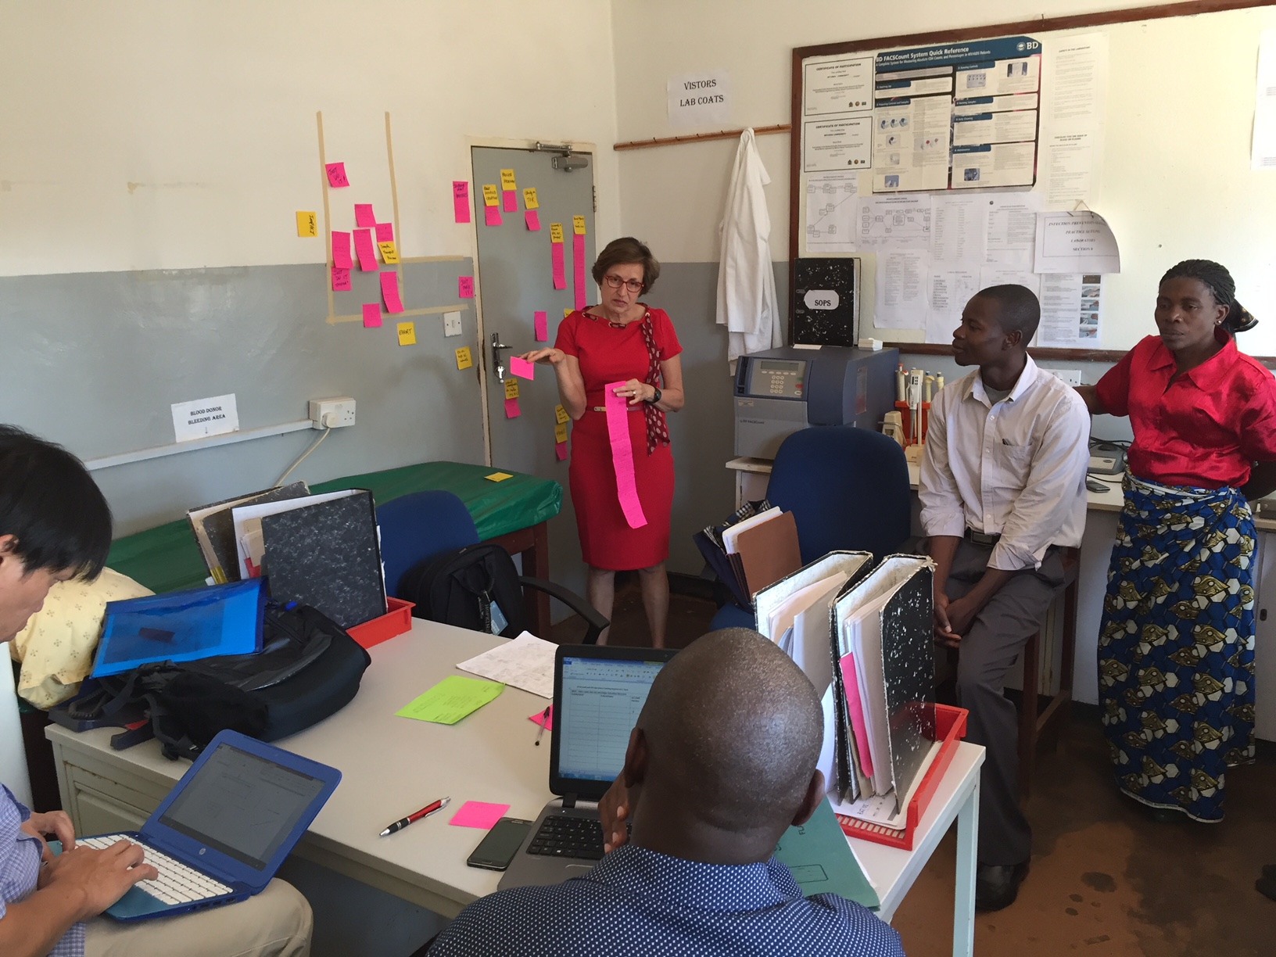
Project Kickoff – Day #2
Day #2
Identify / Prioritize Opportunities for Improvement (OFI) Problem Statement
Project Implementation - Outline & Action Plan Project Communication

Slide 13
Deliverables
See / Understand the Process
Process Map & Process Table (Current State)
Identify (Brainstorm) Opportunities For Improvement (OFI)
Prioritize (Impact-Effort Grid) OFI
Project Implementation
Project Outline
Problem Statement
Aim Statement – Goal, Measure & Timeline
Measure – Baseline Data, Data Collection Tool & Data Collection Plan
Scope of Project
Action Plan
Project Communication
Elevator Speech
Communication Plan
Notes:
Show actual documents that need to be completed.
Create checklist on flip chart – giving overview of deiiverables

Slide 14
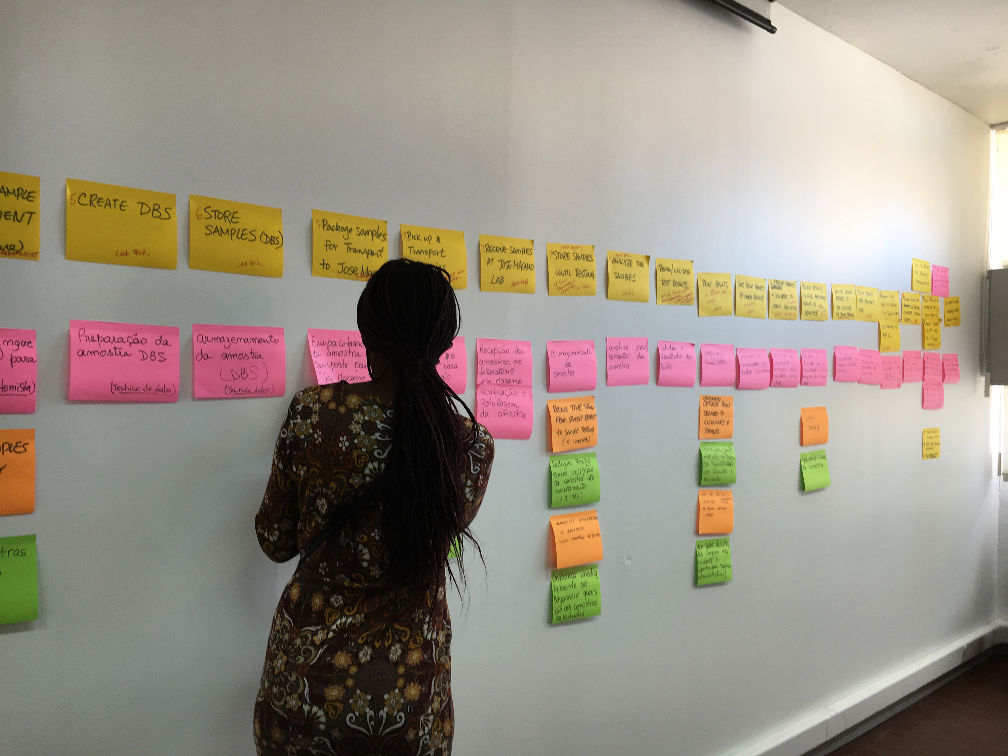
Process Mapping

Slide 15
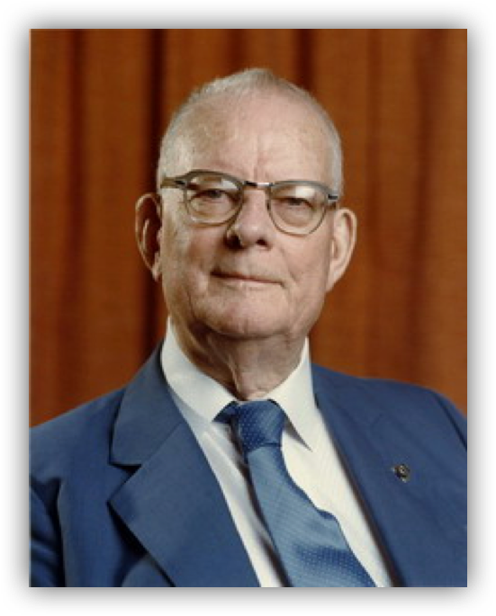
"The first step in any organization is to draw a flow diagram (process map) to show how each component depends on others. Then everyone may understand what their job is. If people do not see the process, they cannot improve it."
W Edwards Deming (1900-1993)

Slide 16
To Improve a Process
See
Understand
Improve
Notes:
WHY
To improve a process, you must first see and understand the process.
SEE
The process map is visual. Visual information is a more efficient way of communication.
UNDERSTAND
Help everyone to see the entire process and their place in the process
Clearly define the current process or variation in the process; Understand what is actually happening
Identify wasteful steps and inefficiencies
IMPROVE
Improving the process by eliminating the wasteful steps and/or reordering the steps for maximum efficiency
A visual picture of the future (improved) state PM can be created & communicated
The improved PM can be used as a tool to orient new staff & train according to new standard work

Slide 17
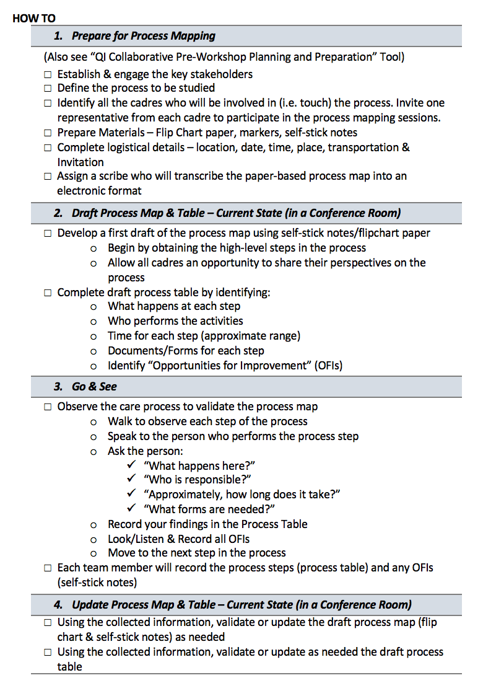
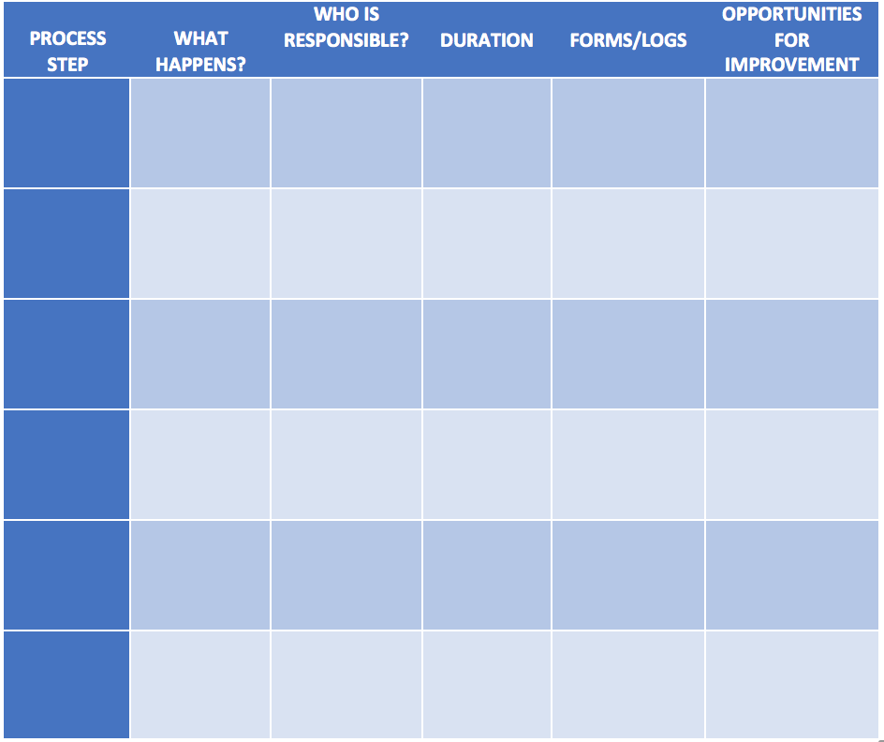
Workbook Resource: Process Mapping
Pages 38-40

Slide 18
Process mapping - A visual documentation (picture) of the sequence of steps in any process
How TO
Plan
Draft Process Map & Table
(Conference room)
Go & See
Update Process Map & Table
(Conference room)
(See Checklist in ‘Planning for Process Mapping’ tool for complete details)
Establish & engage the key stakeholders
Define the process to be studied
Identify all the cadres who will be involved in (i.e. touch) the process. Invite one representative from each cadre to participate in the PM sessions.
Prepare/Organize/Invite for the PM Session
Develop a first draft of the process map using post-it-notes initially
Begin by obtaining the high-level steps in the process
Allow all cadres an opportunity to share their perspectives on the process
Complete draft process table by identifying:
What happens at each step
Who performs the activities
Time for each step (approximate range)
Documents/Forms for each step
Identify “Opportunities for Improvement” (OFIs)
Observe the care process to validate the process map
Walk to observe each step of the process
Speak to the person who performs the process step
Ask the person:
“What happens here?”
“Who is responsible?”
“Approximately, how long does it take?”
“What forms are needed?”
Record your findings in the Process Table
Look/Listen & Record all OFIs
Move to the next step in the process
Each team member will record the process steps (process table) and any OFIs (post-it-notes)
Using the collected information, validate or update as needed the draft process map
Using the collected information, validate or update as needed the draft process table
Create an electronic version of the Process Table (e.g., PowerPoint or Visio)
Circulate to team members to assure accuracy and a clear representation of the current process
Tips
Capturing the current state - Use pose-it notes on flipchart paper to facilitate discussion and modification until an accurate “picture” of the current process is captured. If you need to send the process map to someone, take a picture of the flipchart and email it.
Tip on time management (how not to get distracted)

Slide 19
Process Mapping
Step 1 – Process Steps (Classroom)
Develop a first draft of the process map using post-it-notes initially
Begin by obtaining the high-level steps in the process
Allow all cadres an opportunity to share their perspectives on the process
Complete draft process table by identifying:
What happens at each step
Who performs the activities
Time for each step (approximate range)
Documents/Forms for each step
Identify “Opportunities for Improvement” (OFIs)

Slide 20
Process Mapping
Step 2 – Go & See (Clinic)
Observe the care process to validate the process map
Walk to observe each step of the process
Speak to the person who performs the process step
Ask the person:
“What happens here?”
“Who is responsible?”
“Approximately, how long does it take?”
“What forms are needed?”
Record your findings in the Process Table
Look/Listen & Record all OFIs
Move to the next step in the process
Each team member will record the process steps (process table) and any OFIs (post-it-notes)

Slide 21
Process Mapping
Step 3 – Update Process Map
Using the collected information, validate or update as needed the draft process map
Using the collected information, validate or update as needed the draft process table
Create an electronic version of the Process Table (e.g., PowerPoint or Visio)
Circulate to team members to assure accuracy and a clear representation of the current process

Slide 22
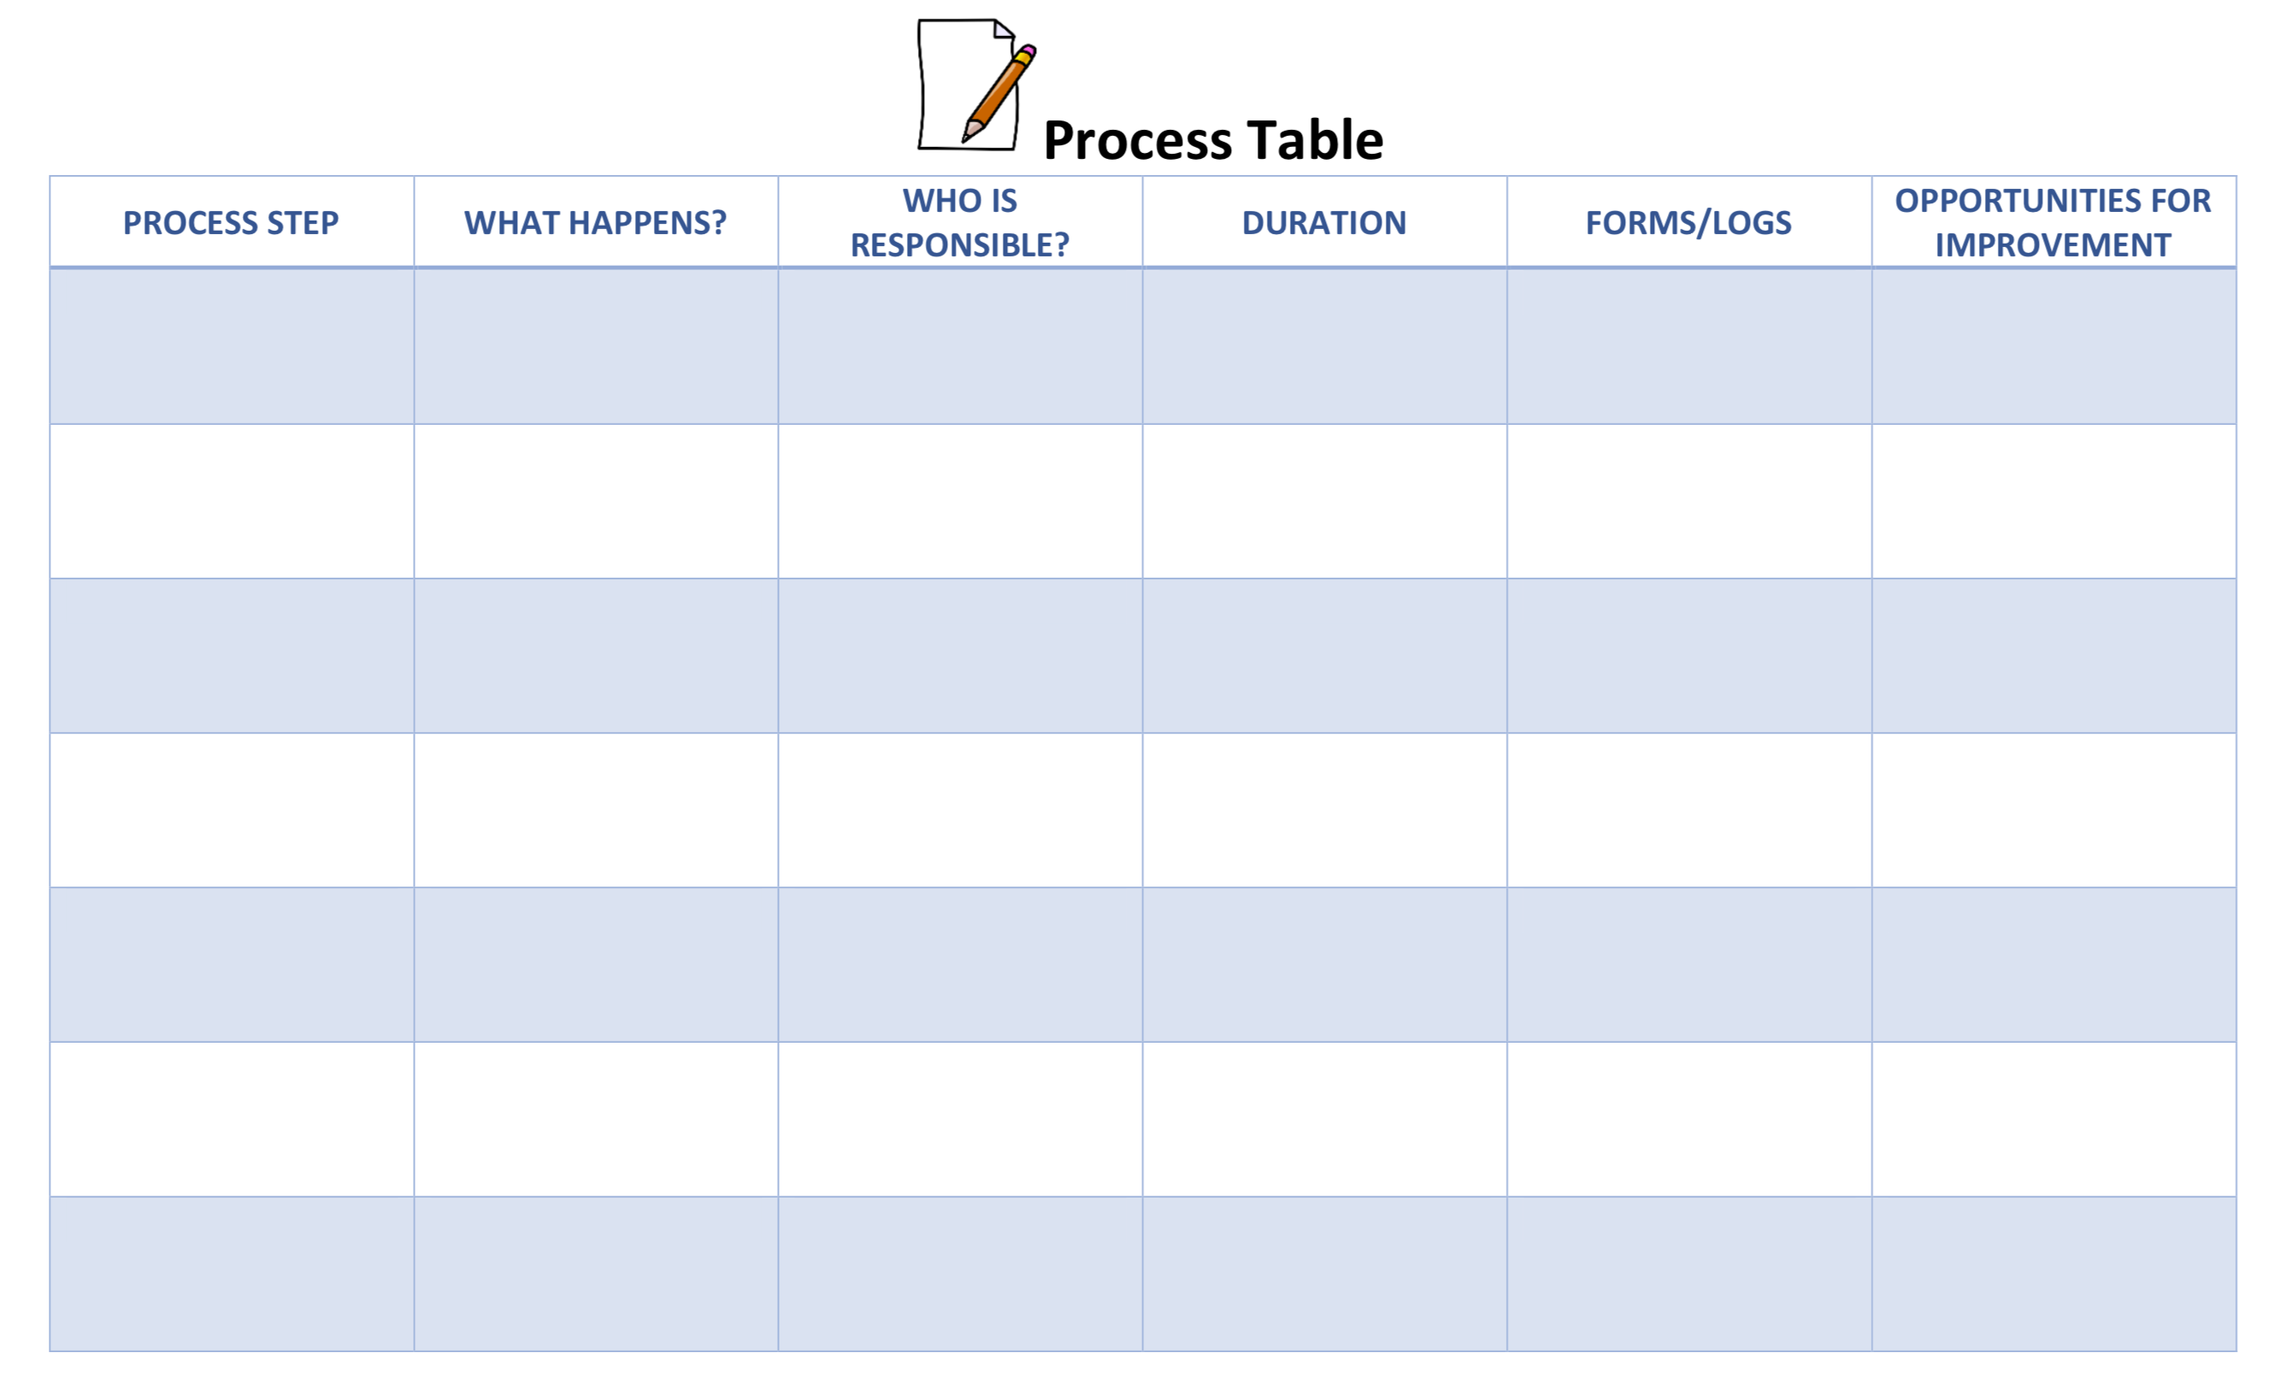

Slide 23
Process Maps
Current State
Future State

Slide 24
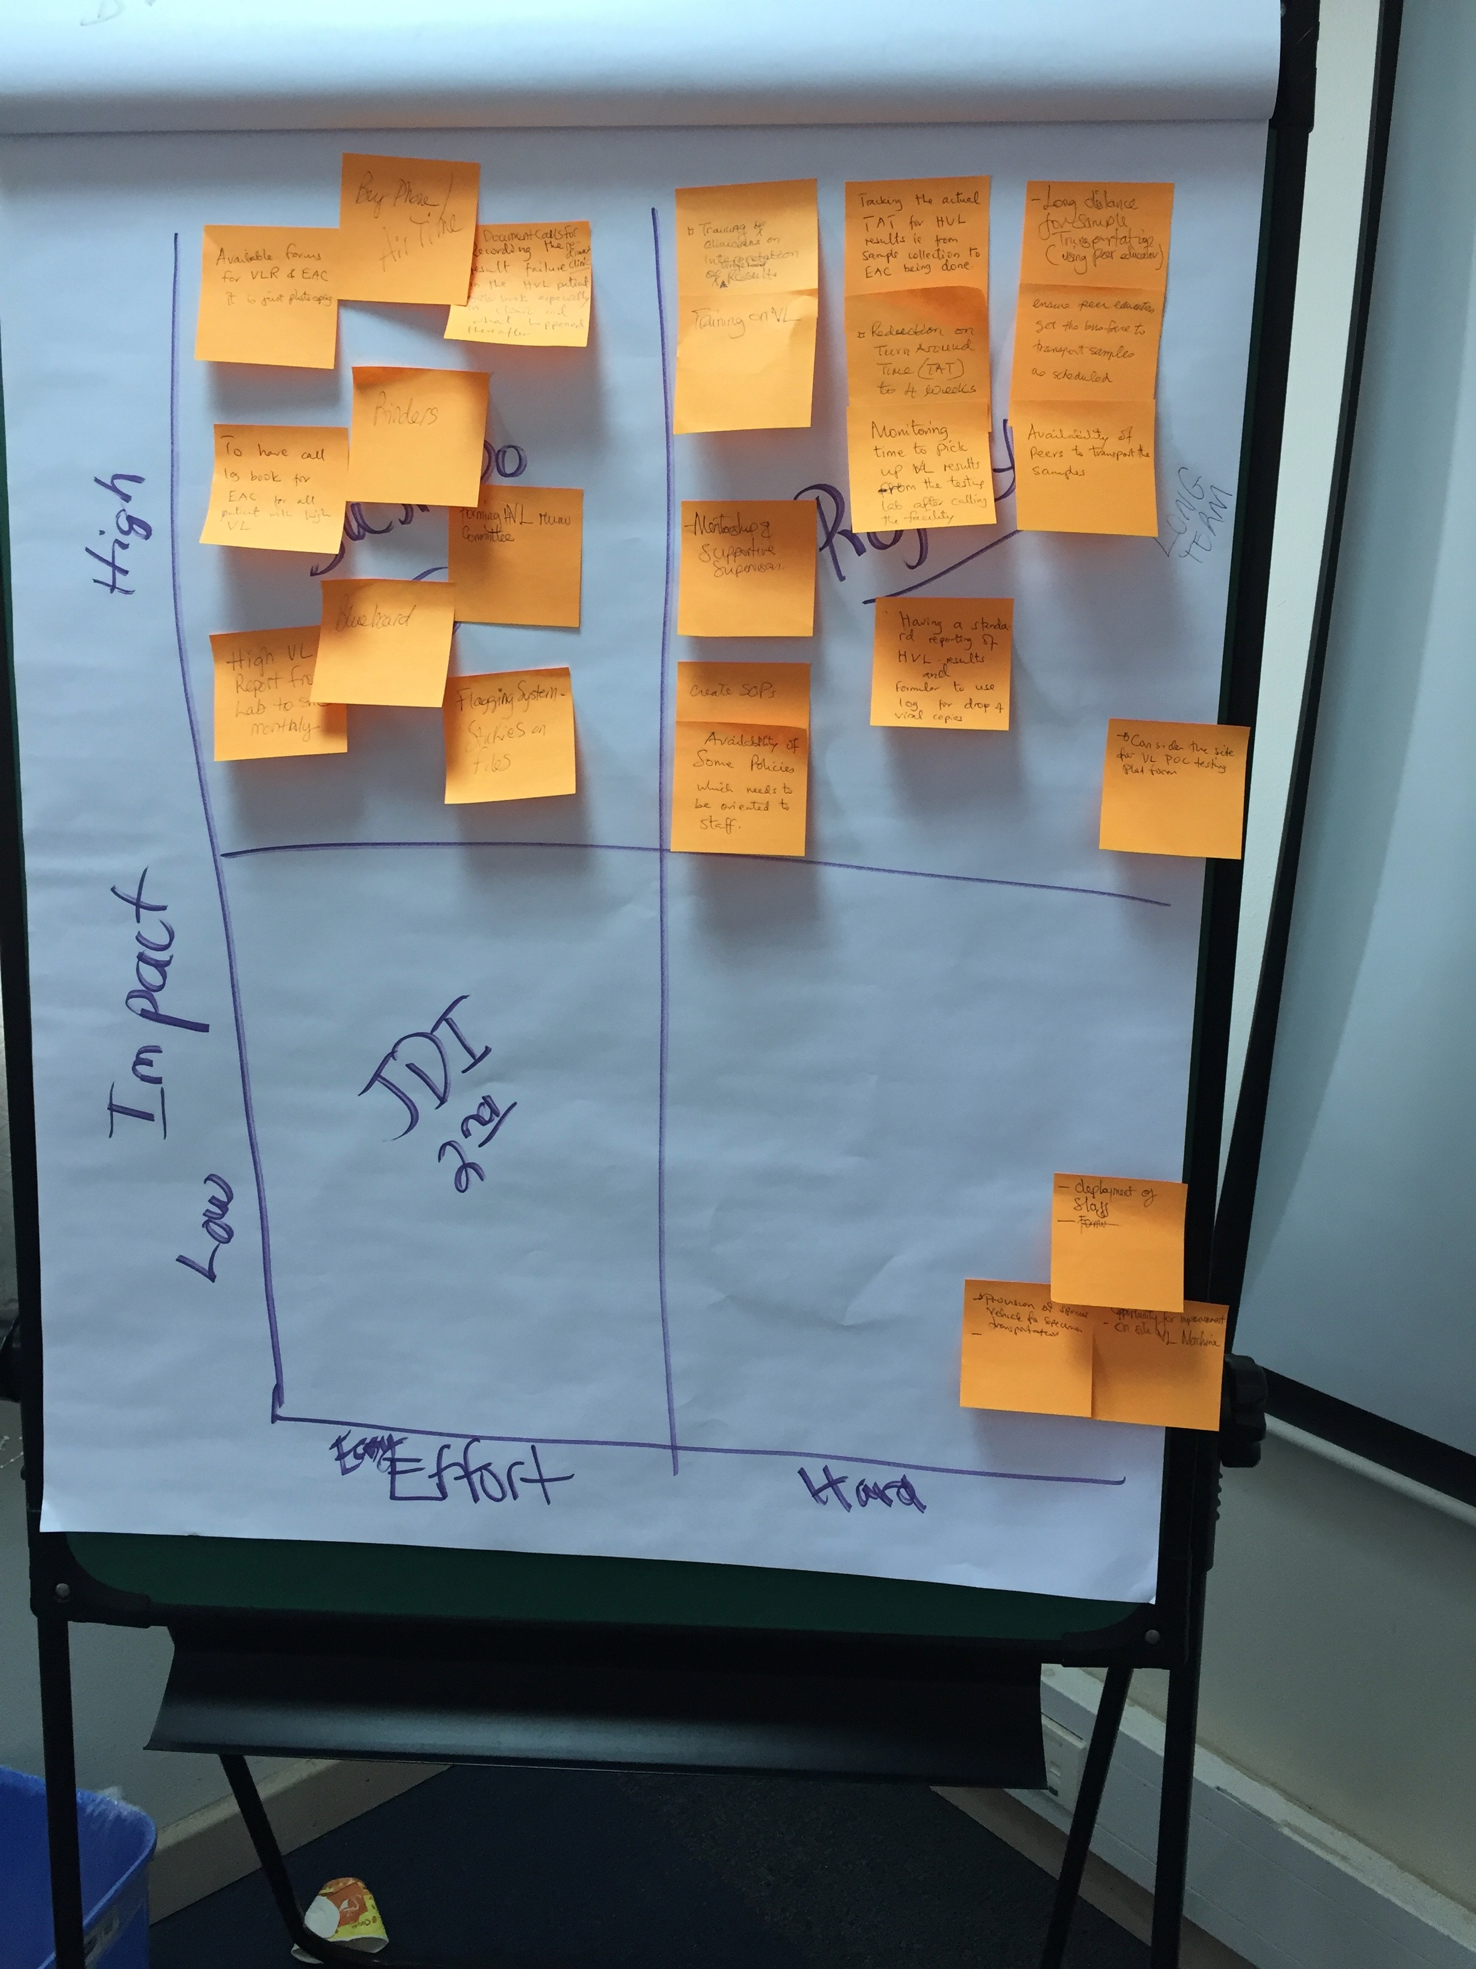
Brainstorming → Affinity Diagram → Impact-Effort Grid

Slide 25
IMPACT / EFFORT GRID A Tool for Prioritizing Opportunities
Projects - Detailed planning and work
Major
Improvement
Just Do It
IMPACT
Just Do It if Impactful
Maybe some day
Minor
Improvement
Easy to Do
Difficult to Do
EFFORT

Slide 27
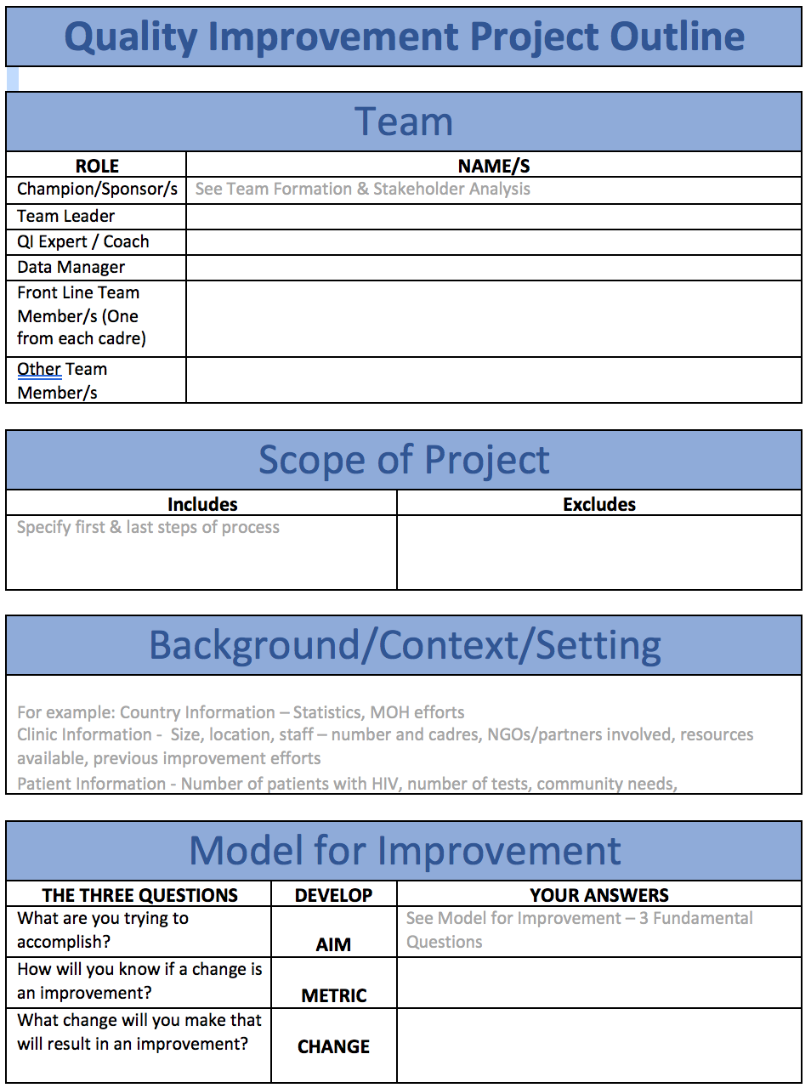
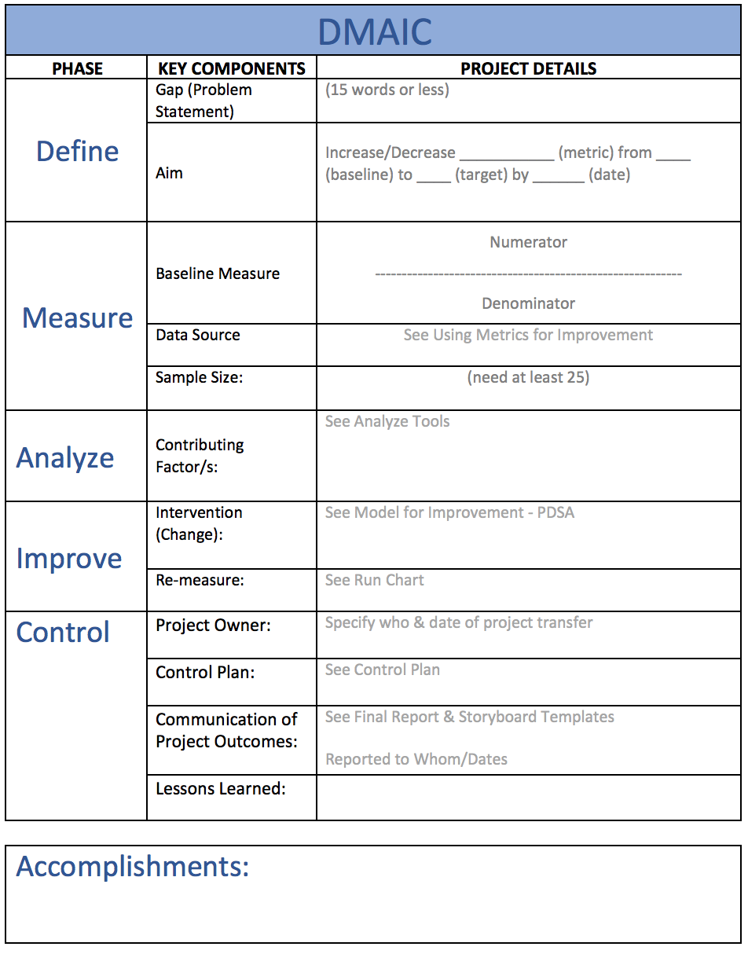

Slide 28
Ask 3 Questions – The Model for Improvement
AIM
What are you trying to accomplish?
METRIC
How will you know if a change is an improvement?
CHANGE
What change will you make that will result in an improvement?

Slide 29
Aim Statement
Improve (increase, decrease) _______ (metric) from _____ to ____ by ________ (date).
Do What, by When?

Slide 30
Getting to your aim statement and metric
Accomplish?
Measure?
Accomplish?
Measure?
An iterative process

Slide 31
Getting to your aim statement and metric
Accomplish?
Measure?
Accomplish?
Measure?
Goal = All patients viral load suppressed
An iterative process
Can I measure that given the time frame of this project?
Goal = High viral load results clinically acted upon
What does that mean?
How am I going to measure that?
What is my numerator & denominator?

Slide 32
Create a Data Collection Tool/Log
Workbook, p. 50-53

Slide 33
Create a Data Collection Plan
Workbook, p. 54

Slide 34
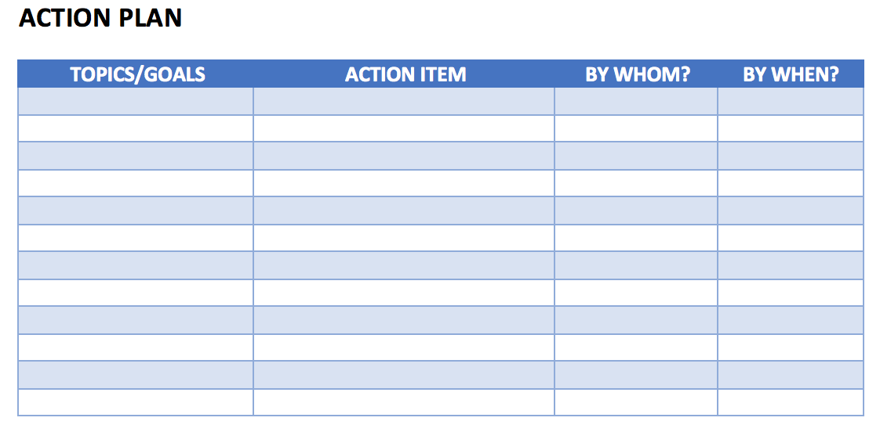
Action Plan

Slide 35
Elevator Speech
This project is about __________________________________________
As a result of these efforts, __________________________________________
It’s important because we are concerned about:
____________________
____________________
Success will be measured by showing improvement in:
____________________
____________________
What we need from you (Specify to whom)
______________________________

Slide 36
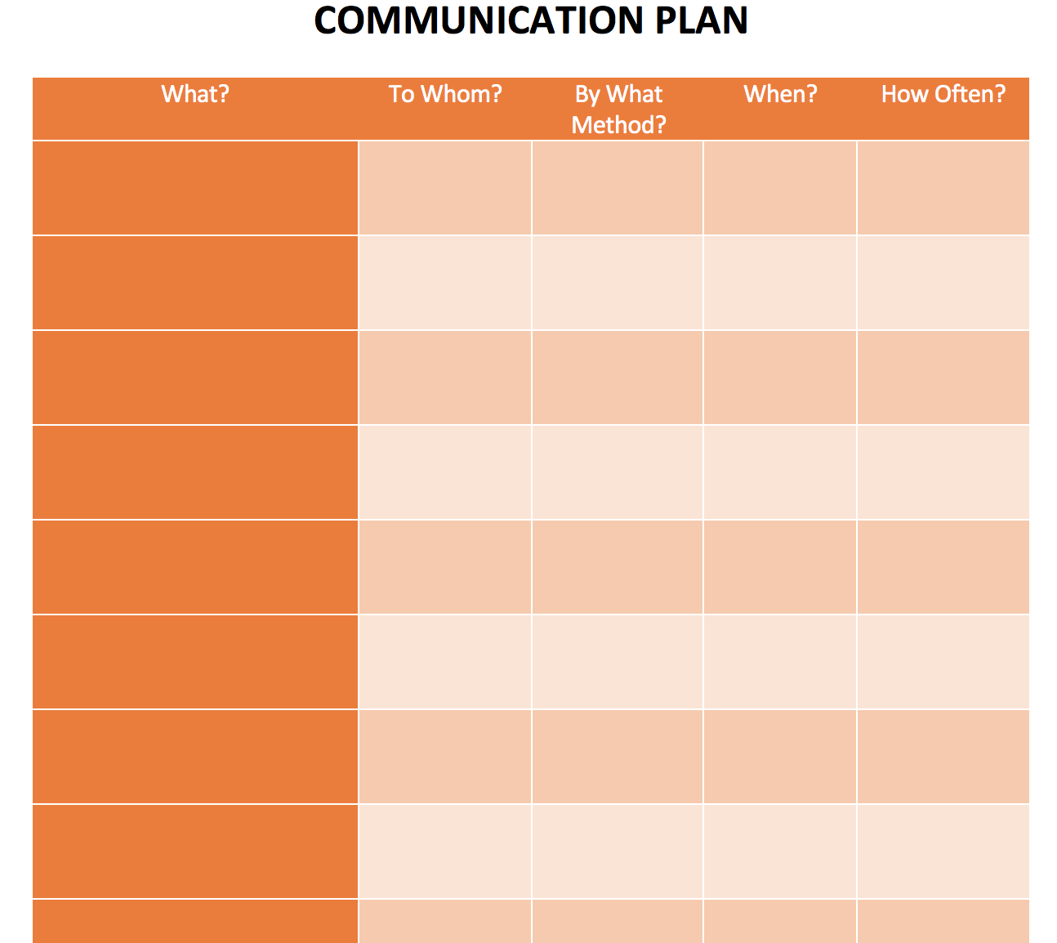
Communication Plan

Slide 37
Deliverables
See / Understand the Process
Process Map – Current State
Identify (Brainstorm) Opportunities For Improvement (OFI)
Prioritize (Impact-Effort Grid) OFI
Project Implementation
Project Outline
Problem Statement
Aim Statement – Goal, Measure & Timeline
Measure – Baseline Data, Data Collection Tool & Data Collection Plan
Scope of Project
Action Plan
Project Communication
Elevator Speech
Communication Plan

