Slide 1
LARC Quality Improvement Collaborative
Introductory Webinar:
Need-to-Know Information to Prepare for LARC
LARC

Slide 2
Introductory Webinar
For TODAY
LARC Collaborative Overview
Why?
What?
Quality Improvement
Guiding Principles
Model for Improvement
DMAIC
Metrics/Measurement
Preparation for Smart Start (On-site Session) / Process Mapping
Stakeholder Analysis
Team Formation
Planning Timeline
Pre-preparation for on-site session

Slide 3
WHY
Notes:
Why does quality matter?

Slide 4
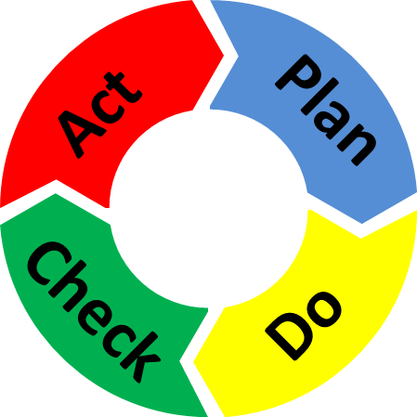
Quality Improvement is all about CHANGE!
Old Process
Tests of CHANGE
Sustain the New CHANGE
Implement the New CHANGE
Notes:
The skeleton of the Quality Improvement process…

Slide 5
The great aim of education is not knowledge, but action!
Herbert Spencer

Slide 6
Purpose/Expectations: To create an improvement culture where team members understand and utilize practical QI tools:
to successfully complete a QI project
and
to make continuous process improvement the way you work for the future!

Slide 7
Embed Improvement in your DNA

Slide 8
LARC = Measurable RESULTS
Results from 6 countries – 2016-2017
Notes:
WHY – Because LARC is proven to be effective in creating improvement!

Slide 9
To increase the percentage of viral load samples collected from eligible patients from 45% (Jul 2016) to 80% by Aug 2017
To increase the percentage of viral load tests ordered for eligible patients from 0% (July 2016) to 80% by June 2017 in CPN, CCR, and ARV clinics
To increase the percentage of patients with viral load results placed in their files from 4% (October 2016) to 80% by June 2017
Mozambique
Malawi
Kenya
LARC Project
spread to
all Clinic
Clinician Education
All Clinic
Clinic Director Follow-up
Clinician Education began
Nationwide HCW strike
To increase the percentage of high viral load patients with documented timely follow-up from 12% (average from Dec’15 to June ‘16) to 80% by June 2017
To increase the percentage of high VL patients with a documented return visit from 35% (Oct 2016) to 100% by June 2017
To increase the percentage of high VL patients 1) contacted ≤ 1 week after results receipt from 27% to 90%, and 2) initiated with IAC ≤ 1 month from 6% to 90% between June 2016 and June 2017
Swaziland
Tanzania
Uganda
Baseline
HVL register implemented
IAC forms implemented
HVL stickers on patient files

Slide 10
WHAT
Notes:
Next, let’s discuss WHAT… WHAT is LARC…

Slide 11
Quality Improvement Overview
Old Process
Tests of CHANGE
Implement the New CHANGE
Sustain the New CHANGE
Define
Measure
Analyze
Improve
Control
Notes:
Adding in elements of the Quality Improvement process… This is an introductory overview. You will see this again. It will all become clearer. For now…
DMAIC – the framework for approaching quality improvement
PDSA – a very useful and essential QI tool

Slide 12
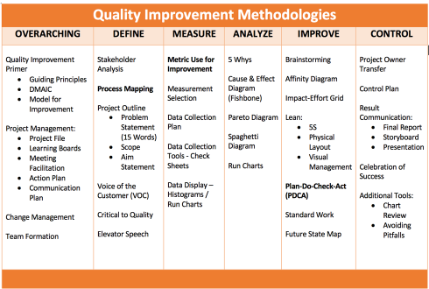
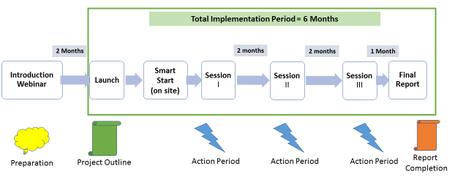
Curriculum + Delivery Model = Outcome
Curriculum
Program Delivery Model
QI Concepts/Skills
WORKBOOK
(QI TOOLS)
Notes:
LARC – 2 components
The educational content, - material, tools, concepts, skills = the curriculum – includes the content – delivered by PPT, and the Playbook – the resource for tools
The model of delivery - # of sessions, timing of sessions, action periods – all = The Delivery Model

Slide 13
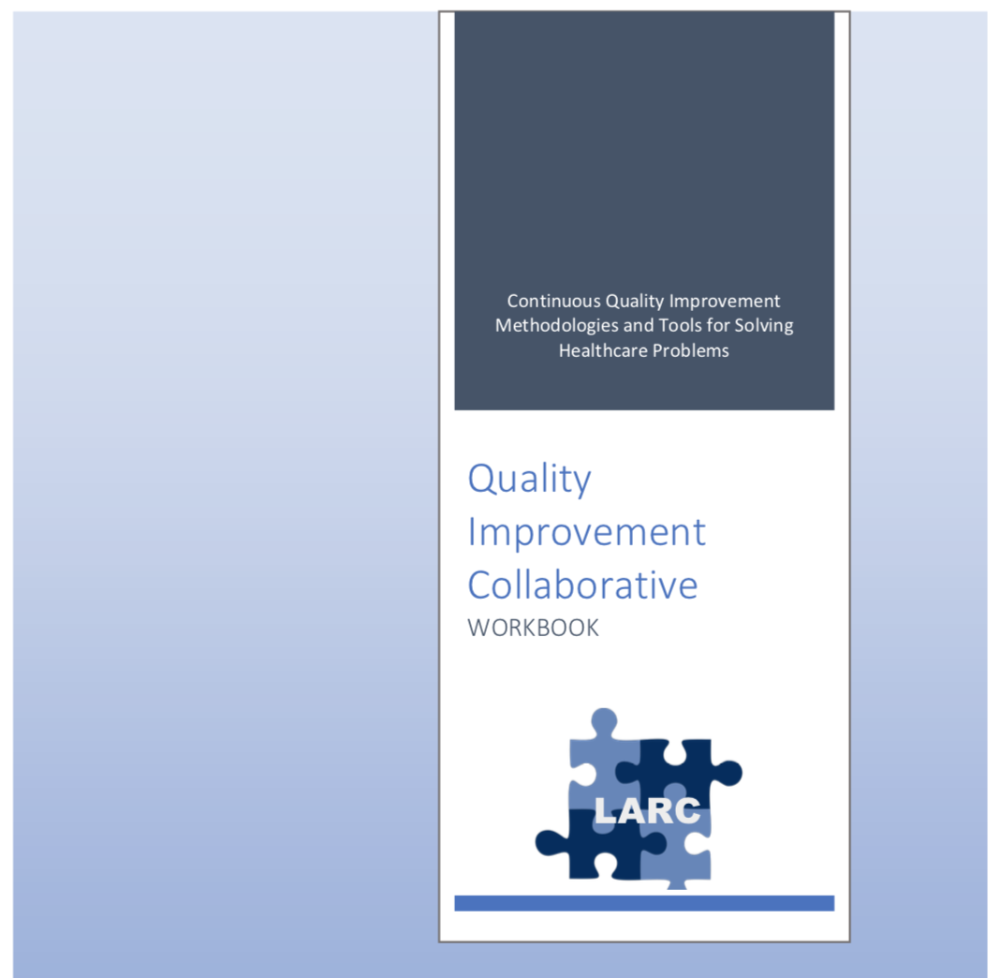
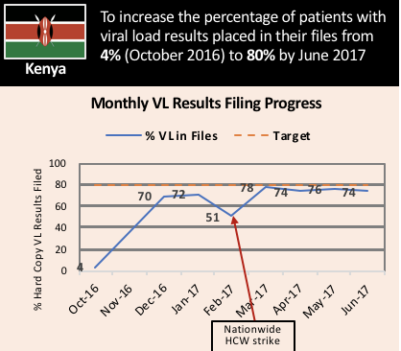
What is LARC? African Regional Improvement Collaborative focused on the Laboratory-Clinic Interface
LARC
Bringing together multidisciplinary clinical teams to improve any process or system
CURRICULUM: Quality Improvement (QI) Methodologies |  | DELIVERY MODEL: Learning Collaborative |  | OUTCOME
Focused on QI concepts, skills, tools & implementation 30+ QI Tools with Templates Coordinated step-by-step guidance through project Just-in-time training to produce QI project deliverables |  | Introductory Webinar 4 Learning Sessions – 1 On-Site Delivered over 6-9 months Action Periods Interspersed for Project Implementation Mentoring & Coaching Site Visits Learning shared among collaborative members |  | Improved Healthcare Delivery – Safer, higher-quality, client-centered Successfully Completed Project/s - Result-driven Embedded QI Concepts & Skills → Culture of Improvement

Slide 14
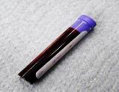
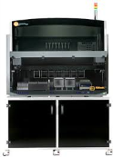
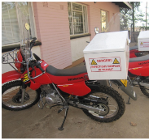
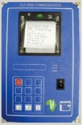
LARC = African Regional Improvement Collaborative
LARC
The Viral Load Cascade
Bringing together the laboratory and clinical cadres to implement and scale up HIV viral load testing
Demand Creation for Testing
Specimen Collection & Processing
Sample Transport
Laboratory Testing
Result Reporting & Interpretation by Clinician
Patient Management

Slide 15
LARC 2.0
What stays the same – from LARC 1.0
What changes - LARC 2.0
Focus on the lab-clinic interface
Emphasis on holistic approach to address health system issues
Collaborative Model = Learning Sessions followed by Action Periods
‘Viral Load Cascade’ Focus
Curriculum – Standardized Knowledge
Prerequisites
Deliverable focused
CONTENT - All New PowerPoint Presentation, Additional Tools
WORKBOOK (Tool Resource)
Delivery Model
Timeframe
Pre-training Preparation – New Webinar
New On-Site Session
Accountability/Follow-Up
Focus on Scalability
Notes:
Reminder – the basic values of LARC remain unchanged
Over the next few minutes, I will describe the new elements in the following categories:
Curriculum
Delivery Model
Scalability

Slide 16
STOP & SUMMARIZE
WHAT
WHY

Slide 17
Curriculum
Prerequisites
Deliverable-focused
CONTENT (PowerPoint)
WORKBOOK (Resource)
Notes:
The curriculum is the educational content of the program – the concepts, tools, skills, etc.
We will cover these 4 elements of the Curriculum next.

Slide 18
Prerequisites*
Assuring a standardized QI Knowledge
Prerequisites – Seven (7) Mandatory Courses
For Country Leads & Coaches
Improvement Capability
QI 101: Introduction to Health Care Improvement (1hr:15 min) QI 102: How to Improve with the Model of Improvement (1hr:30 min) QI 103: Testing and Measuring Changes with PDSA Cycles (1hr:15 min) QI 104: Integrating data: Run Charts, Control Charts, and other Measurement Tools (1hr:30 min) QI 105: Leading Quality Improvement (1hr:15 min) QI 201: Planning for Spread, From Local Improvement to System-wide Change (1hr:15 min)
Leadership
L 101: Introduction to Health Care Leadership (1hr:15 min)
* From the Institute for Healthcare Improvement (IHI) Open School - http://www.ihi.org
Notes:
Important implications for in-country LARC leads, faculty, and site mentors

Slide 19
DELIVERABLE-FOCUSED
Project Deliverables
On-Site / Session 1
DEFINE / MEASURE / ANALYZE
Session 2
IMPROVE
Session 3
CONTROL
Identify Stakeholders
Team Formation
Map the Process (Current)
ID / Prioritize Opportunities
Project Outline
Baseline Metrics - Data Collection Tool/Plan
Action Plan
Elevator Speech
VOC Information
Root Cause Analysis
1 Rapid/Small Test of Change (PDSA)
Presentation
Update Project Outline, if necessary
1 5S Exercise
1 Visual Management Application
2 or more Tests of Change (PDSA)
Select and Implement Change
Modify Solution(s) where necessary by additional Test of Change (PDSA)
Create Future State Map
Standard Work
Presentation
Update Project Outline, if necessary
Validate Solution(s) / Interventions
Create Control Plan
Transfer to Operational Owner
Share/Spread Intervention, if applicable
Final Presentation
Project Champion
Notes:
Just in Time training to accomplish deliverables

Slide 20
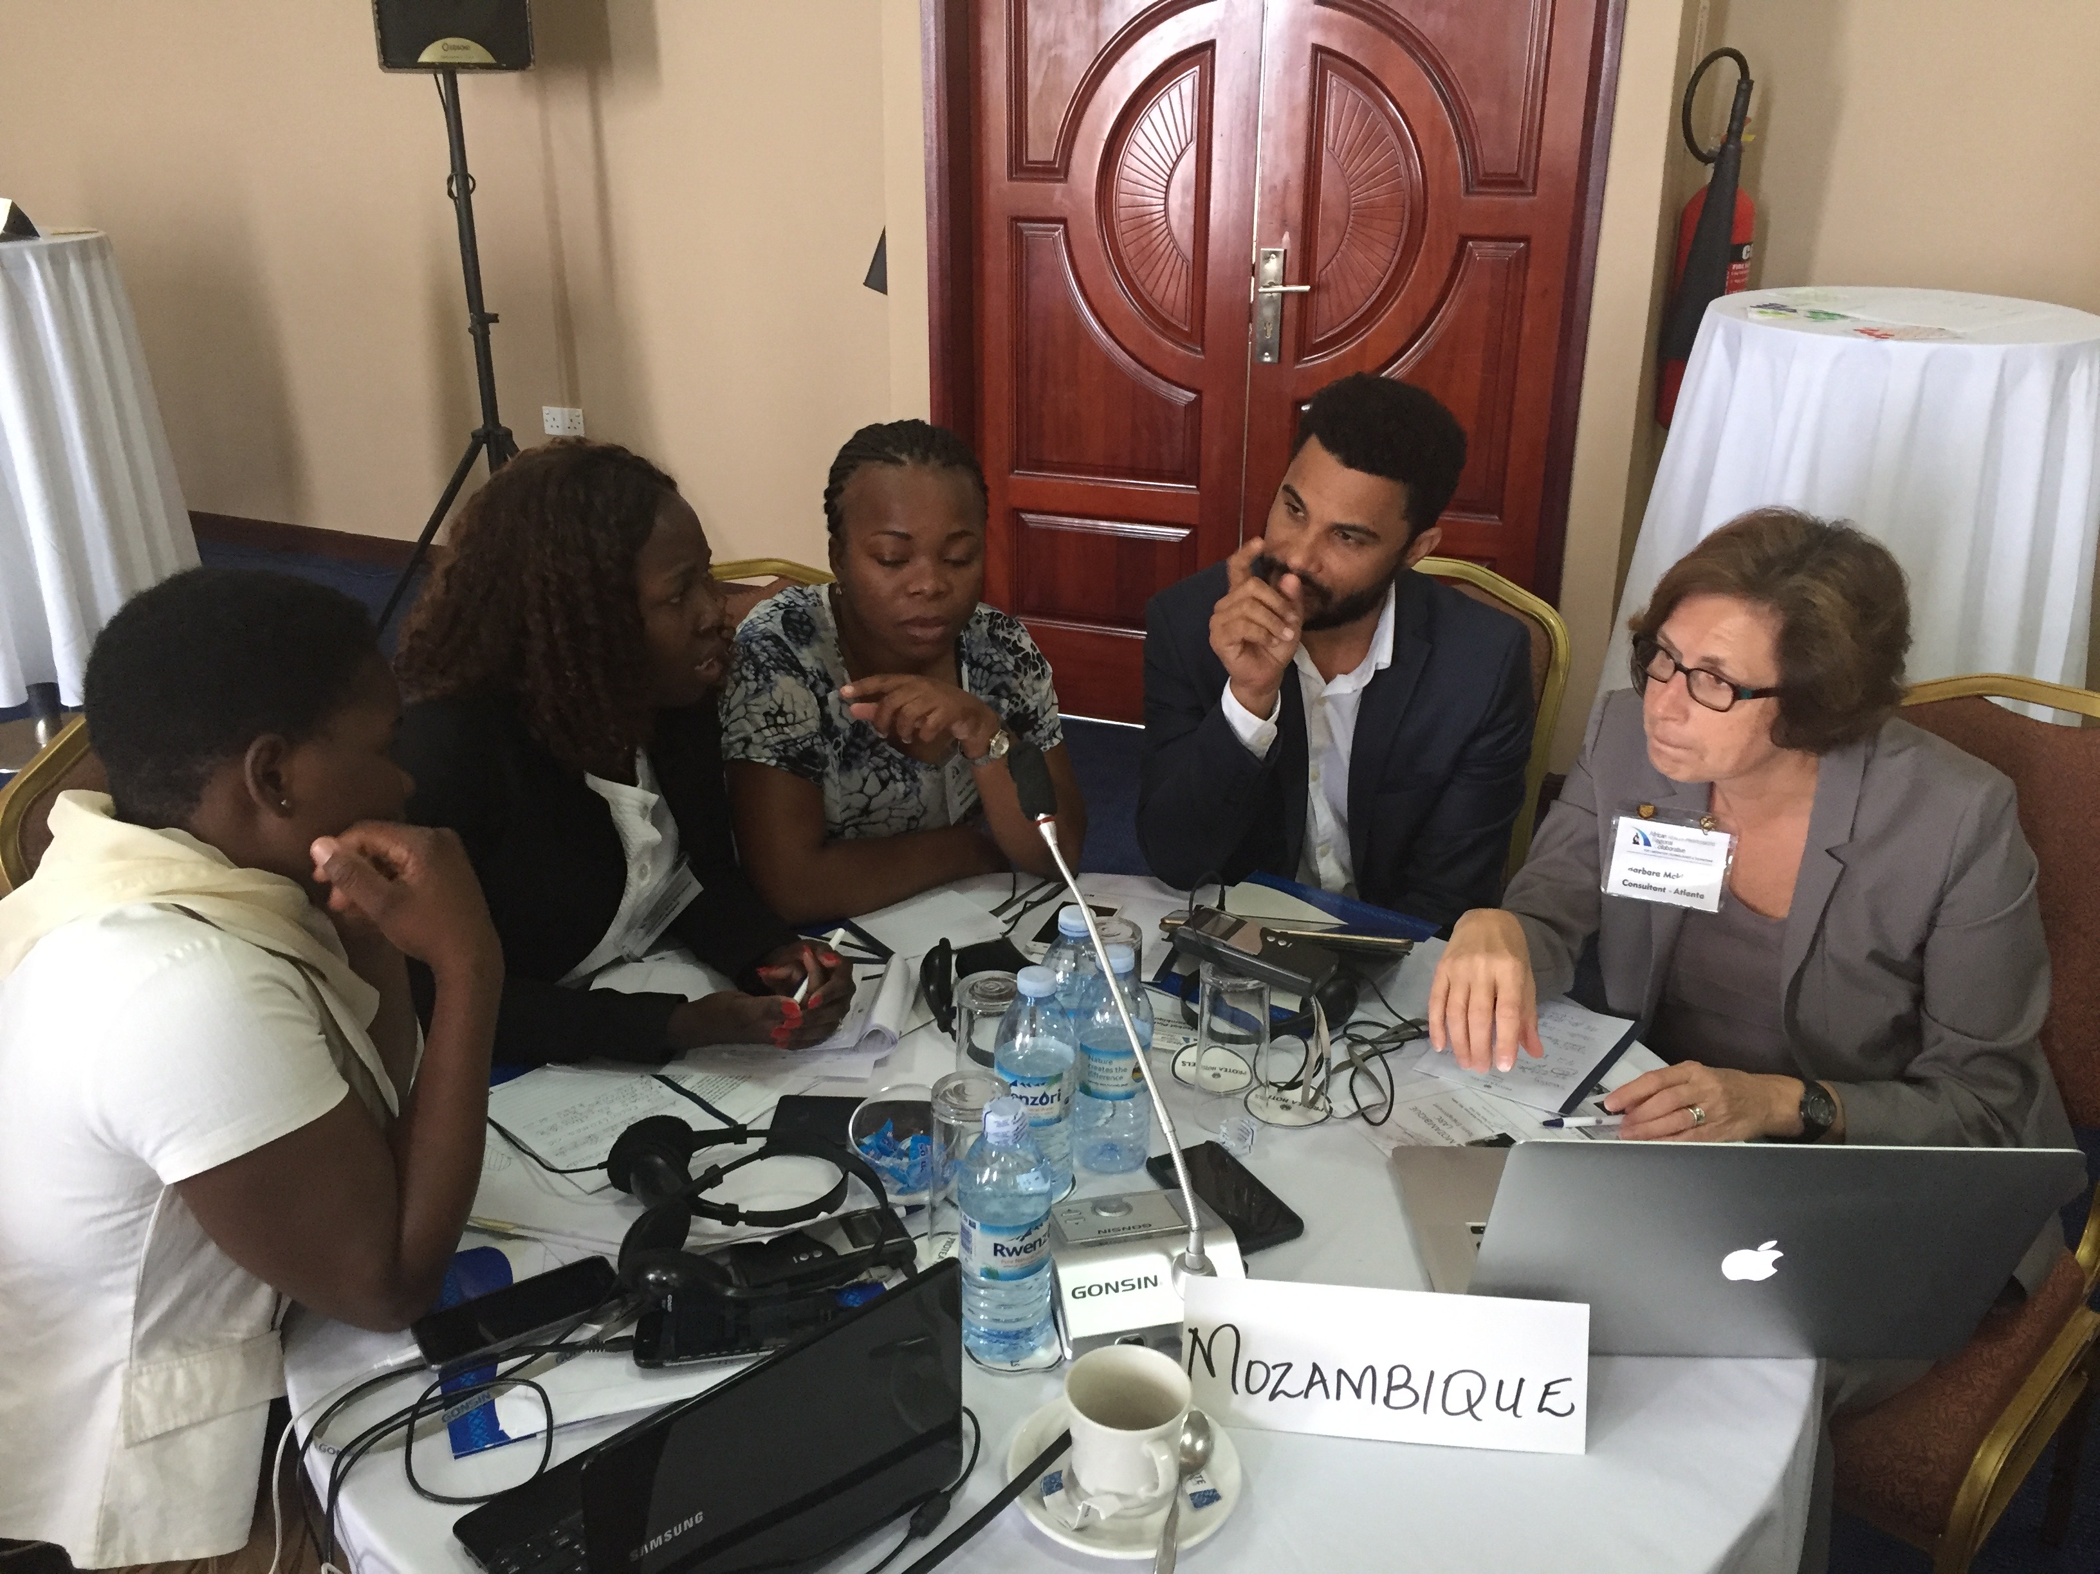
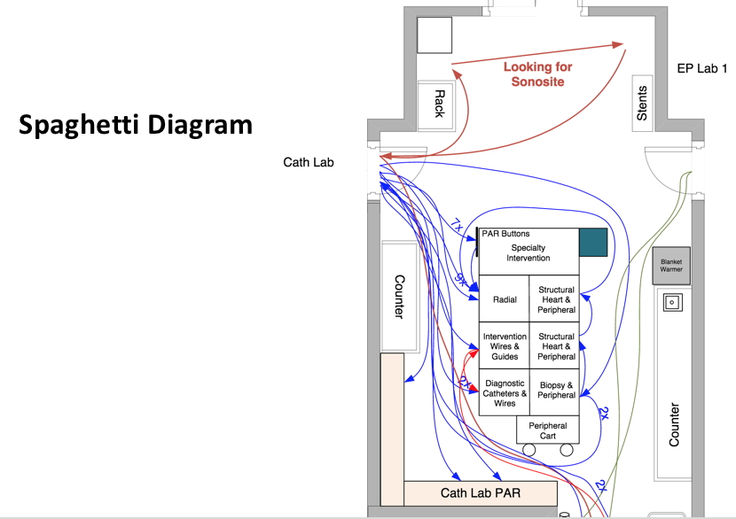
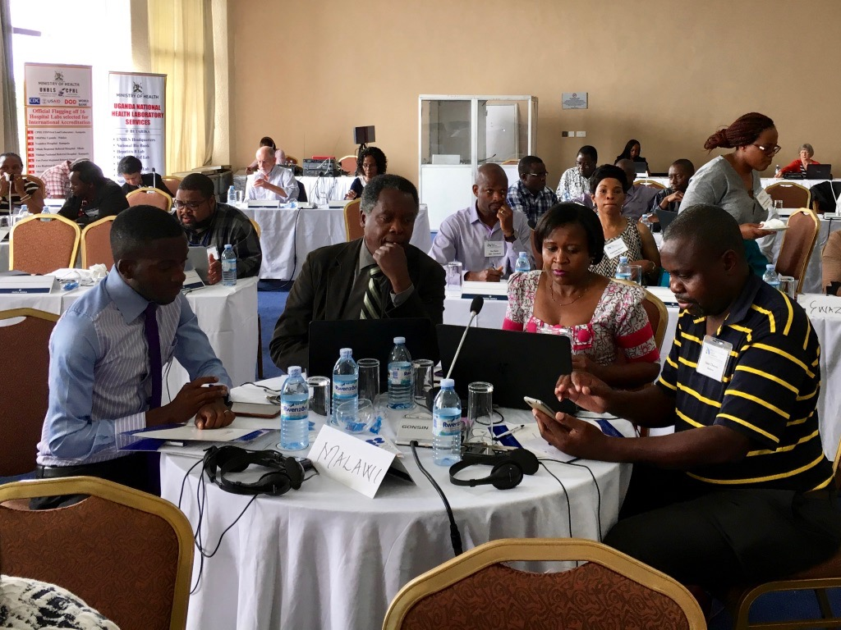
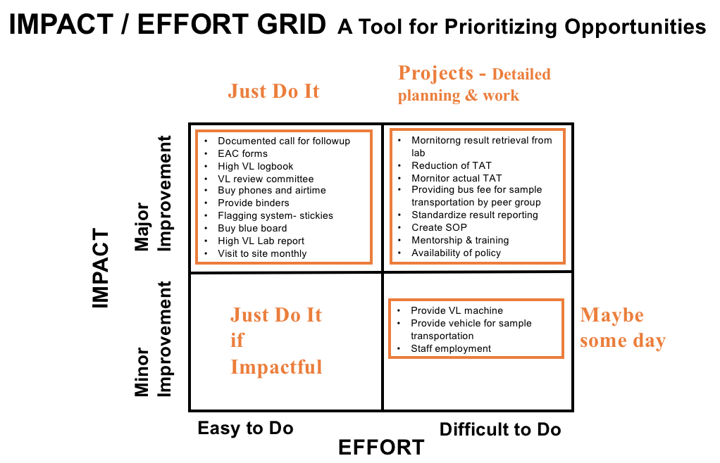
CONTENT: QI Concepts, Tools & Skills (PowerPoint) Presented in Learning Sessions
All NEW PowerPoint Content

Slide 21
30+ Quality Improvement Tools
TOOL-BASED
WORKBOOK
Notes:
The curriculum is based on over 30 proven QI tools (Details not important – just to see the number of tools)
LARC 2.0 - New Tools Added – Change Management, Voice of the Customer, Etc.
Enhanced practical training on the use of each tool

Slide 22
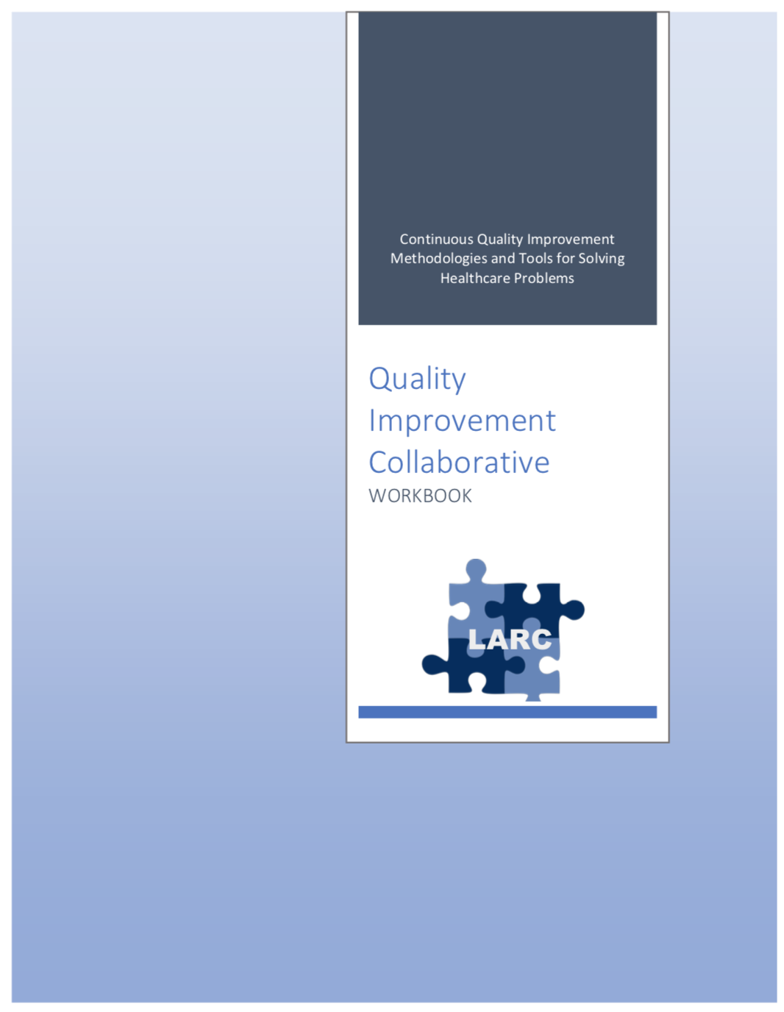
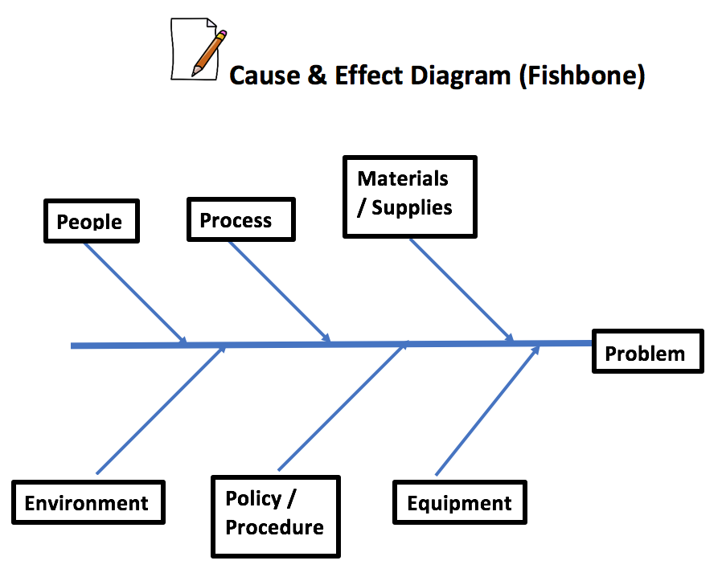
WORKBOOK
QI TOOL RESOURCE
30+ Tools in 80+ pages
Notes:
Leave behind resource with all the tools & templates

Slide 23
Delivery Model
Timeframe
Pre-training Preparation – New Webinar
New On-Site Session
Accountability/Follow-Up
Notes:
Let’s look at the following 4 aspects of the way that the LARC curriculum will be delivered

Slide 24
Planning & Preparation for LARC Sessions: Timeline / Checklist
Planning Checklist
Step-by-Step Planning for Sessions
Notes:
Focus on planning & preparation before the first in-country session – a key to the success of the project; Implications significant for in-country leadership

Slide 25
Quality Improvement Collaborative Overview: Program Delivery
Introduction: Webinar
Session I: Define Measure Analyze
Session II: Simulation Improve
Smart Start: On-Site Session
Session III: Control Share/Report
Final Report
Total
= 6-9
Months
2 Months
1 Week
2-3 months
2-3 months
1 Month
Preparation
Project Outline
Action Period
Action Period
Report Completion

Slide 26
Quality Improvement Collaborative Overview: Program Delivery
Introduction Webinar
Launch
Session I
Session II
Session III
Final Report
Smart Start
(on site)
Total Implementation Period = 6 Months
2 Months
2 months
2 months
1 Month
Project Outline
Action Period
Action Period
Action Period
Report
Completion
Preparation
Notes:
Still the collaborative model – learning sessions and action periods, but Shortened

Slide 27
Introductory Webinar
Conducted 2 months prior to the first Smart Start Session to:
Sensitize & engage stakeholders
Orient teams
Complete planning and preparation to ensure readiness before launch
Target Audience:
In country leadership
Faculty/coaches
Team leaders
Notes:
2 New sessions:
The introductory webinar is for the in-country leadership, faculty, site mentors, coaches & team leaders.
Key purposes:
Sensitization
Identifying & engaging stakeholders
Selecting & engaging team
Assuring planning & preparation complete prior to the first Smart Start Session – Essential to the success of this new model

Slide 28
Quality Improvement Collaborative Overview: Program Delivery
Introduction Webinar
Launch
Session I
Session II
Session III
Final Report
Smart Start
(on site)
Total Implementation Period = 6 Months
2 Months
2 months
2 months
1 Month
Project Outline
Action Period
Action Period
Action Period
Report
Completion
Preparation
Notes:
Still the collaborative model – learning sessions and action periods, but Shortened

Slide 29
Smart Start: 2-Day On-Site Session
Expected Outcomes:
Understanding of the current state via process mapping
Opportunities for Improvement (OFI) identified
Select project / Write problem statement
Project Outline:
Aim statement
Measures and data collection plan/tools
Intervention (the change to be implemented)
Action and communication plans
Purpose:
To set the site up for successful project implementation
To standardize mentorship practice by different coaches across all project sites
Notes:
The Smart Start Session – NEW Session
Purpose:
To clearly understand the problem through process mapping
To provide direction to start the improvement work – quicker, faster, smarter
A critical new session to get the project off to a productive start – On-site coaching of the team in process mapping and project implementation

Slide 30
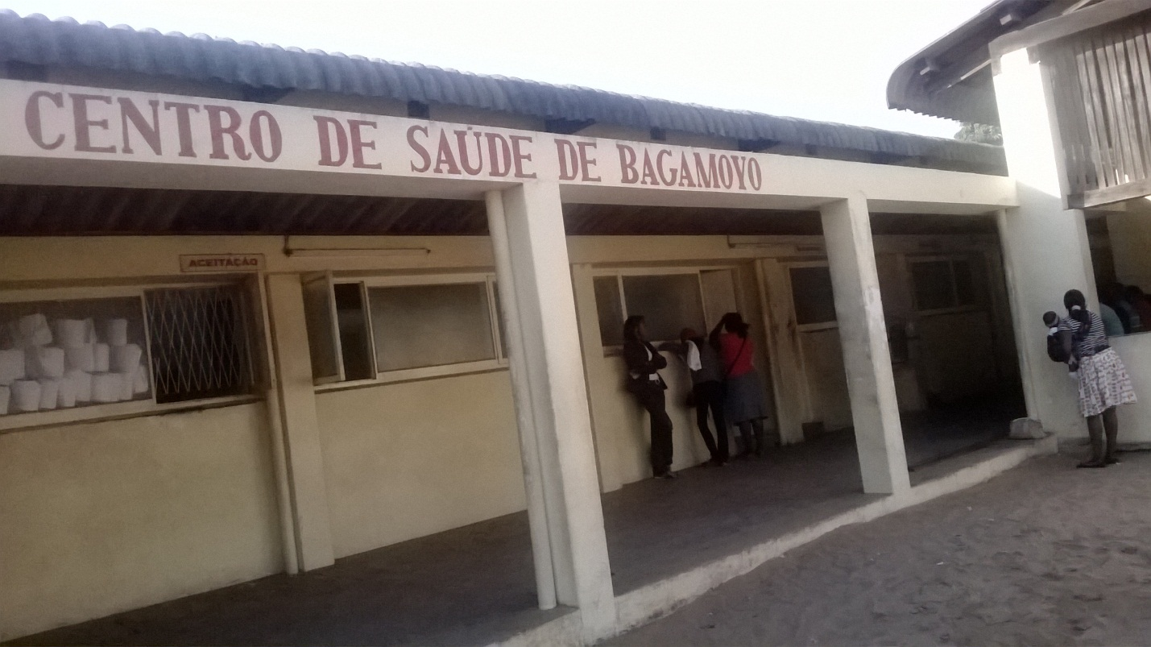
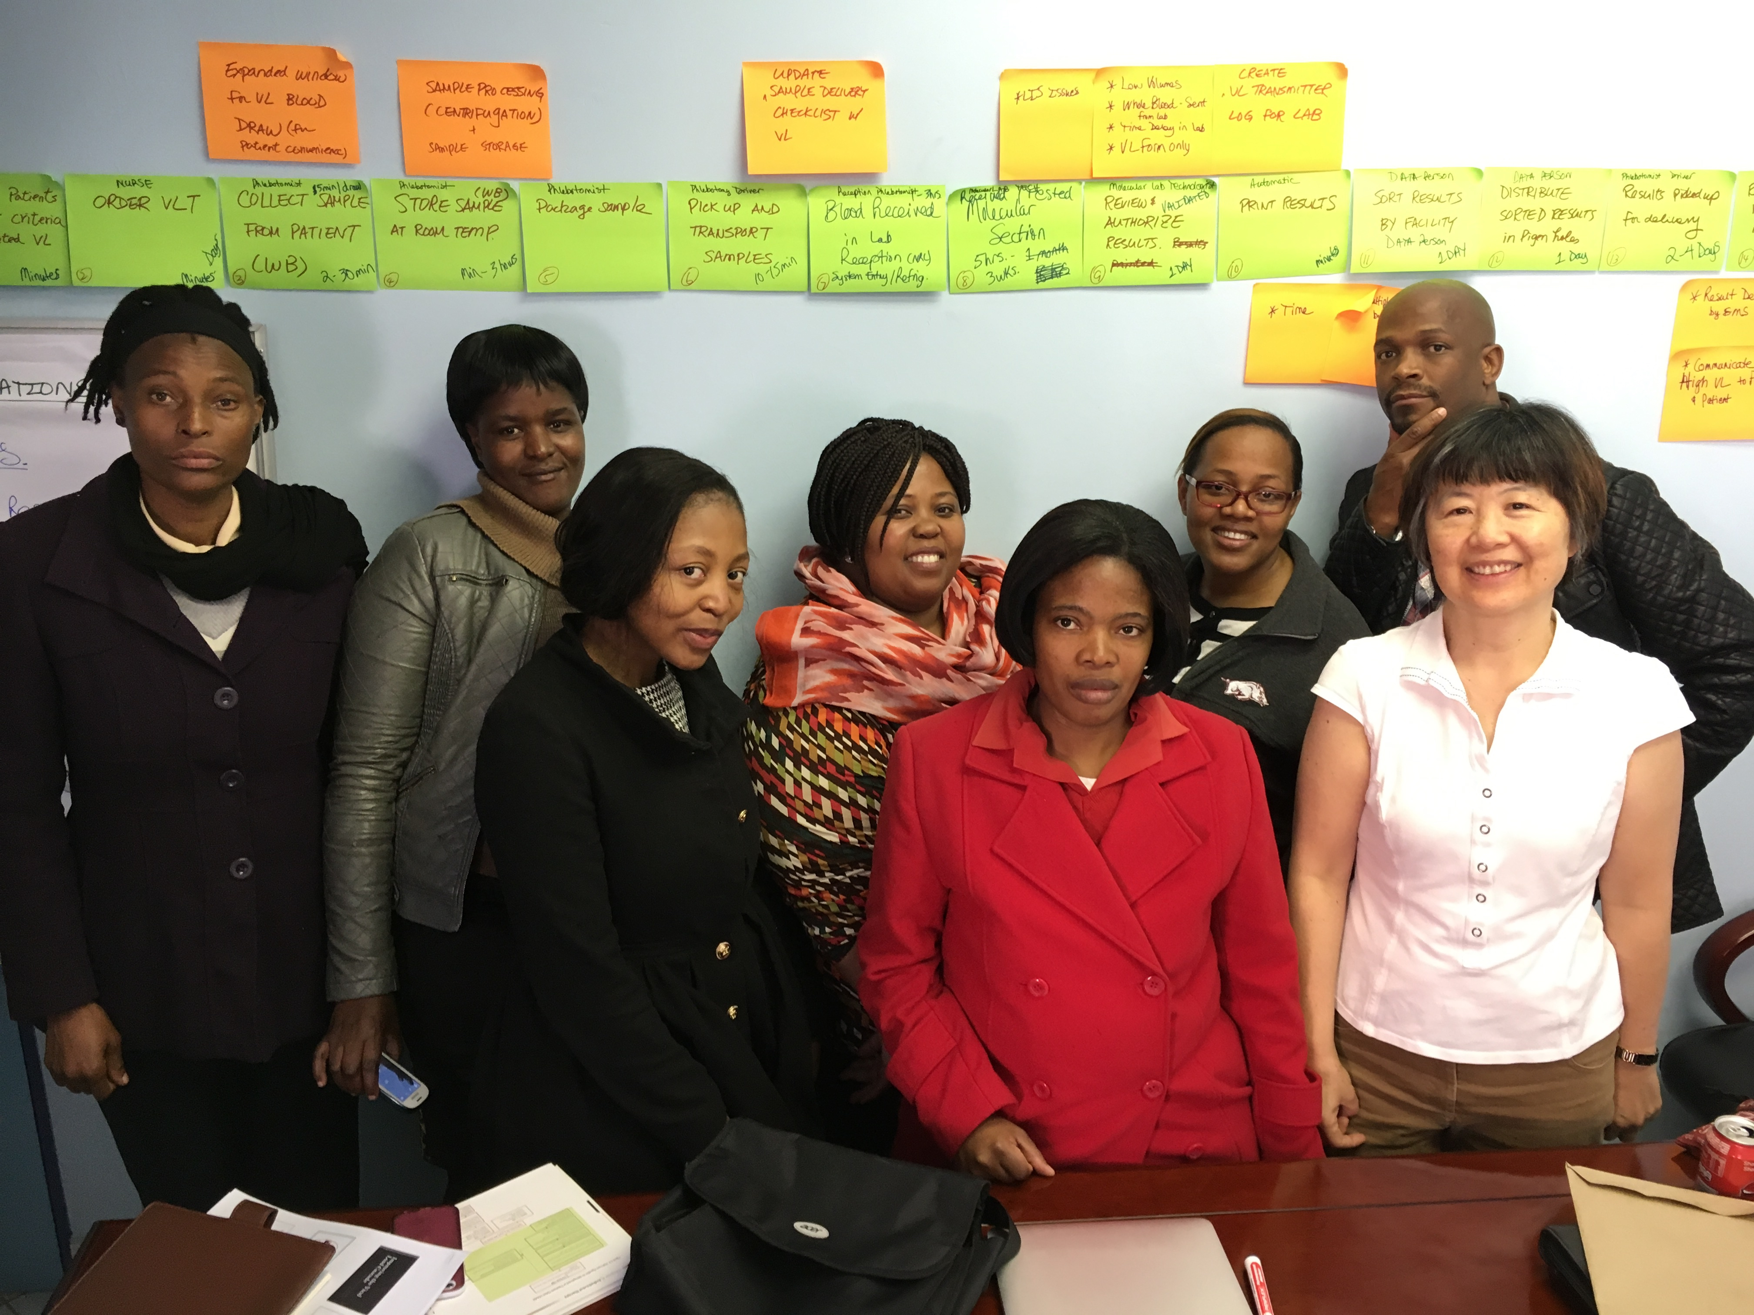
Smart Start: Tested in 4 LARC 1.0 Countries
Day #1 | Day #2
Orientation Process Mapping Current State (Conference Room) | Identify / Prioritize Opportunities For Improvement (OFI) Problem Statement
Process Mapping @ Site - Go and See | Project Implementation – Outline & Action Plan Project Communication
Notes:
Conducted in several of the countries for LARC 1.0

Slide 31
SESSION | Introductory Webinar | Smart Start: 2-Day On-Site | Learning Session #1 | Learning Session #2 | Learning Session #3
CONTENT | Quality Improvement Primer - Guiding Principles DMAIC Model for Improvement Data/ Measurement Overview Stakeholder Analysis Team Formation Planning for Smart Start / Process Mapping | DEFINE / MEASURE Process Mapping Brainstorming / Affinity Diagram Prioritize Opportunities for Improvement (OFIs) Impact/Effort Grid Project Outline Problem Statement Scope Aim Statement / Metric Elevator Speech Action Plan Communication Plan | Quality Improvement Review Smart Start Outputs PDCA Overview Project Mgmt. Change Mgmt. Voice of Customer Critical to Quality Data/Measurement ANALYZE 5 Whys, Cause & Effect Diagram, Pareto Diagram, Spaghetti Diagram, Run Charts/Control Charts | IMPROVE Simulation Before/After PDCA / Small Test of Change Lean 5S Visual Management Physical Layout Standardized Work Future State Process Map Data Display | CONTROL Process Owner Transfer Control Plan Result Communication Final Report Storyboard Presentation Spread Best Practices Celebrate Success Additional Tools Chart Review Avoiding Pitfalls

Slide 32
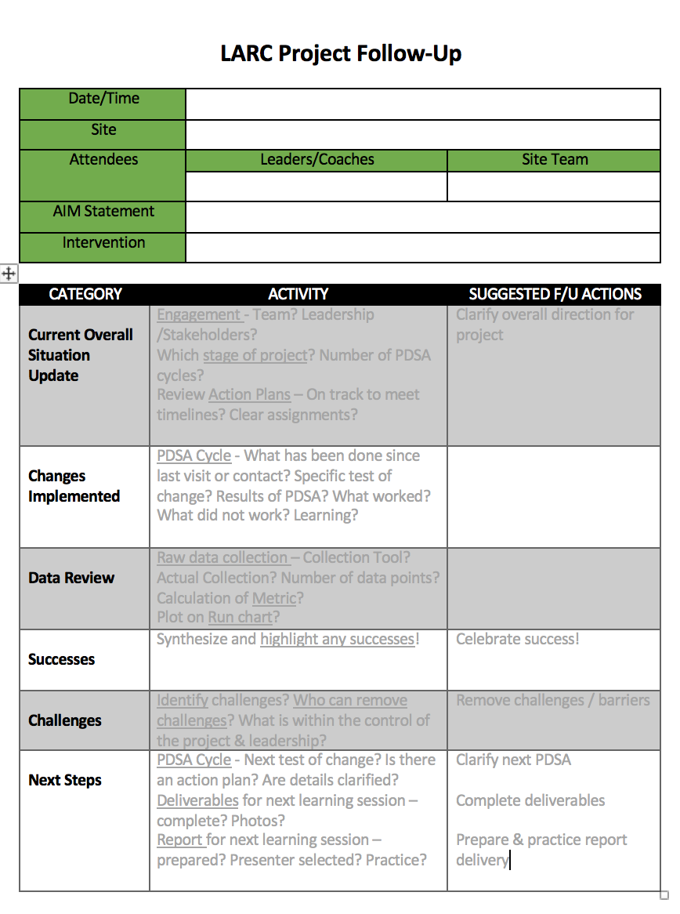
After each training session: Accountability and Follow-Up
Focus on Project Follow-up
Site Visits
Phone Calls
Mentoring
Coaching
Notes:
Assuring that there is ACTION in the Action Periods

Slide 33
Plan for Spread from the Very Beginning
IHI Open School Course
Learn the Improvement Methodologies
Start Small – Small tests of change
Select changes that result in improvement
Implement changes that result in improvement
Plan for Implementation at Scale
Notes:
Just a reminder for the countries – start small and plan for spread from the beginning
Encourage the country LARC leaders to take the IHI course early – while ”piloting” LARC 2.0 so they will be ready for spread when the “pilot” is complete

Slide 34
STOP & SUMMARIZE

Slide 35
Quality Improvement
Change/Model for Improvement
DMAIC
Guiding Principles

Slide 36
Quality Improvement is all about CHANGE!
Old Process
Tests of CHANGE
Sustain the New CHANGE
Implement the New CHANGE
Notes:
The skeleton of the Quality Improvement process…

Slide 37
How do we create change?
3 Questions + PDCA = The Model for Improvement

Slide 38
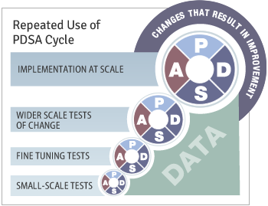
Quality Improvement Overview
Old Process
Tests of CHANGE
Implement the New CHANGE
Sustain the New CHANGE
Define
Measure
Analyze
Improve
Control

Slide 39
Guiding Principles for Quality Improvement
Focus on the needs of the USERS
Focus on PROCESSES to increase the productivity of work
Use DATA to improve services
Use TEAMS to improve quality
Improve COMMUNICATION

Slide 40
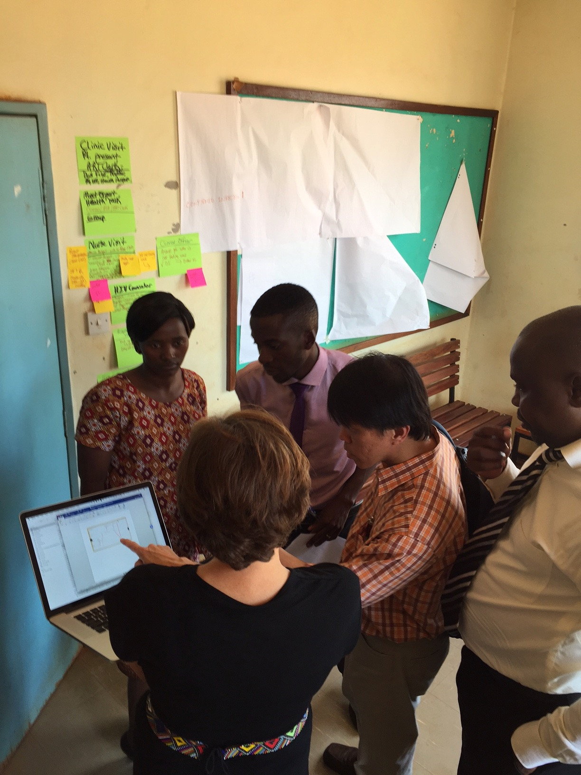
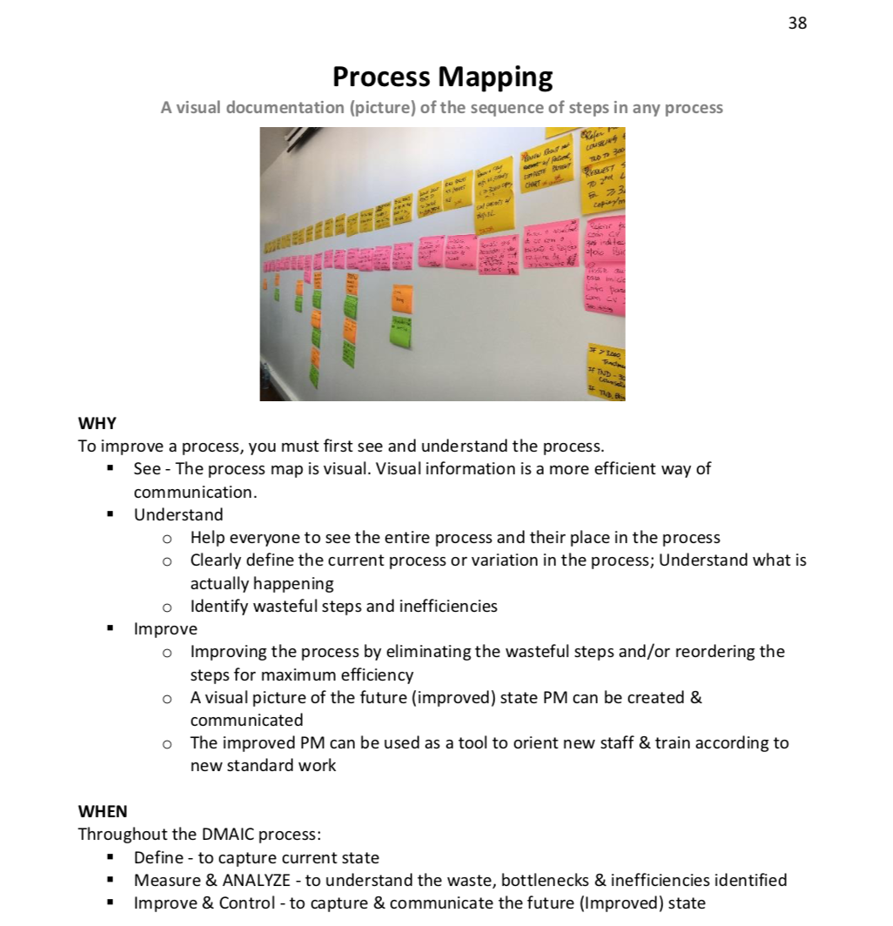
Process Mapping
RESOURCE: WORKBOOK

Slide 41
“What gets measured, gets fixed.”
DATA

Slide 42
TEAMS

Slide 43
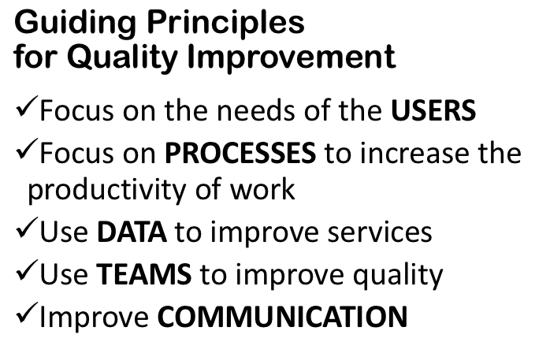
STOP & SUMMARIZE
CHANGE
LEARNING

Slide 44
Preparation for Smart Start: The 2-Day On-Site Session
Stakeholder Analysis
Team Formation
Timeline / Checklist

Slide 45
Stakeholder Analysis

Slide 46
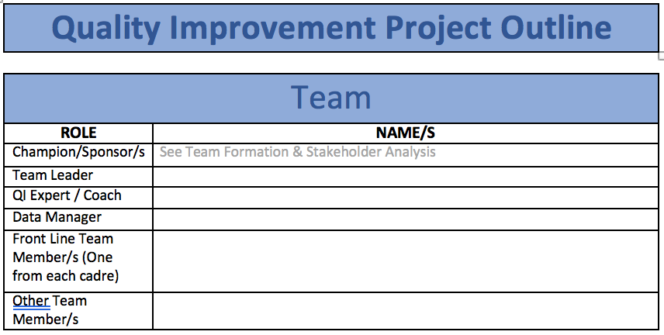
Team Formation

Slide 47
Planning & Preparation Timeline: Month by Month*
Planning
Month #1
> 3 months
WEBINAR
Month #2
2 months
Preparation
Month #3
1 month
* Before Smart Start on _____________
Notes:
The planning & preparation are essential to a successful LARC implementation. This is new to LARC 2.0 and will require a significant amount of focus, commitment, time and resources – not to be taken lightly!

Slide 48
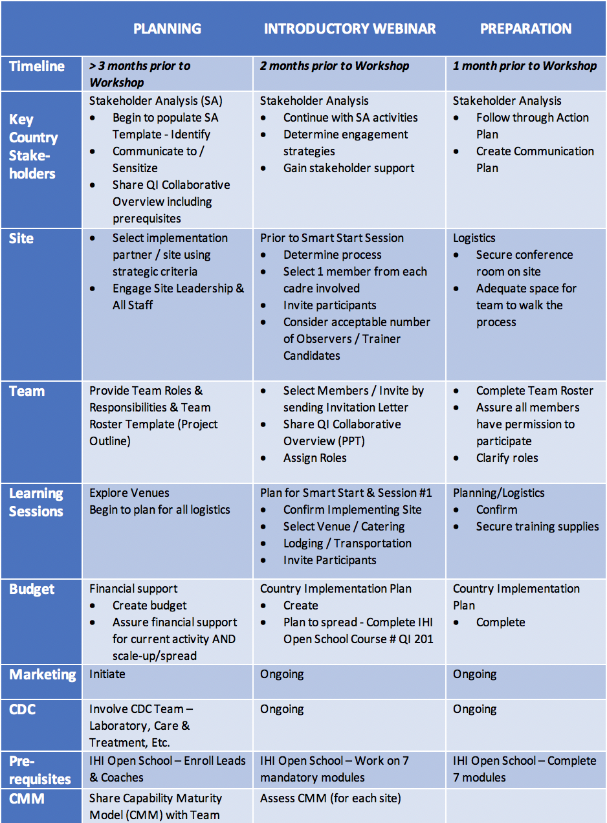
Planning for Smart Start/ On-Site Session: Use the Timeline / Checklist
Planning Checklist
Step-by-Step Planning for 2-day Session

Slide 49
STOP & SUMMARIZE
CHECKLIST
STAKEHOLDER ANALYSIS
TEAM FORMATION

Slide 50
Quality Improvement Collaborative
Thank You
LARC
LARC

Slide 51
Questions
Thank You
??????????????????

