Slide 1
Site (e.g., LARC Embakasi)
[Identify which Viral Load Cascade component your project addresses
(e.g. Demand Creation)]
Speaker Name, Title,
Organization
Date

Slide 2
Country Team
List the members of the team & team member roles
  Include photo of LARC team

Slide 3
Facility Selected/Information / Background
Photo here if possible
Brief description of the facility - # of patients on ART, etc.

Slide 4
Stakeholder Analysis
Display which one of the two tools used

Slide 5
The Story of Our Project

Slide 6
Project Summary
What are we trying to accomplish? | How will we know if a change is an improvement? | What change will we make that will result in an improvement?
Overarching Goal | AIM Statement Improve (increase, decrease) _______ (metric) from _____ to ____ by ________ (date). Metric: (specify numerator and denominator) | Intervention (Describe the key elements of your new process/intervention)

Slide 7
Elevator Speech
This project is about _________________________________________
As a result of these efforts, (What will your project actually accomplish)
It’s important because we are concerned about:
___(Big Picture Here)_________________
____________________
Success will be measured by showing improvement in:
____________________
____________________
What we need from you –
___(Describe to whom you are presenting the “ask”) What do you need from this person? Or organization?___________________________

Slide 8
Process Mapping
The First Step Towards Improvement
(Show your process map. Use any format that you have learned - chart, swim lanes, photo of sticky notes on paper. Highlight the area/s for improvement)

Slide 9
Process Mapping
The First Step Towards Improvement
(Show your process table. Provide sufficient detail of the entire process. Highlight the area/s for improvement.)
Process Step | What Happens? | Who is responsible? | Duration | Forms/logs | Opportunity for Improvement

Slide 10
Define
Measure
Analyze
Improve
Control
Gap (Problem Statement):
  Why did you start? Provide a short, clear statement of the problem (use 15 words or less if possible)
Notes:
10
10

Slide 11
Define
Measure
Analyze
Improve
Control
Voice of Customer (VOC)
  Who is your customer? (patients, health care workers) Did you select the right customer for your identified problem?
  Tool used to collect the VOC (survey, focus group)
  Collection Process (# surveyed, method surveyed)
  Results (Display)
  What did you learn? How did you apply what you learned in your intervention?
Notes:
11
11

Slide 12
Define
Measure
Analyze
Improve
Control
Metric Selected
  Numerator/Denominator
Baseline Data
  Give percentage/number
Notes:
12
12

Slide 13
Define
Measure
Analyze
Improve
Control
Data Collection Process
  Data Collection Tool
    List or insert picture (if available) of any data collection tool that was used for your project
  Data Collection Plan
    How many data points for baseline?
    Timeframe of data collection. How frequently did you collect your data? – baseline & project data?
  Data Analysis
    How did you interpret your data?
    What did you learn about the magnitude of the problem?
Notes:
13
13

Slide 14
Define
Measure
Analyze
Improve
Control
Materials / Supplies
People
Process
Problem
Environment
Policy /
Procedure
Equipment
Root cause - insert picture/diagram of your fishbone diagram or other tool used.
Circle your root cause
Notes:
14
14

Slide 15
Define
Measure
Analyze
Improve
Control
IMPACT / EFFORT GRID A Tool for Prioritizing Opportunities
Projects - Detailed planning and work
Major
Improvement
Just Do It
IMPACT
Just Do It if Impactful
Maybe some day
Minor
Improvement
Easy to Do
Difficult to Do
EFFORT

Slide 16
Define
Measure
Analyze
Improve
Control
Just Do Its
  Include lists and/or photos of Just Do Its completed
Notes:
16
16

Slide 17
Define
Measure
Analyze
Improve
Control
5S - BEFORE
5S - AFTER
Insert Photo
Insert Photo
Notes:
17
17

Slide 18
Define
Measure
Analyze
Improve
Control
5S - BEFORE
5S - AFTER
Insert Audit Score
Insert Audit Score
Notes:
18
18

Slide 19
Define
Measure
Analyze
Improve
Control
Visual Management
  Photos of Visual Management Changes
Notes:
19
19

Slide 20
Define
Measure
Analyze
Improve
Control
Small Test of Change (PDSA #1)
ACT
PLAN
DO
STUDY
PDSA – Describe in Detail your PDSA. Did you Adopt, Adapt or Abandon?
Notes:
20
20

Slide 21
Define
Measure
Analyze
Improve
Control
Small Test of Change (PDSA #2)
ACT
PLAN
DO
STUDY
PDSA – Describe in Detail your PDSA. Did you Adopt, Adapt or Abandon?
Notes:
21
21

Slide 22
Define
Measure
Analyze
Improve
Control
Intervention – ‘After State’ Process Map
  What did you do to solve your problem?
  Give an overview of your intervention
  Show New Process [May use boxes, draw, or use sticky notes (must be able to read)]
Notes:
22
22

Slide 23
Define
Measure
Analyze
Improve
Control
Intervention – ‘Before’ State Process Map
  Compare the problem area in the ’Before State’ process map to the updated ‘After State’ process map
Notes:
23
23

Slide 24
Define
Measure
Analyze
Improve
Control
Data Display
  Show your run chart
  Annotate your run chart, showing the different PDSAs / Tests of Change
Notes:
24
24

Slide 25
Challenges
Share challenges; What did the team do to address the challenges?
Challenges
Address challenges

Slide 26
Lessons Learned
What did the team learn? Reflect on what you will do differently in the future.

Slide 27
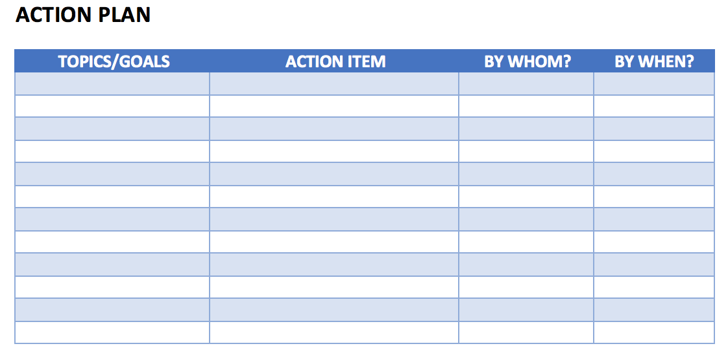
Action Plan
Action Plan – Share your action plan, if you have
any additional actions to complete

Slide 28
Learning Session #3 Presentation
Focus of Your Presentation – New Deliverables
  Make It a Story; Connect every tool to your project
  Summary (Slide #6) – Sum up your intervention as a process change – add sub-bullets to give the highlights of your new process
  5S (Slide # 17 & 18)
  Visual Management (Slide # 19)
  2 Tests of Change (PDSA) (Slide #20 & 21)
  Intervention/Change (Slide # 22) – This is the most important deliverable of your project – clearly describe and show in your process map the new process
  Show old process – (Slide # 23) – Show the old process so we can see & compare the improvement in the new process
  Standard Work (Slide # 24) – A nice “package” (= SOP) of your intervention
  Lessons Learned (Slide # 27) – One of the most important slides
  Update Previous Items (See Deliverables – Slide #29)

Slide 29
Session 2 Deliverables
Improve
  Update Project Outline, if necessary
1 5S Exercise
1 Visual Management Application
2 or more Tests of Change (PDSA)
Select and Implement Change
Modify Solution(s) where necessary by additional Test of Change (PDSA)
Data Display
Create Future State Map
Create Standard Work
Presentation

