Slide 1

Site:
Notes:
Please fill in site name

Slide 2

Information / Background
FACILITY | DATA
Level of Facility
# of Patients on ART
# of Patients VL Eligible / Month
# VL Samples Collected / Month
VL Coverage
VL Suppression Rate
Notes:
Insert your facility photo (LEFT) and the facility data points (RIGHT)
Brief description of facility
Level of the facility
# of patients on ART
# patients VL eligible
# VL samples collected / month
VL Coverage
VL Suppression Rate
Accuracy of Data – Match between # of patients, # of samples, % coverage, etc.

Slide 3
Stakeholder Analysis
Notes:
Capture all stakeholders
Includes actions for continued stakeholder engagement
Use one of the SA Tools and paste here.

Slide 4
TEAM
Team Role | Member Name
Notes:
Insert Photo and Complete team table

Slide 5

Project Summary
Problem Statement:
What are we trying to accomplish? | How will we know if a change is an improvement? | What change will we make that will result in an improvement?
AIM STATEMENT | METRIC | INTERVENTION
Notes:
Please add in:
Problem Statement
Aim Statement
Metric – with numerator and denominator
Interventions tested and selected – ONLY after testing and selecting complete, at the end of the project
Overarching Goal, Aim Statement, and Intervention all related to same problem statement
Problem Statement - 15 words or less, Adequately captures the actual problem addressed by the project, No solutions included
Aim Statement - Includes WHAT (Target improvement) BY WHEN (Timeline)
Intervention described / titled clearly and succinctly (can listeners tell what they did??)

Slide 6
DEFINE

Slide 7


Elevator Speech
This project is about:
As a result of these efforts:
It’s important because we are concerned about:
Success will be measured by showing improvement in:
What we need from you:
Notes:
Complete each line of the elevator speech
On the last line, identify to whom you are making the request or ask
Includes the big picture / goal – “This project is about”
Appeals to the stakeholder audience by answering the why & stating the importance – “As a result of these efforts” and It’s important”
Includes metrics
Includes an “ask”

Slide 8
DEFINE: Process Table - Current Process
PROCESS STEP | WHAT HAPPENS | WHO’S RESPONSIBLE | Duration | Forms Needed | Opportunities for Improvement
Client Initiated on ART
VL Sample Collected
VL Results Received
Notes:
Please complete with as much detail as possible. May use more than 1 slide if needed.
Sufficient detail showing understanding of current process
Only a single step, completed by a single person, included in each process step
Process Table AND Process Map (Visual)
Clearly identified OFI (Opportunities for Improvement)
All OFIs included in the Action Plan (whether related to the main aim or a “Just Do It”)

Slide 9
Client Initiated on ART
VL Result Received from LAB
Notes:
Build a process table, using the boxes, arrows & symbols provided. A red dot = an opportunity, A yellow diamond = a decision point.

Slide 10
DEFINE: Voice of Customer
Notes:
INSTRUCTIONAL:
Data Collection
Who did you ask? What questions did you ask? How many clients? How did you select the clients?
How was the data collected, i.e., method?
Data
Show data collected
Data Analysis & Action
How did you analyse & interpret what you learned?
What did you do with this information?
Data collection / method / Questions asked related to problem statement
Correct customer identified
Summarize results clearly

Slide 11
MEASURE

Slide 12
MEASURE: Baseline Data – Run Chart
Notes:
Insert Run Chart with Baseline data, include the data box
INSTRUCTIONAL ONLY
Show multiple months of data collection
Average all baseline data points to determine one Baseline data number
Always include the numbers in a data table – numerator & denominator
Data Source Identified
Sample Size identified
At least 6 points
Raw data (numbers) included – Data Box
Percentage calculated correctly
Plotted on a Run Chart
Integrated into Aim Statement

Slide 13
ANALYZE

Slide 14
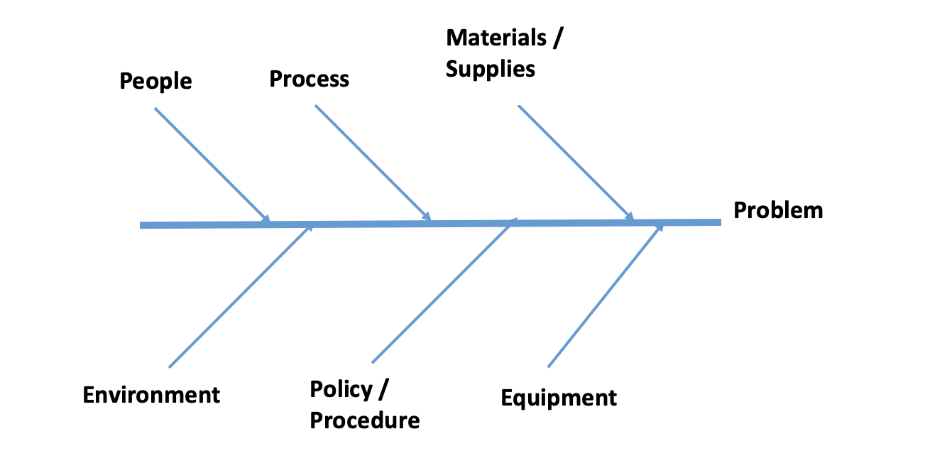
ANALYZE: RCA
Aim #
1.
2.
3.
1.
2.
3.
1.
2.
3.
1.
2.
3.
1.
2.
3.
1.
2.
3.
Notes:
What is/are the root cause/s identified? Circle / highlight the ones that you feel are root causes – that you will address in your project because you feel that they will be significant in solving the problem.
Problem Statement at head of the Fish (if using the Fishbone)
Complete list for each “bone” of the fish
Includes all data gathered from Process Map & VOC
Clearly identifies cause/s of the identified problem
Utilizes at least one or more QI tools (Fishbone, 5 Whys, etc.)

Slide 15
ANALYZE: 5 Whys
Aim #
Why?
Why?
Why?
Why?
Why?
Notes:
You may want to take the one or more of the root causes and submit them to the 5 Whys tool – taking you further to discover the true root cause.

Slide 16
IMPROVE

Slide 17
IMPROVE: 5S
5S – BEFORE
5S – AFTER
Notes:
Photos - Before & After, Included
5S Audit completed – Before & After

Slide 18
Improve: 5S Audit
BEFORE
AFTER
Notes:
Photos - Before & After, Included
5S Audit completed – Before & After

Slide 19
I/E Grid
Just Do It
___________
____________
__________
Do 3rd – Detailed Planning (Projects)
___________
____________
__________
Just Do It 2nd if Impactful
___________
____________
__________
Maybe Someday
___________
____________
__________
Major Improvement
IMPACT
Minor Improvement
Easy
EFFORT
Difficult
Notes:
Place all identified OFIs into the I/E Grid; Circle / Highlight the one project on which you will work. Show the JDIs on the next slide.
Are the “Just Do Its” correctly identified?
Is there a clearly defined project?

Slide 20
IMPROVE: Just Do It
Notes:
Instructional: Show photos or evidence of the JDI Actions Taken
Are the “Just Do Its” correctly identified?

Slide 21
Facility Name:
Worksheet for Testing Change
Change Idea A
Aim #
Describe your first (or next) test of change | Person responsible | By When | Where
PLAN
List the tasks needed to set up this test of change | Person responsible | By When | Where
Predict what will happen when the test is carried out | Measures to determine if prediction succeeds
DO
Describe what actually happened when you ran the test:
STUDY
Describe the measured results and how they compared to the predictions:
ACT (select one)
Adopt → Standardize
Adapt → Describe what modifications to the plan will be made for the next cycle
Abandon
Notes:
Instructional: Do not report what actually happened and the measured results were achieved until AFTER you have tested the change AND measured the results
Tests related to causes identified in the Analyze phase (Rationale for selecting each change given)
Each Test of Change clearly identified / described
Remeasurement after each PDSA
Remeasurement displayed on the Run Chart & Annotated
How many tests of change?
Any progress on AIM?
Actions for next test (PDSA) identified after each test?

Slide 22
Facility Name:
Worksheet for Testing Change
Change Idea B
Aim #
Describe your first (or next) test of change | Person responsible | By When | Where
PLAN
List the tasks needed to set up this test of change | Person responsible | By When | Where
Predict what will happen when the test is carried out | Measures to determine if prediction succeeds
DO
Describe what actually happened when you ran the test:
STUDY
Describe the measured results and how they compared to the predictions:
ACT (select one)
Adopt → Standardize
Adapt → Describe what modifications to the plan will be made for the next cycle
Abandon
Notes:
Tests related to causes identified in the Analyze phase (Rationale for selecting each change given)
Each Test of Change clearly identified / described
Remeasurement after each PDSA
Remeasurement displayed on the Run Chart & Annotated
How many tests of change?
Any progress on AIM?
Actions for next test (PDSA) identified after each test?

Slide 23
Improve: Process Map
‘Before’ State Process Map
‘After’ State Process Map
Notes:
23
23
Show 2 process maps – Before & After your improvement - May use boxes, draw, or use sticky notes (must be able to read. Compare the problem area in the ’Before’ State process map to the updated ‘After’ State process map.

Slide 24
IMRPOVE: Run Chart
Notes:
Insert Run Chart with Baseline Data (BEFORE) and Improvement Data (AFTER)
Instructional: Insert Run Chart here
Include numbers in a data table – numerator & denominator
Improvement – Did it occur? Was AIM reached?
Is the evidence of improvement seen in the run chart? Is the run chart annotated to indicate the various tests of change?

Slide 25
Improve: Final Intervention (Change Package)
Notes:
Quality of Intervention – Innovative, sustainable, makes sense, demonstrates connection to entire project (i.e., related to identified causes and addresses problem statement)
Standardized – Presented in a standardized format, a SOP, a job aid, or a video - for reproducibility & spread

Slide 26
CONTROL

Slide 27
Control Plan
ELEMENTS OF A CONTROL PLAN | Process Owner | SOP for New process | Ongoing Plan for Monitoring of metrics | What will you do if metrics do not maintain goals? | Communication of Results
Details | Who will own/monitor the process when the LARC cycle is over? | State/show your new process in enough detail that other sites could implement the new process | How often will you monitor the project measures? Where will the measures be presented? (i.e. Name a specific meeting or management group) | You must know what you will do if your metrics drop below the goal. Give specific details. | Specific plans on who/when you will present your results?
Your Control Plan
Notes:
Transition to Process Owner
Review Criteria for Project Metrics after the project closes – Who, What, When, Where, How often?
Plan for course correction if control is not maintained

Slide 28

Summary

Slide 29
Capability Maturity Model (CMM)
BEFORE
AFTER

Slide 30
Lessons Learned

Slide 31
Appendices

Slide 32
Deliverables
Project Summary Slide: Aim, Metric & Changes
DEFINE
Stakeholder Analysis
MEASURE
Baseline Metric
ANALYZE
Analyze tools (Fishbone, 5 Whys)
IMPROVE
CONTROL
Voice of Customer
5S
Run Chart w/ Improvement Data
Control Plan
Tests of Change – WHAT DID YOU DO
Run Chart
Process Table / Map
Final Intervention - SOP
Final Report
Elevator Speech
Project Outline – Problem & Aim Statement
Team
I/E Grid
Notes:
A summary of all deliverables

Slide 33
Facility Name:
Data Collection Plan
Process Measure
Who
How Often
What
Where
How
Training
Sustainability – See Control Plan
Notes:
Worksheet - Data Collection Plan

Slide 34
Opportunities for Improvement
Process Mapping | Voice of Customer | Root Causes (Fishbone or 5 Whys)
Notes:
Worksheet to Capture ALL OFIs: List all OFIs – from the process mapping activity, from the VOC, from the Root Causes (obtained from the Fishbone or the 5 Whys)

Slide 35



Facility Name:
CHANGES to Test
Process Map – Opportunities for Improvement (OFI)
Root Cause Analysis (RCA)
Voice of Customer (VOC)
1.
2.
3.
1.
2.
3.
1.
2.
3.
Notes:
Worksheet for Selecting Changes: List key findings from each of the inputs noted above, in the orange text boxes. Feel free to add more items if needed. These are the key factors that you identified through each of these tools – the factors that will be used to guide you to the best CHANGES to test.

Slide 36

INSTRUCTIONAL SLIDE ONLY
This is a template for the presentation and final report for a quality improvement project.
Each slide contains specific instructions in the NOTE SECTION, including the actual tool that you will use. The criteria for the correct use of each tool is found on each slide and all together in the QI Project Evaluation Checklist.
This PPT can be used for the life of the project. It can be used for a detailed presentation of the deliverables as they are created throughout the project.
As one tool is complete, that tool can be moved to the appendices and new tools can be presented.
For the final presentation, keep all slides marked with a key icon, showing the outputs of key tools. The team should focus on what they learned from each tool and how those key learnings have been used to inform the next phase. All other slides would be available for review in the appendices.
Of course, if asked to provide a short overview of the project, the project summary slide and the final run chart should tell the project story.
In addition, the appendices include several worksheets that can be used to summarize outputs and plan for next steps.

